Slide 1
MODULE 7
MY DIGITAL WORLD
Youth online safety and well-being

Slide 2
Introduction

Slide 3
We have designed our technologies with young people in mind. We want them to have power and control over their own experiences, including what content they see, share and experience and who can contact them.
INTRODUCTION
Youth online safety and well-being

Slide 4
Preventing harm
Empowering young people and helping support their well-being
INTRODUCTION
Our main goals are
1
2

Slide 5
Responsible empowerment
Age-appropriate safeguards
Innovation
INTRODUCTION
Principles guiding our approach to young people
We strongly believe in the importance of responsibly empowering young people to enjoy the many benefits
our platform provides.
We recognise that youth require additional safeguards for their safety, privacy and well-being. Our approach towards this is expansive, including our investment in parental supervision tools for Instagram and virtual reality (VR).
We continue to explore innovative technologies to provide great experiences for young people,
help keep them safe online and solve the defining challenges for our industry.

Slide 6
LESSON 1
Tools for managing time on Instagram

Slide 7
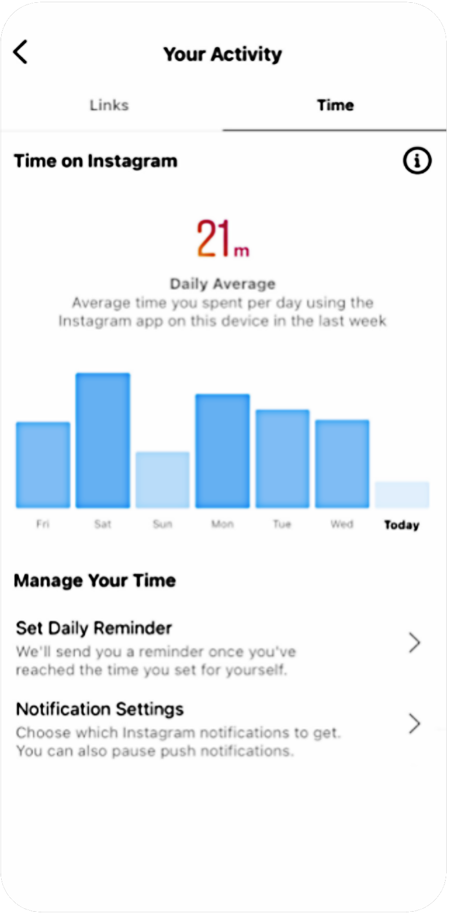
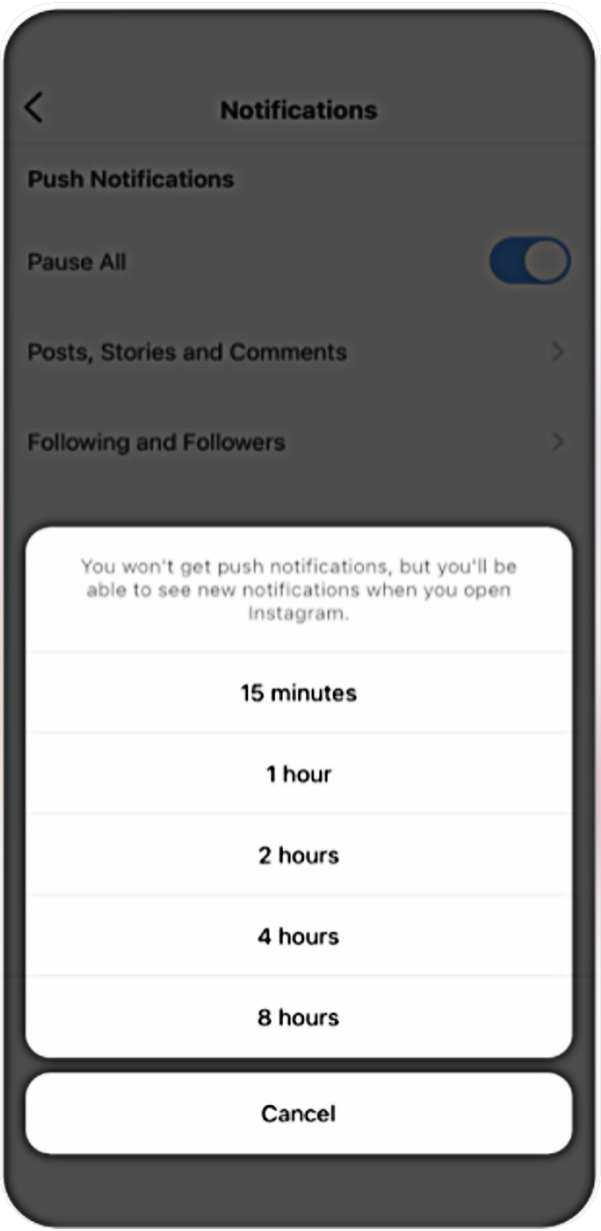
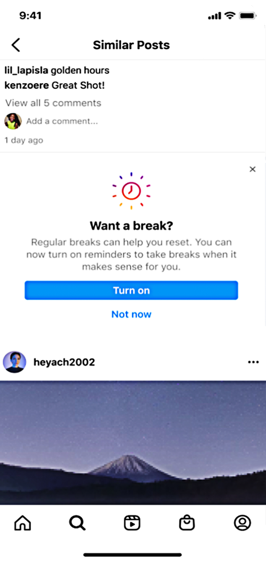
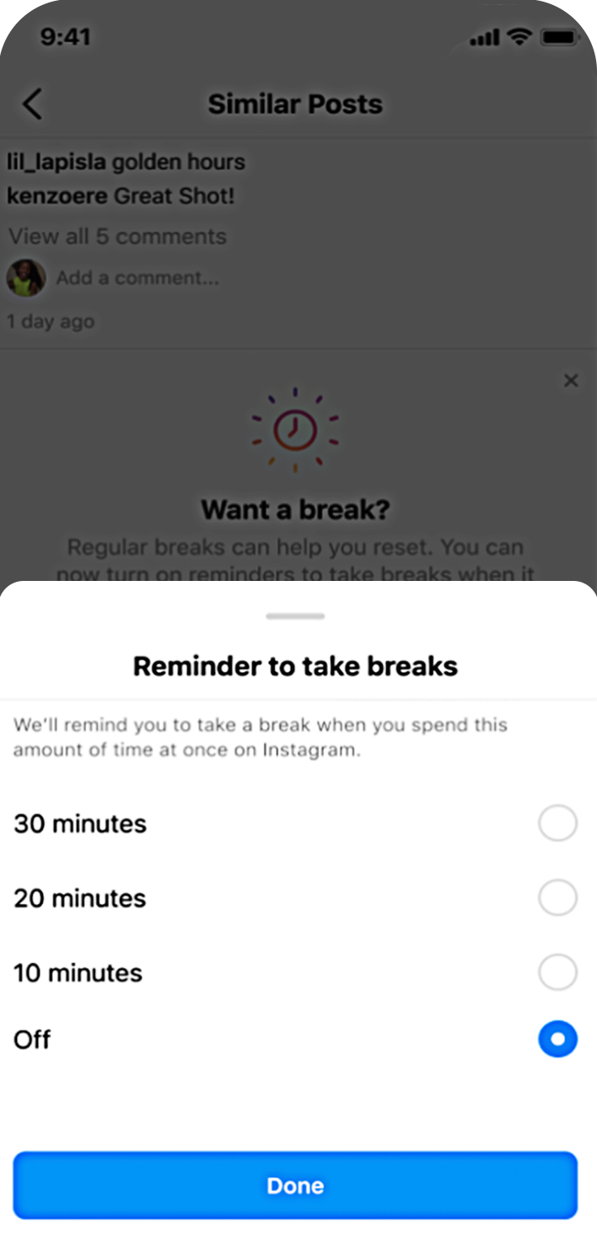
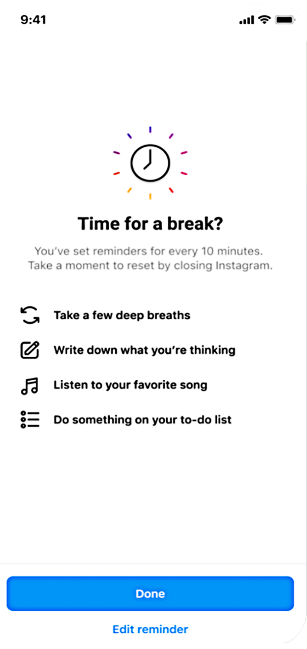
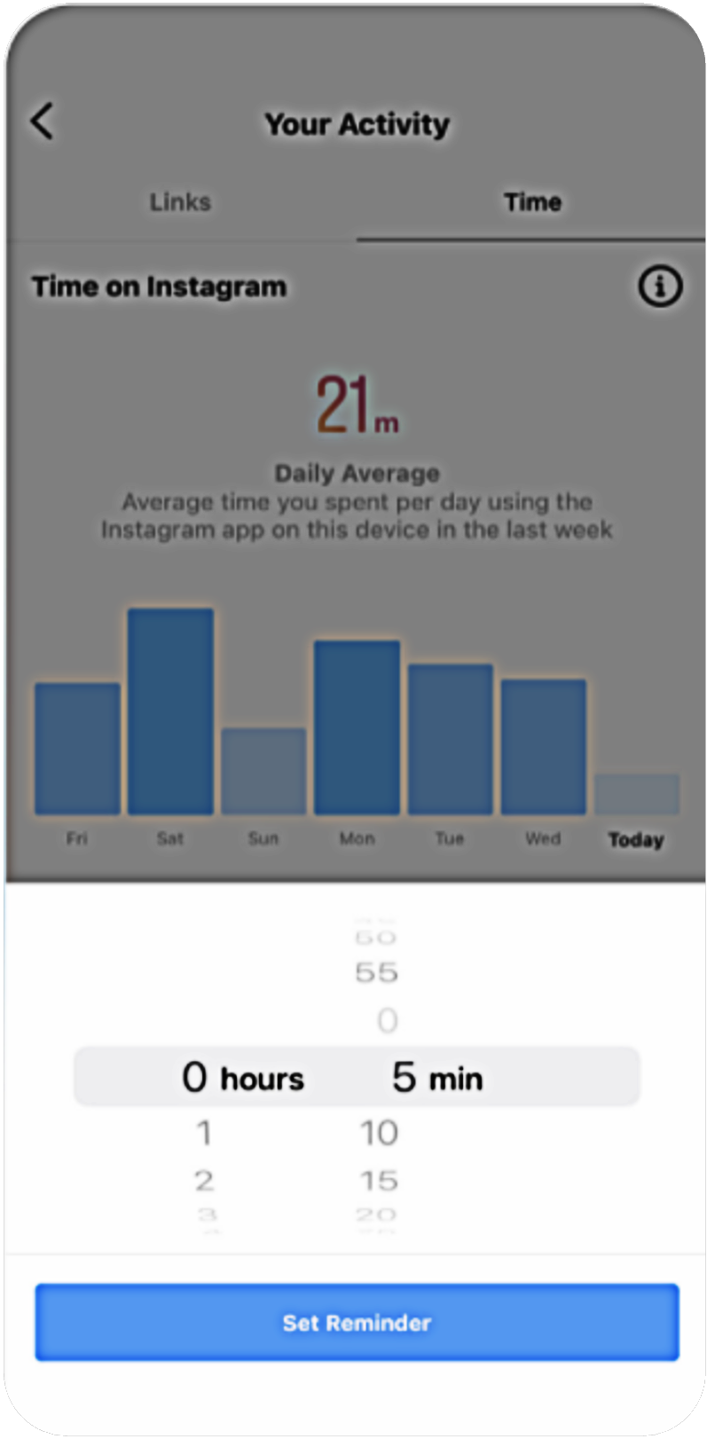
Manage your teen’s time on Instagram and Take a Break
LESSON 1
Tools for managing time on Instagram
See your activity
Set a reminder
Mute push notifications
Take a Break

Slide 8
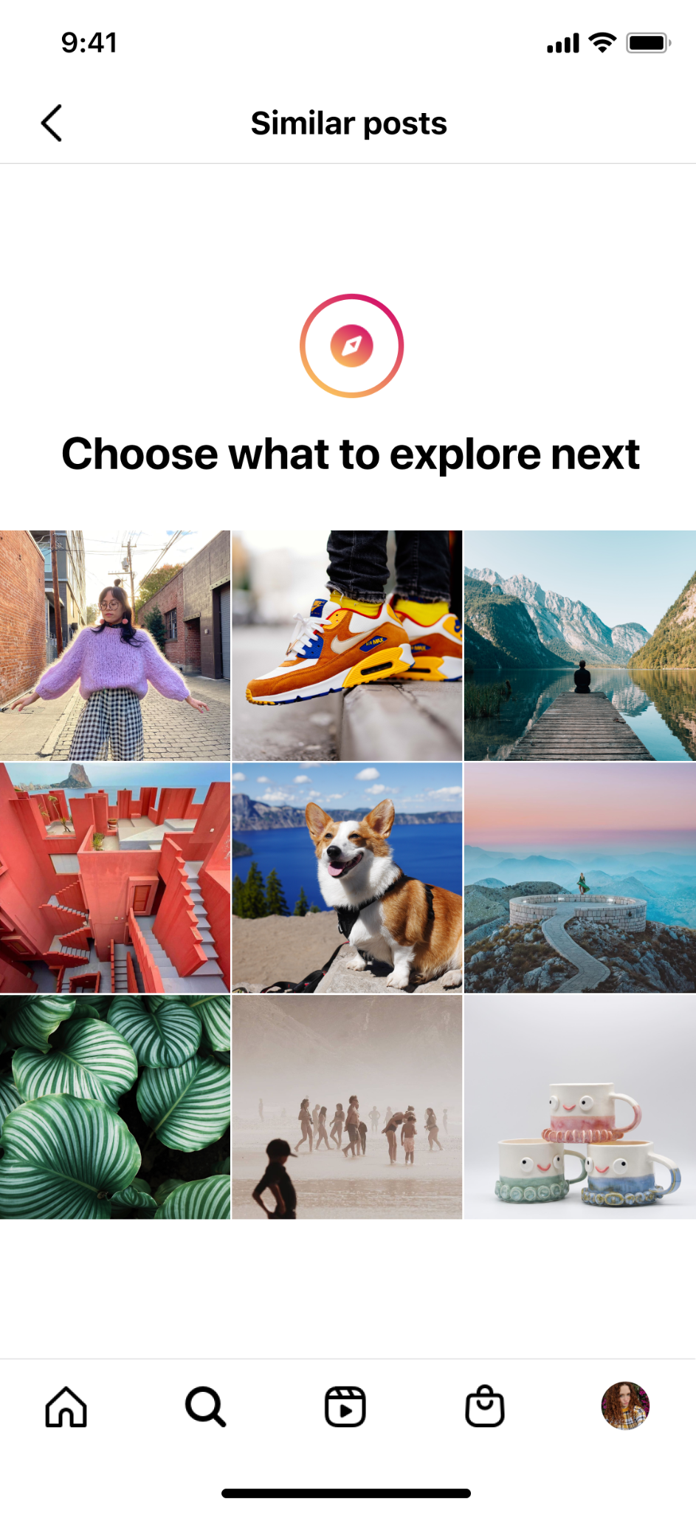
Nudging teens to consider how they’re spending their time
A nudge interrupts teens if they are dwelling on the same type of content for some time. This nudge gives them a way to pivot to something else and will show them a grid of alternative recommended posts.
LESSON 1
Tools for managing time on Instagram

Slide 9
LESSON 2
Options for teens to control their experience on Facebook, Messenger, Instagram and WhatsApp

Slide 10
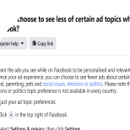
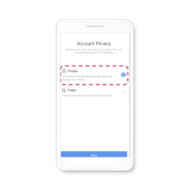
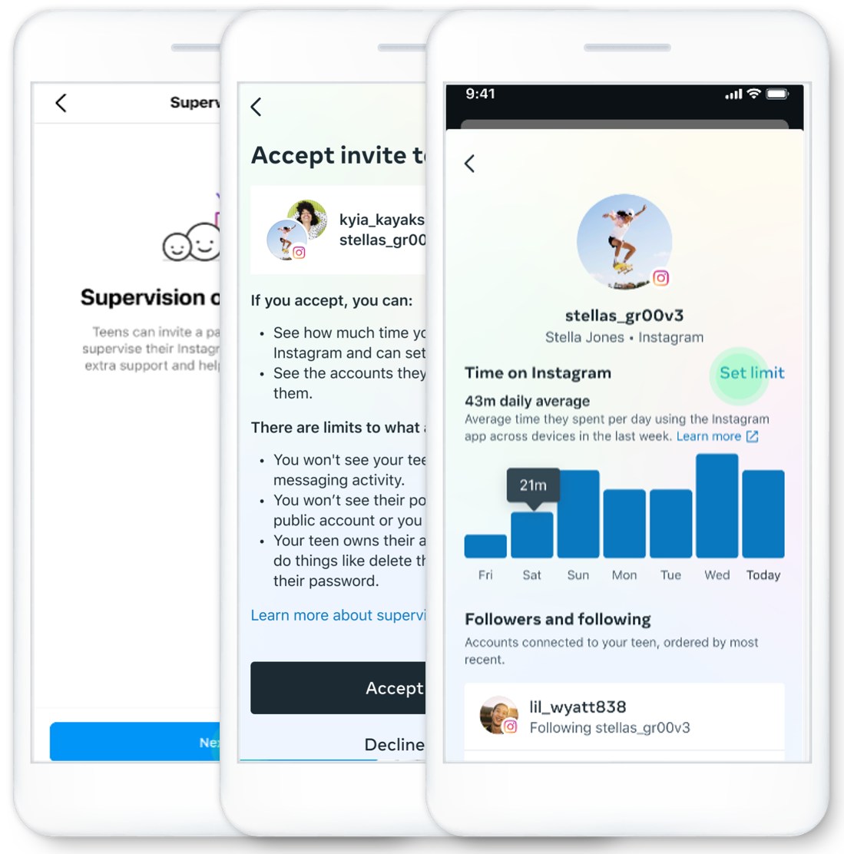
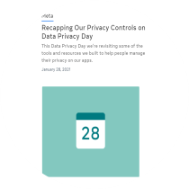
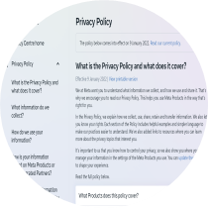
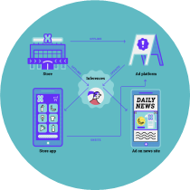
LESSON 2
Options for teens to control their experience on Facebook, Messenger, Instagram and WhatsApp
Services, ads restrictions and controls
No access to Dating
No access to Marketplace
Prohibited ads for under 18
No interest-based targeting
Opt in for 3P data for ads
Hide, report, see less of certain ads
Age assurance
Reporting underage users (available to all)
Safeguards and default settings
Automatic default to private account for teens
Audience selector: general and ad hoc
Commenting audience
No geolocation activated by default
Opt in for SCD in profile (N/A in Instagram)
Limit interactions with strangers on Instagram
Instagram Hidden Words
Instagram parental supervision
Alternate topic nudge, Take a Break, daily limits
Transparency and education for teens and their guardians
Safety Centre
Privacy checkpoints
Parents portal
Instagram Parents Guide
Get Digital
Youth portal and
peer voices
Data policy
Community Standards
Privacy Centre
Privacy setting
Privacy basics
Privacy checkup
TTC Labs
visual explainer
Let Me Explain series
Family Centre and
Education Hub

Slide 11
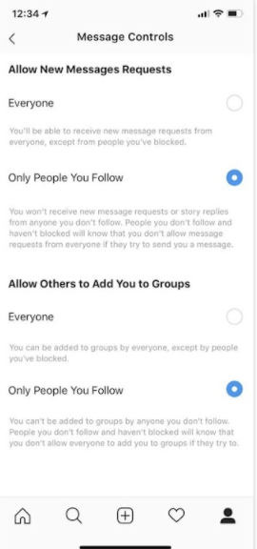
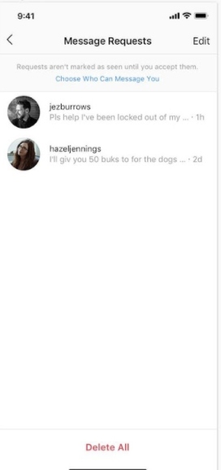
Control who can send your teen private messages across Meta technologies
LESSON 2
Options for teens to control their experience on Facebook, Messenger, Instagram and WhatsApp

Slide 12
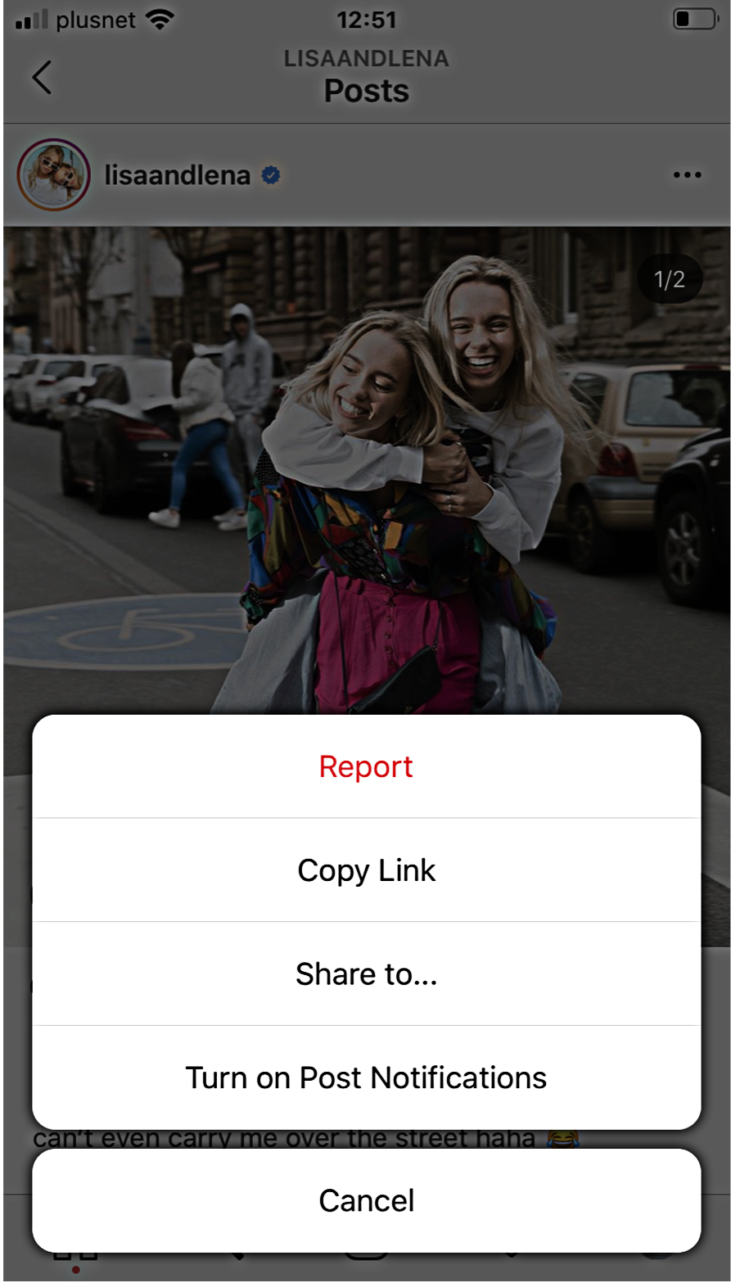
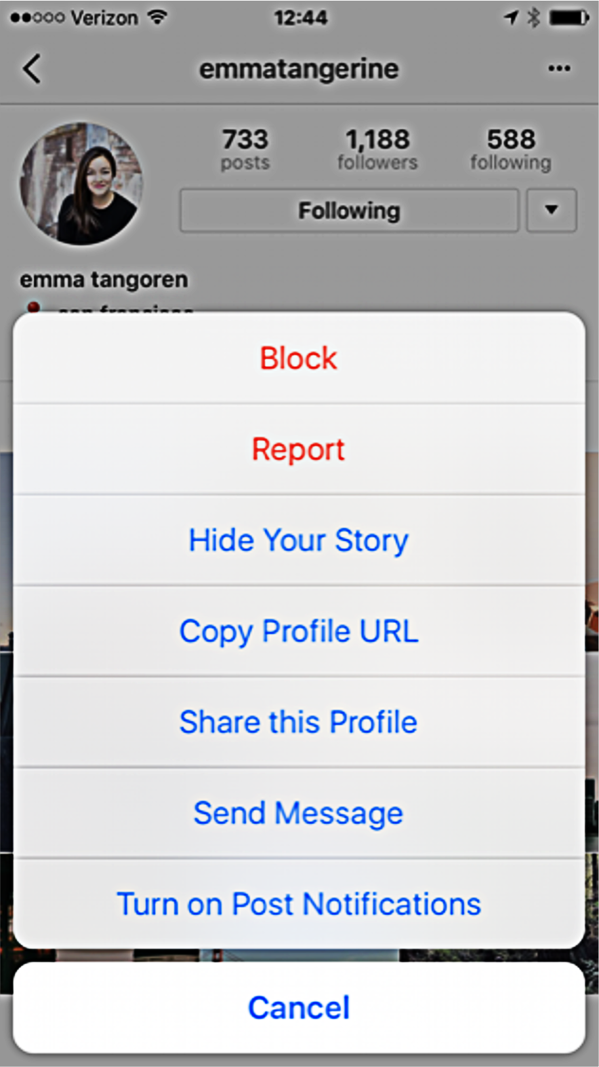
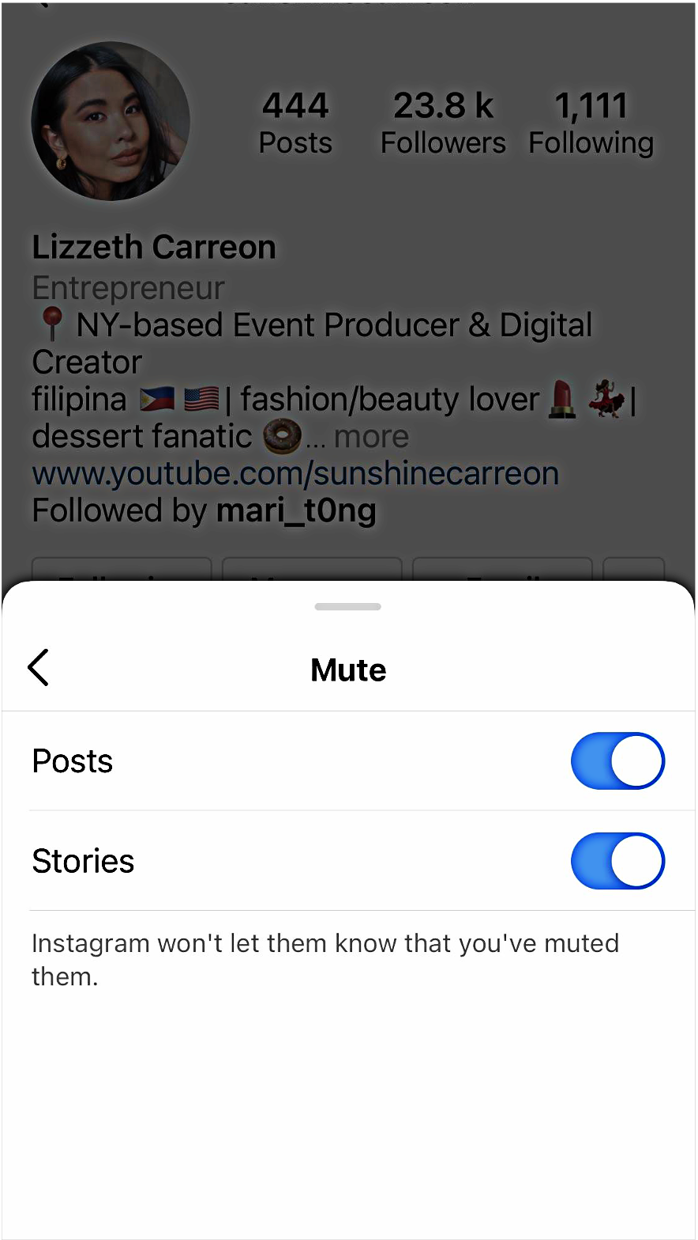
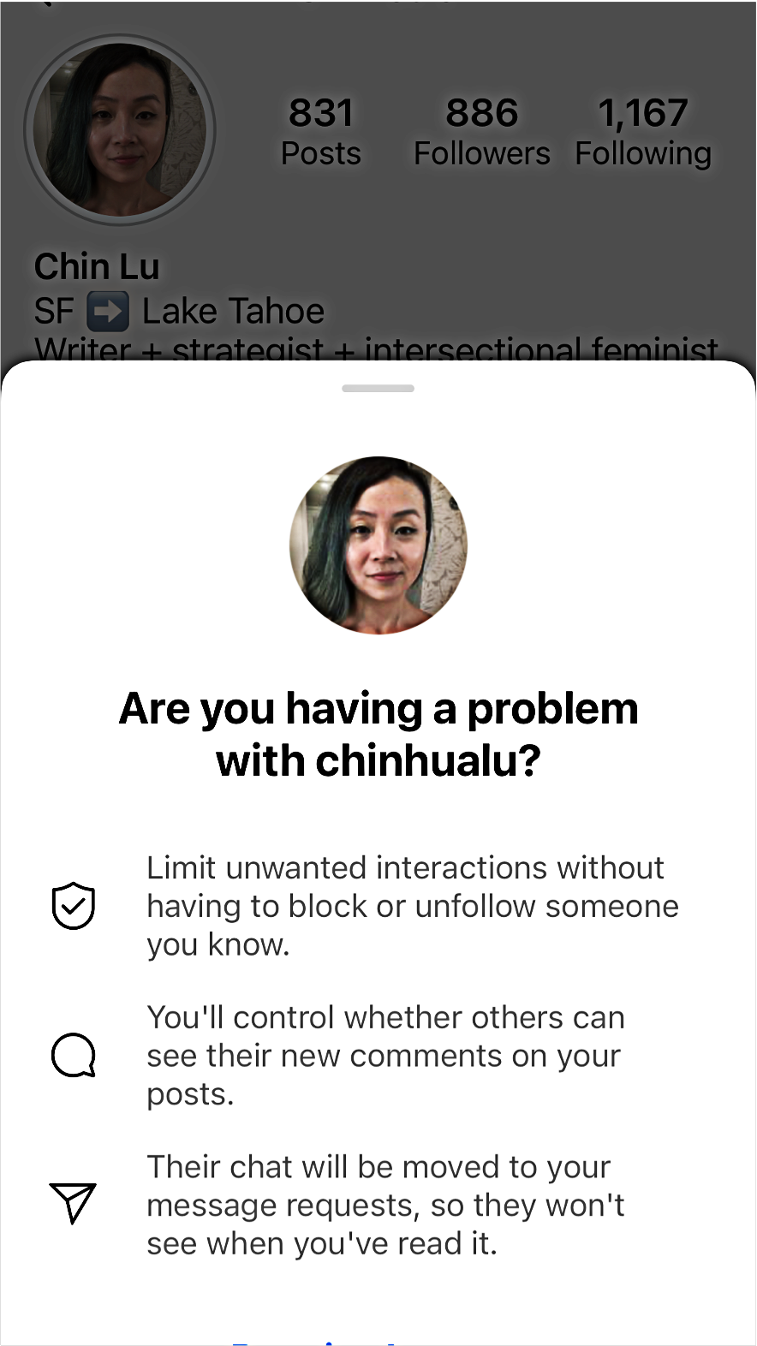
Control your teen’s experience on Instagram
LESSON 2
Options for teens to control their experience on Facebook, Messenger, Instagram and WhatsApp
Report
Block
Mute
Restrict

Slide 13
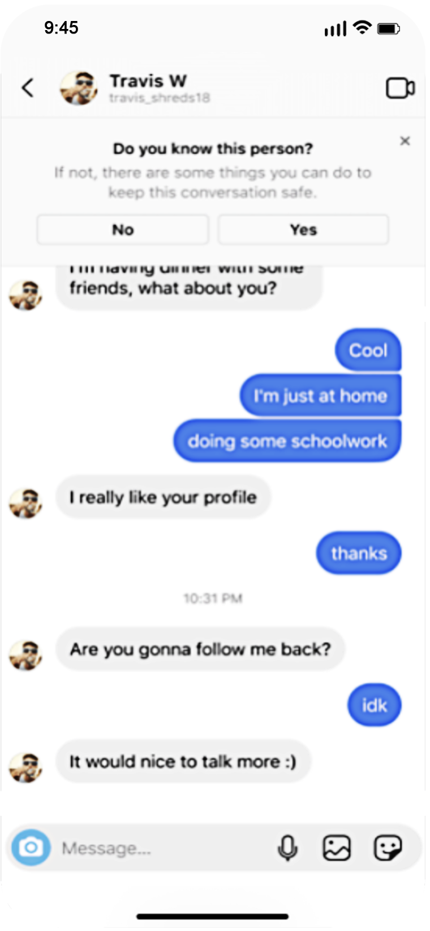
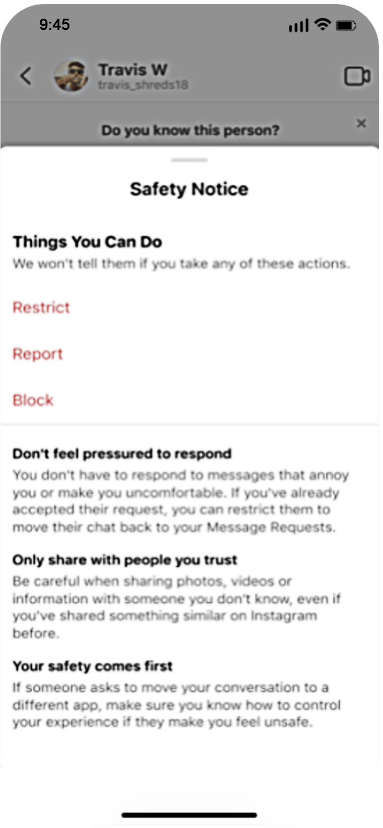
Limiting adults from sending direct messages (DMs) to your teen if they don’t follow them
Prompting your teen to be more cautious about interactions in DMs
LESSON 2
Options for teens to control their experience on Facebook, Messenger, Instagram and WhatsApp

Slide 14
LESSON 2
Options for teens to control their experience on Facebook, Messenger, Instagram and WhatsApp
Updates to Sensitive Content Control
2 options for teens: Standard and Less If your teen is under 16 years old and new to Instagram, they will be defaulted into the Less option. If they are under 16 years old and already on Instagram, we will send them a prompt encouraging them to select the Less option.

Slide 15
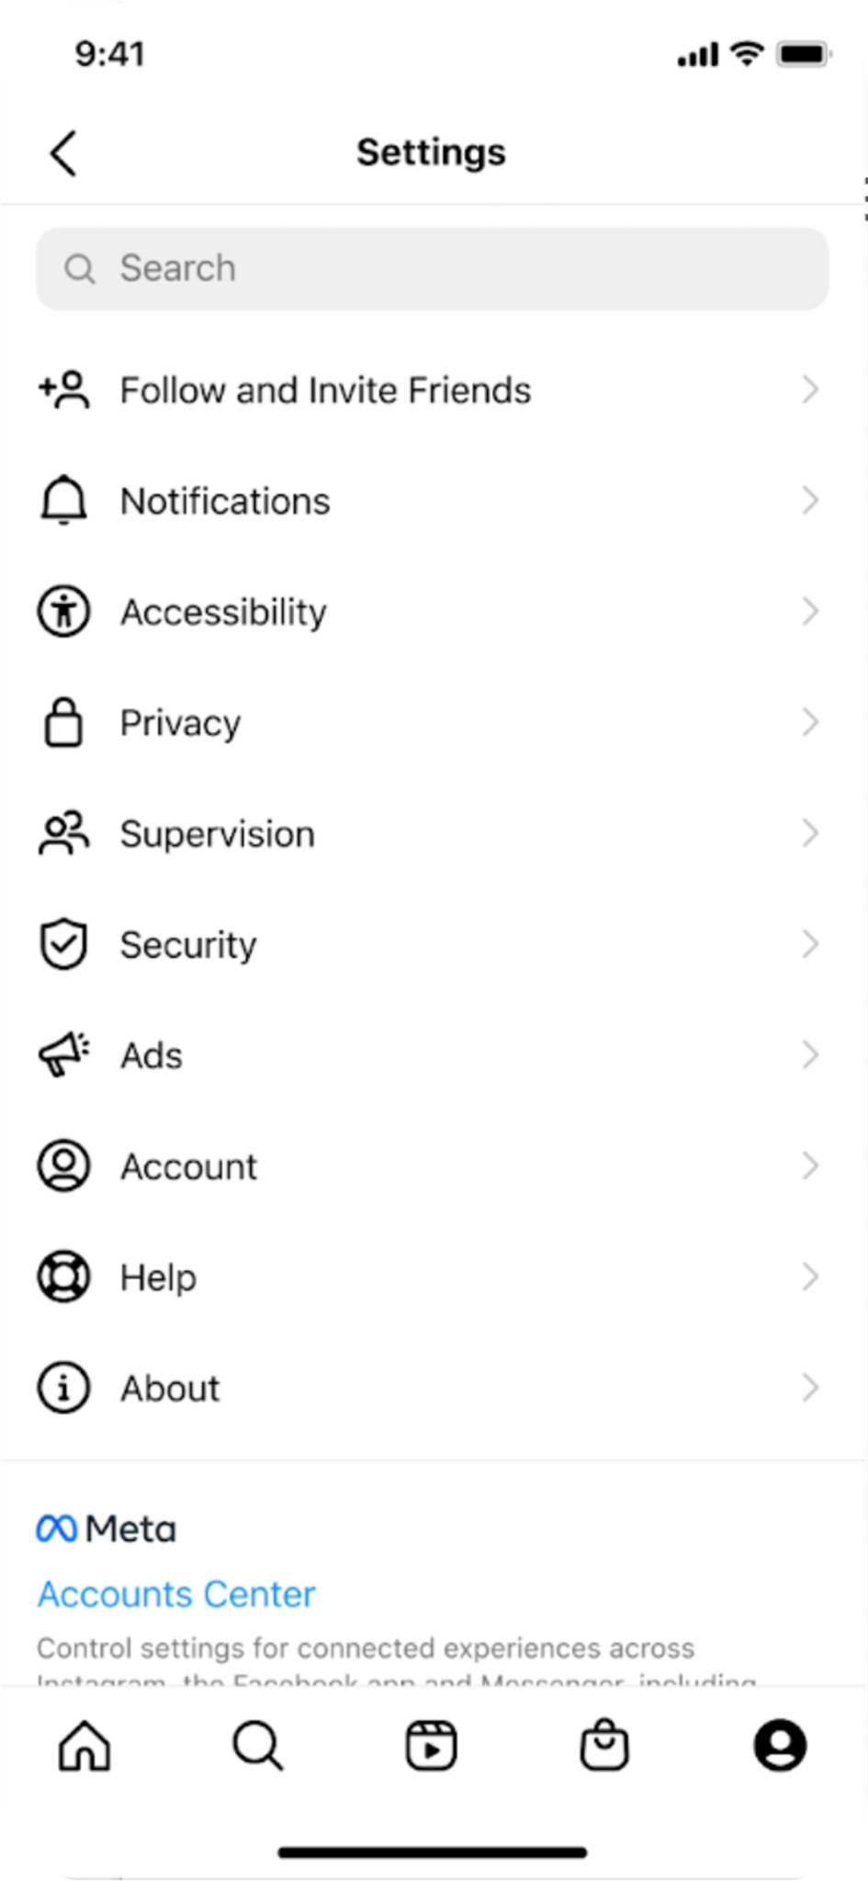
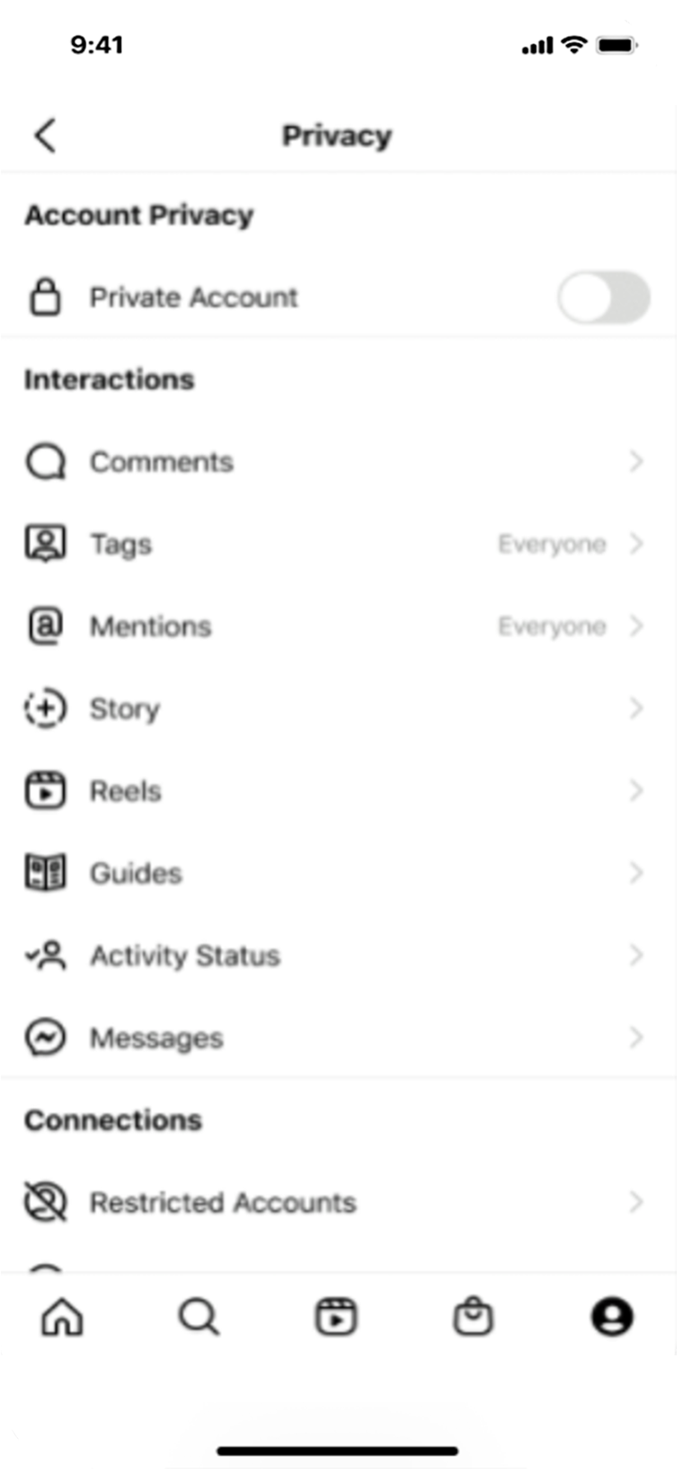
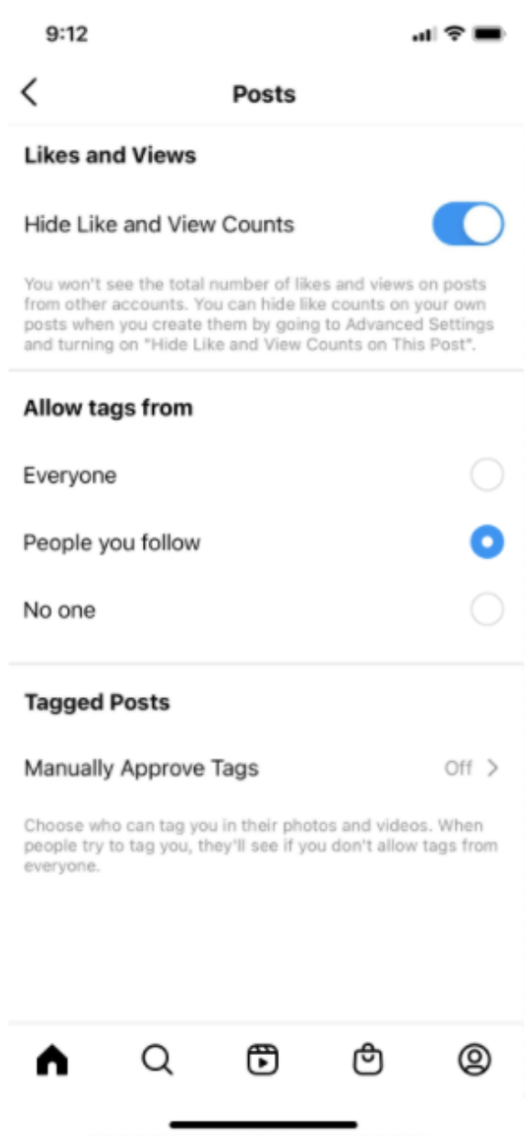
LESSON 2
Options for teens to control their experience on Facebook, Messenger, Instagram and WhatsApp
Tags and mentions
Switching off the ability for people to tag or mention your teen if they don’t follow them

Slide 16
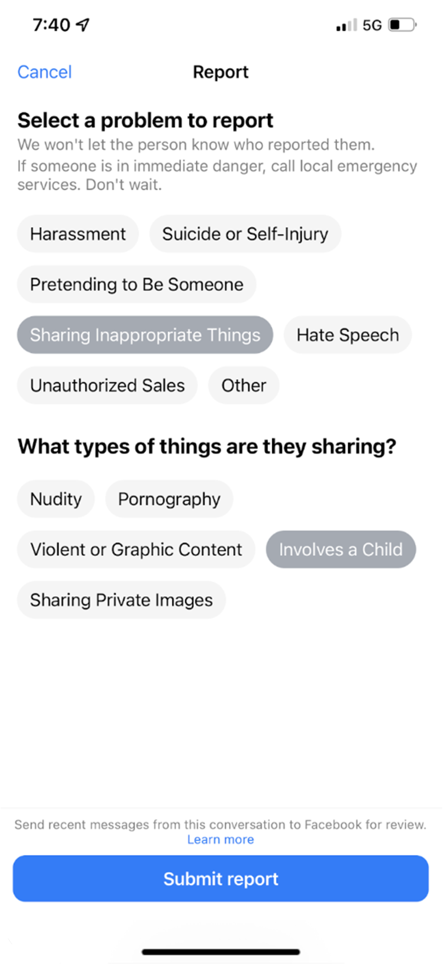
Limiting unknown adult to minor connections
Tools to block and report
Acting on user reports and messaging behaviour
LESSON 2
Options for teens to control their experience on Facebook, Messenger, Instagram and WhatsApp

Slide 17
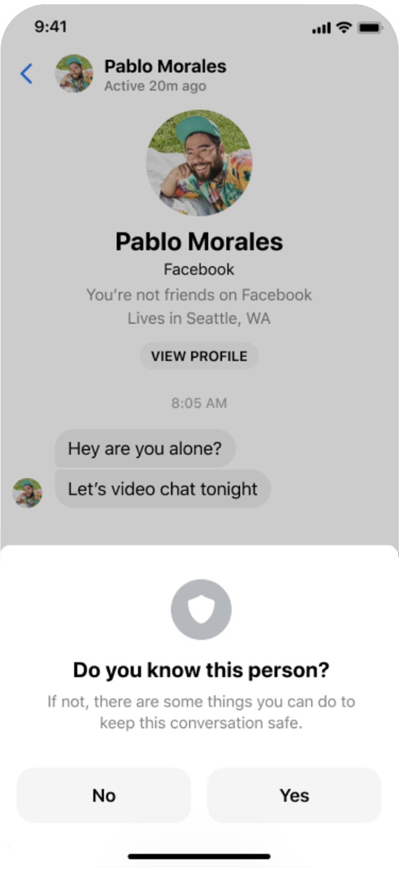
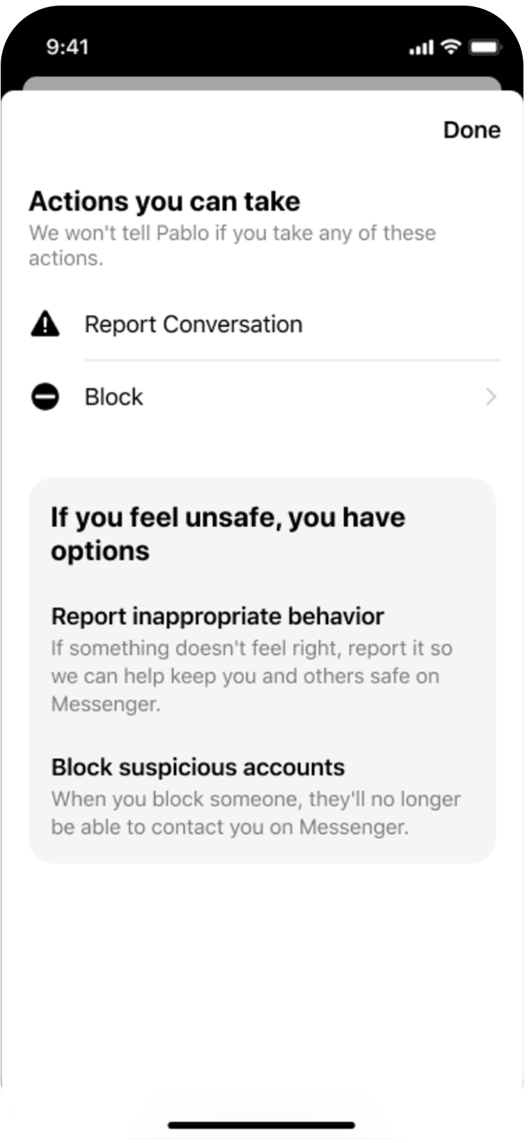
LESSON 2
Options for teens to control their experience on Facebook, Messenger, Instagram and WhatsApp
Reduce harm through in-app education
Safety Notices alert teens of suspicious activity and prompt them to block, report, ignore or restrict when something doesn’t seem right.

Slide 18
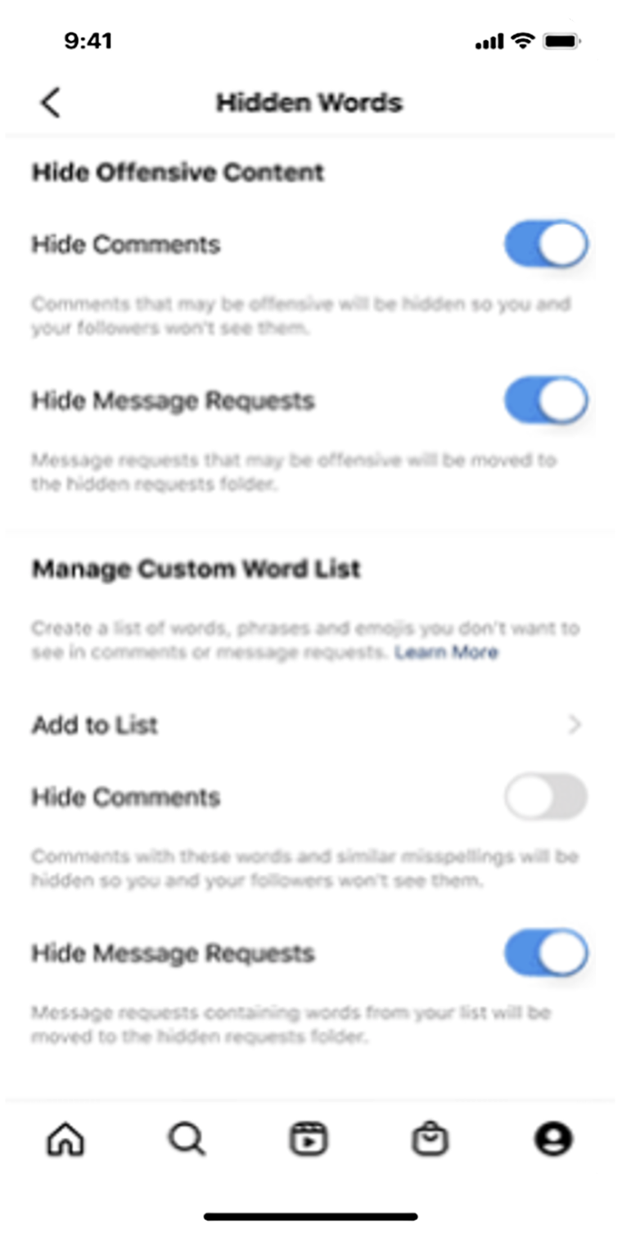
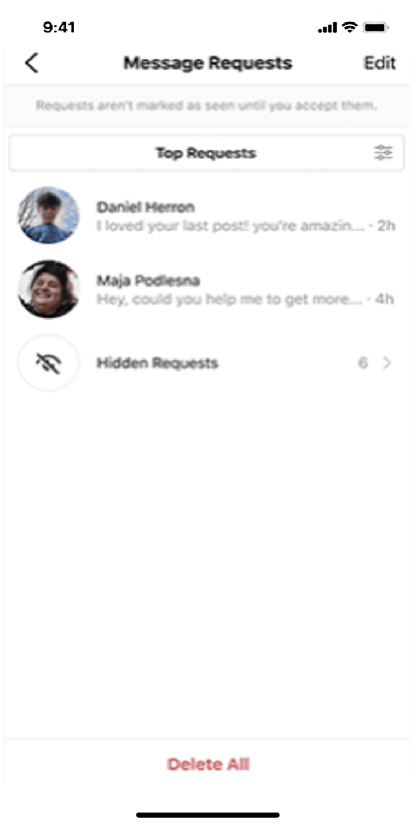
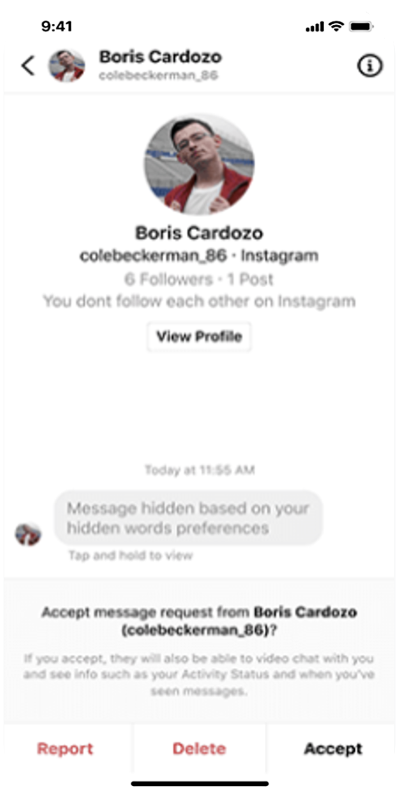
LESSON 2
Options for teens to control their experience on Facebook, Messenger, Instagram and WhatsApp
Hidden Words
Protecting teens from seeing offensive DMs and comments

Slide 19
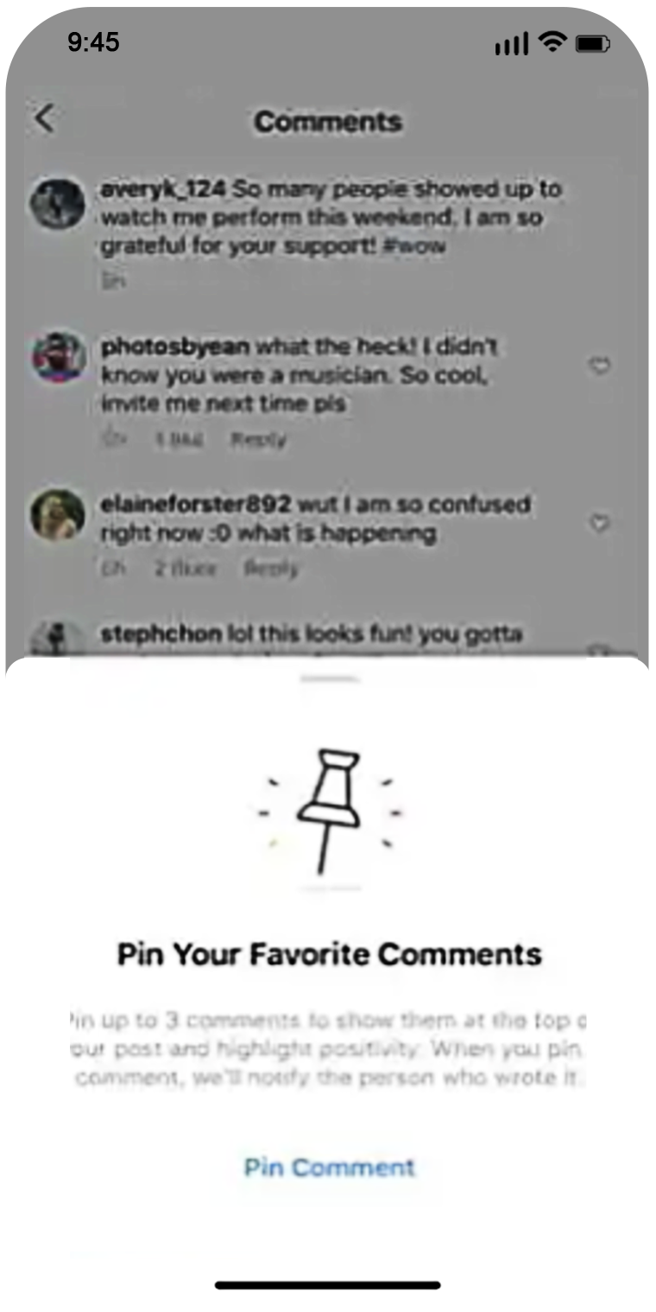
LESSON 2
Options for teens to control their experience on Facebook, Messenger, Instagram and WhatsApp
Encouraging positive interactions
Pinned comments

Slide 20
LESSON 3
Age-appropriate experiences

Slide 21
Responsible
innovation principles
Proactive engagement
Iteration
LESSON 3
Age-appropriate experiences
We engage with experts across privacy, safety, civil and human rights, AR/VR and more to ensure that we are responsive to the key issues and challenges that may arise from our technologies.
The product development process is iterative. While some products to date may be final, feedback and opinions voiced allow us to consider that feedback for future products (software and hardware).
01. Never surprise people
02. Provide controls that matter
03. Consider everyone
04. Put people first

Slide 22
LESSON 3
Age-appropriate experiences
Resources for you and your family
Education Hub

Slide 23
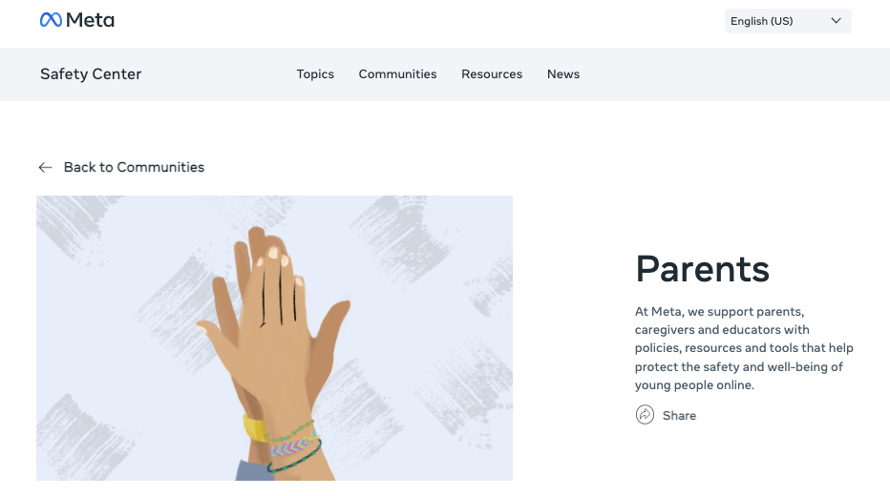
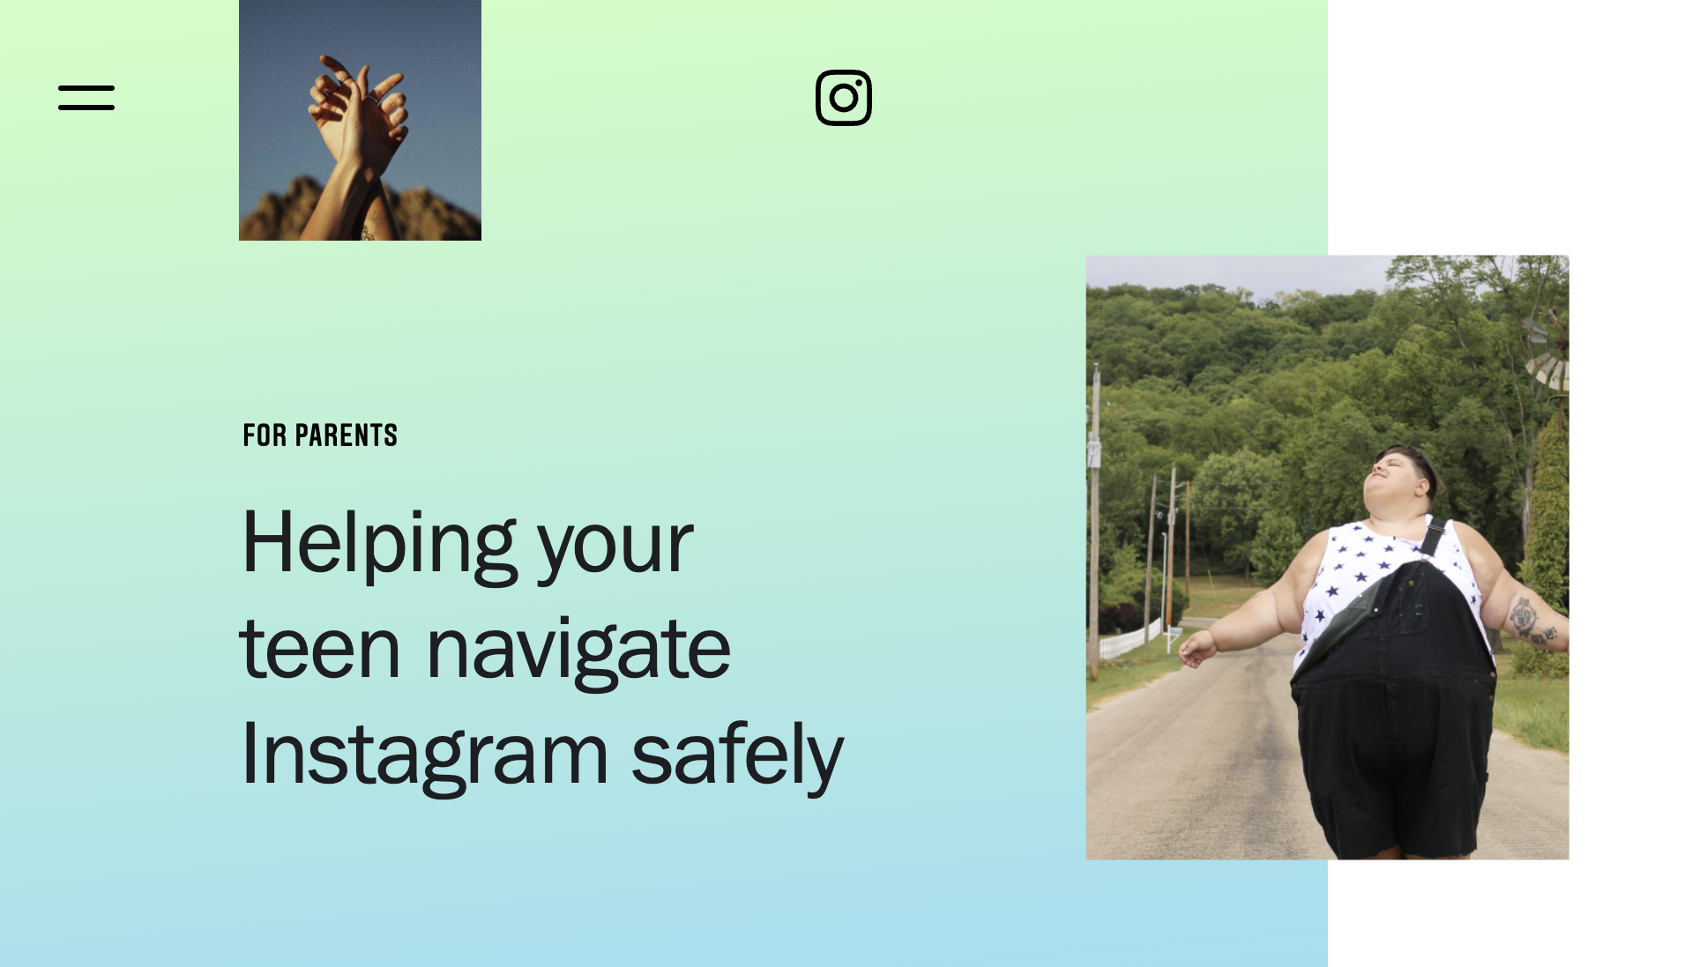
LESSON 3
Age-appropriate experiences
Resources for parents
fb.com/safety/parents
about.instagram.com/community/parents

Slide 24
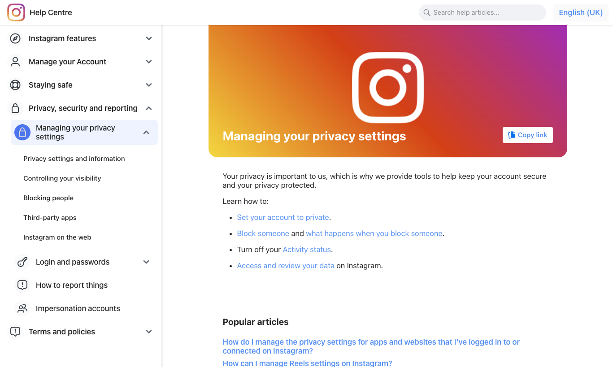
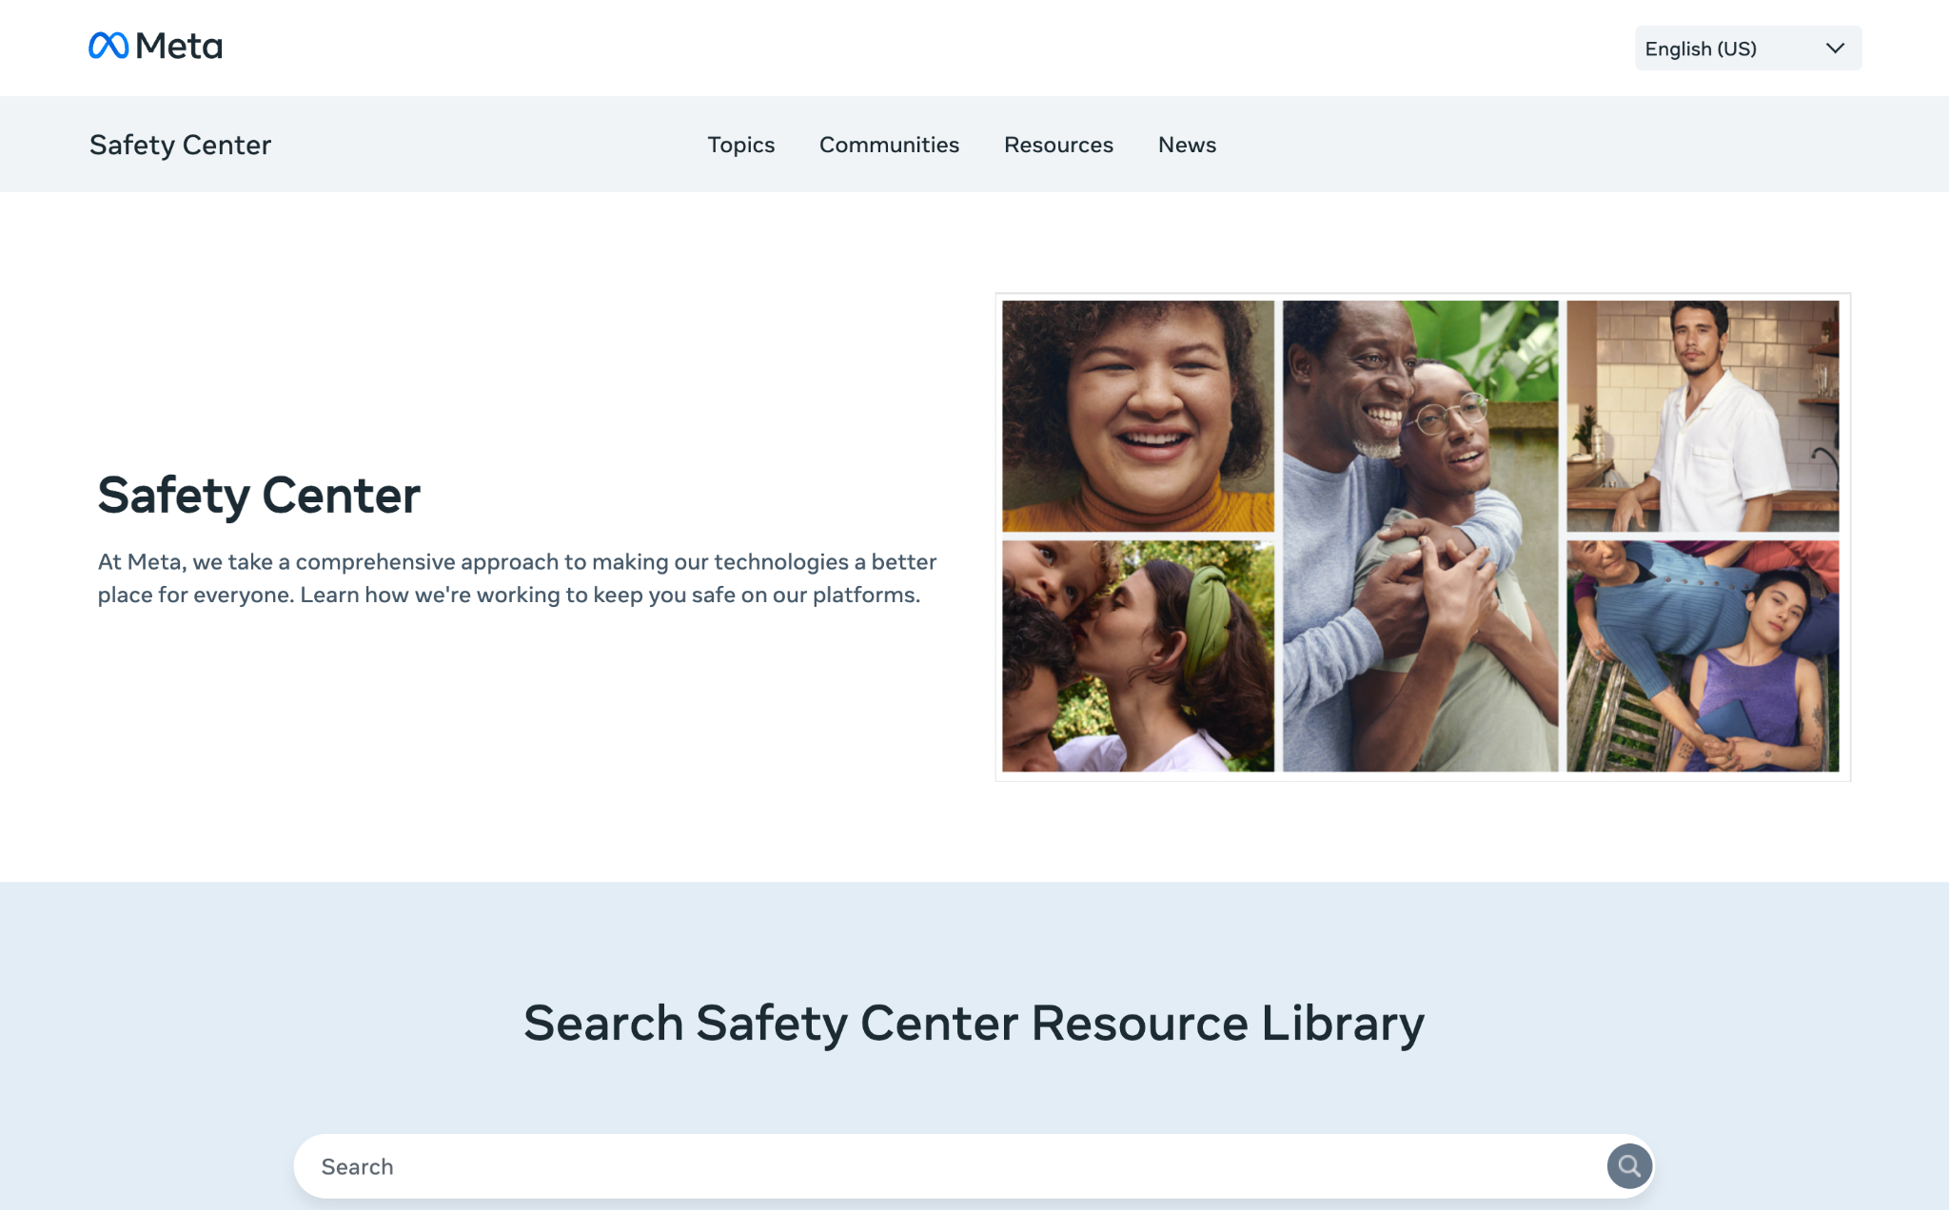
LESSON 3
Age-appropriate experiences
Resources for parents
Help Centre
Safety Centre
fb.com/help
fb.com/help/instagram
fb.com/safety

Slide 25
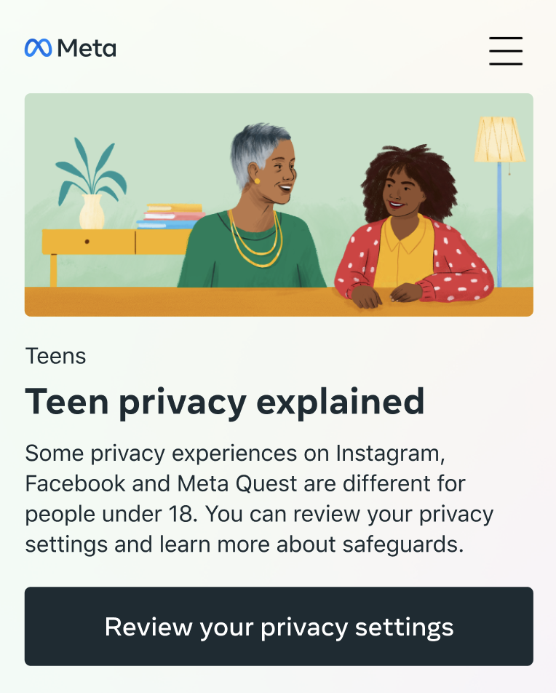
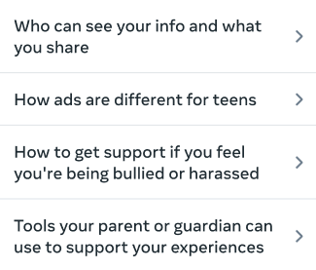
LESSON 3
Age-appropriate experiences
Meta Privacy Centre

Slide 26
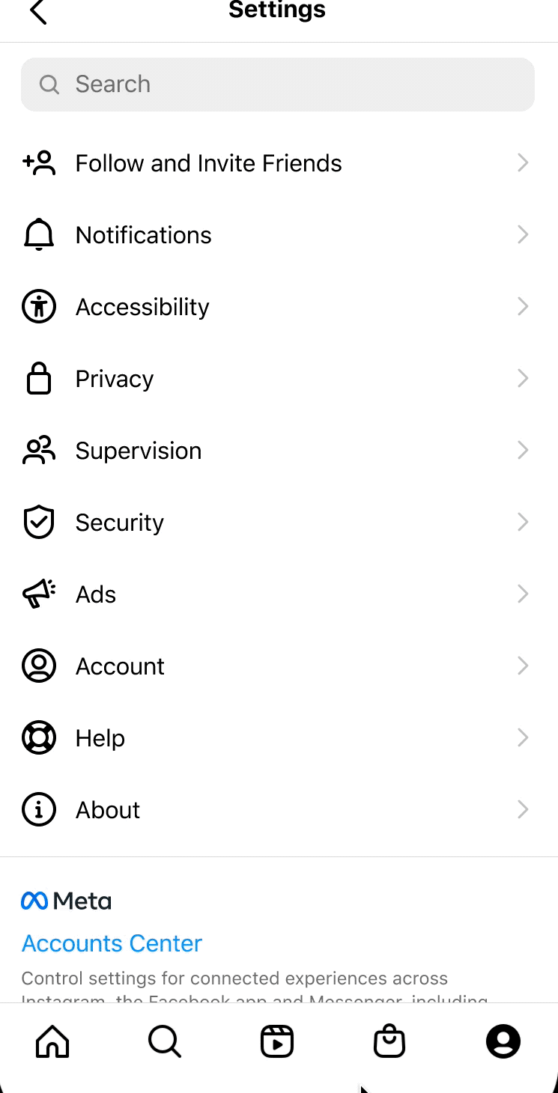
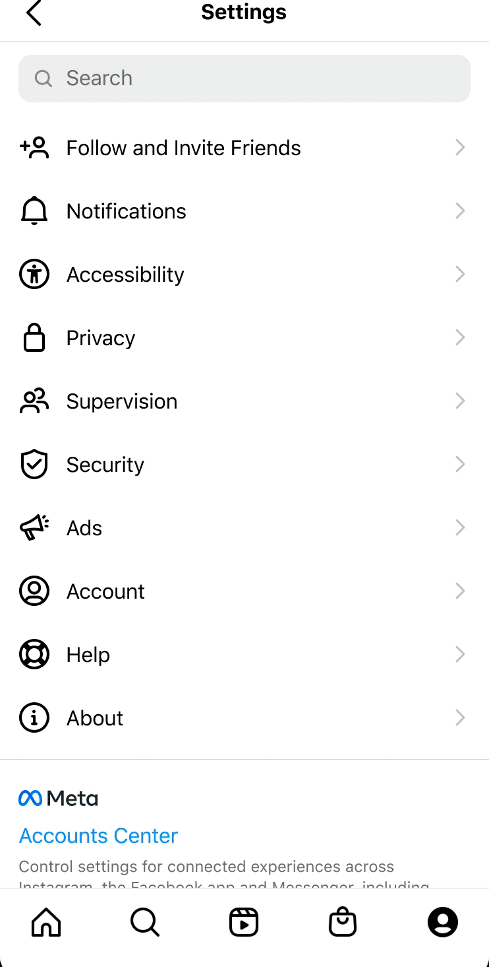
LESSON 3
Age-appropriate experiences
Supervision today
Parent experience
Can manage multiple teens
Teen experience
Can only have one supervisor
Read-only view

Slide 27
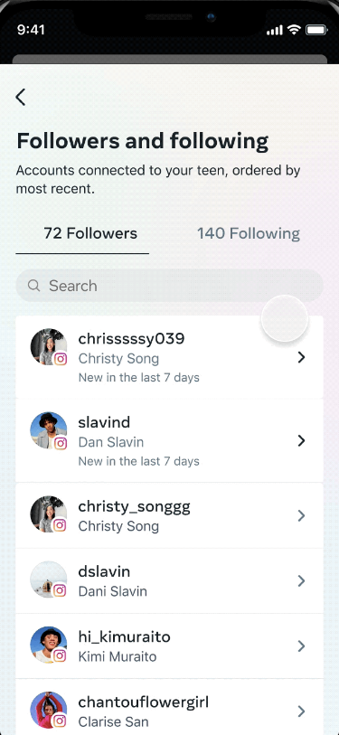
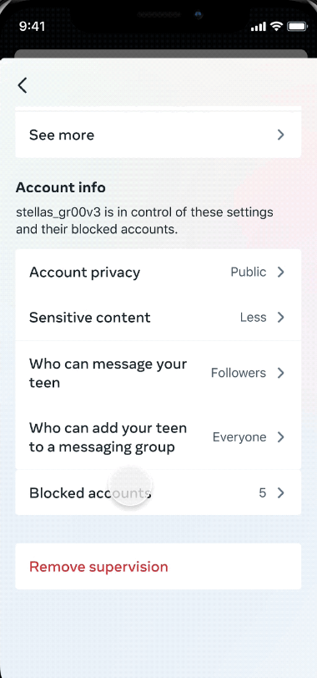
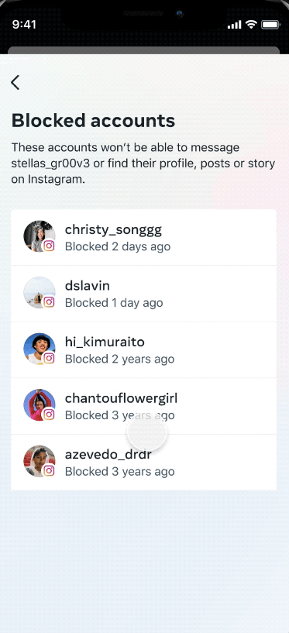
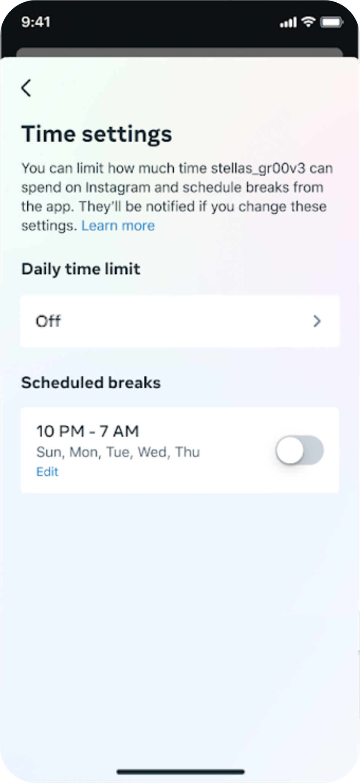
LESSON 3
Age-appropriate experiences
In detail
Visibility into followers and following, account settings and blocked accounts
Time management (limits and scheduled breaks)
Reporting (optional)

Slide 28
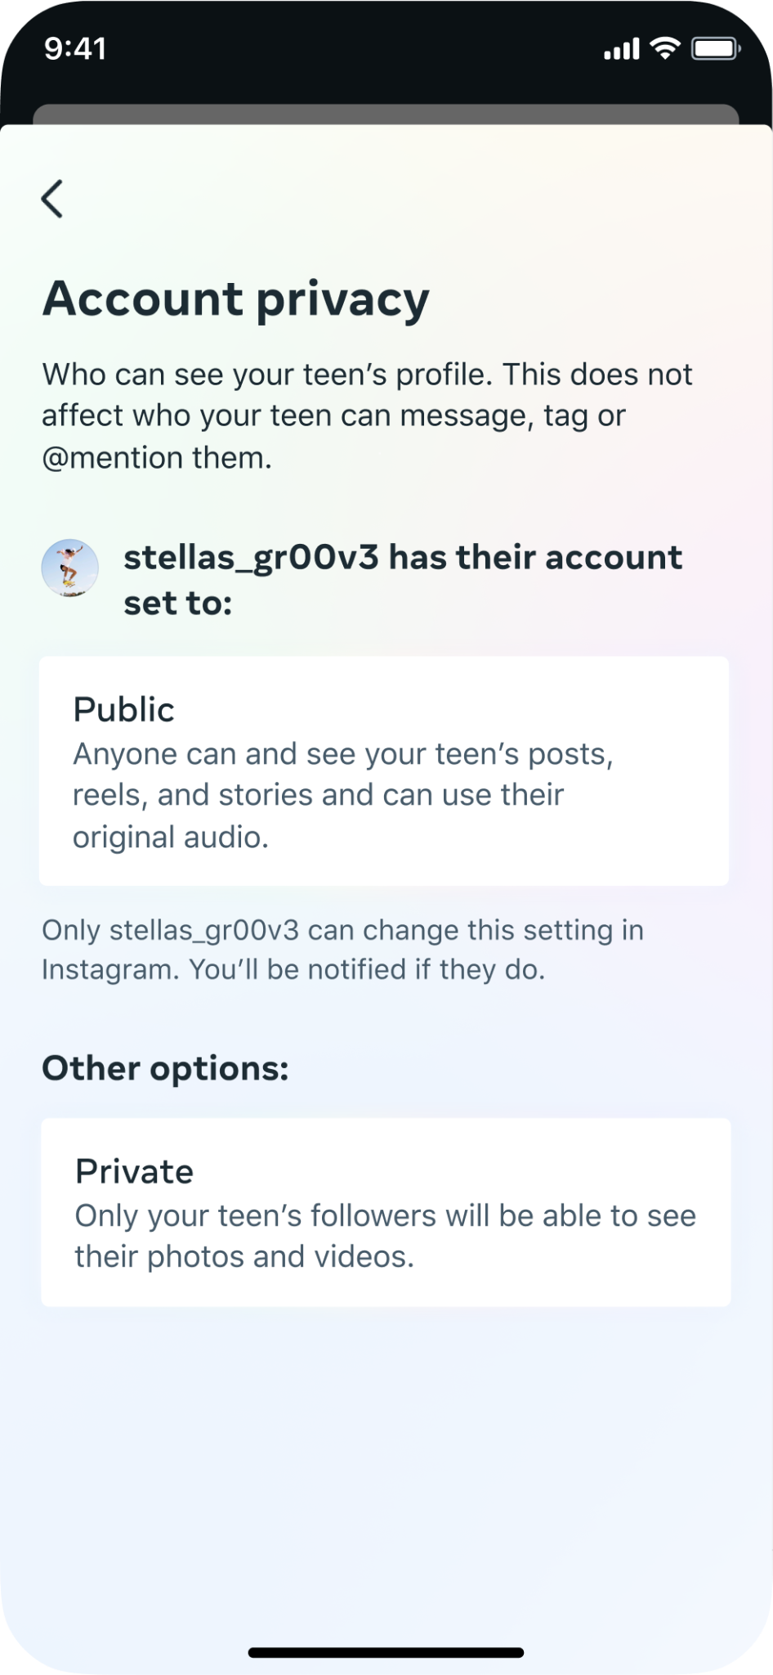
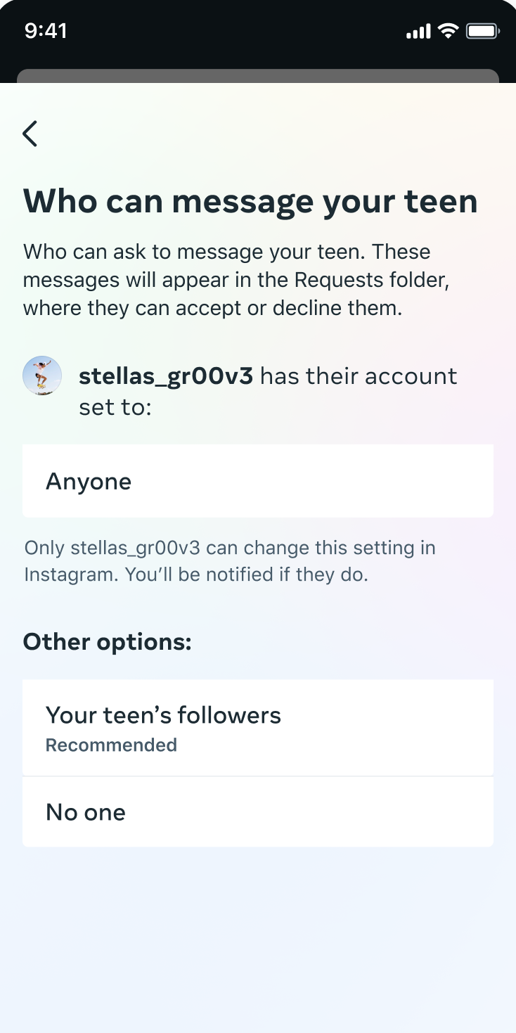
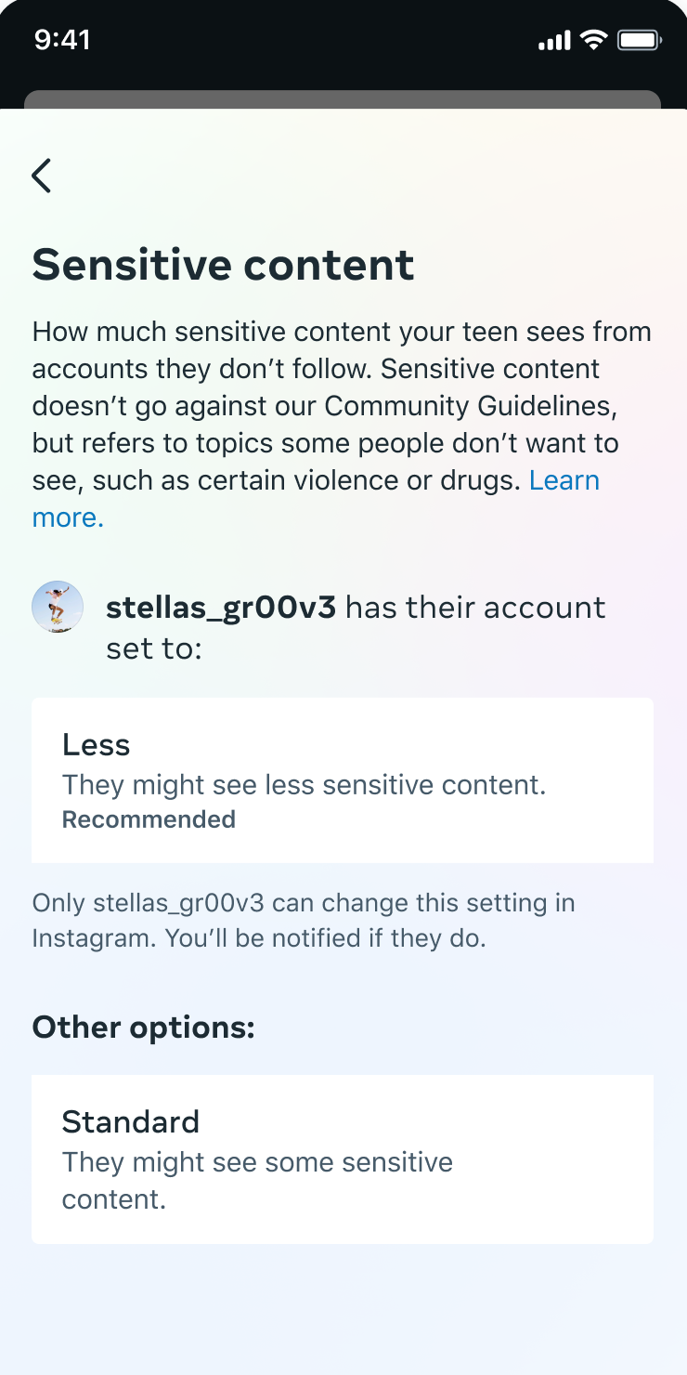
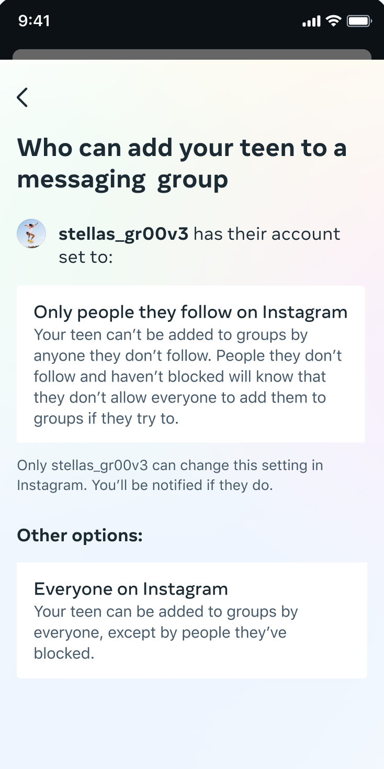
LESSON 3
Age-appropriate experiences
4 settings parents can see

Slide 29
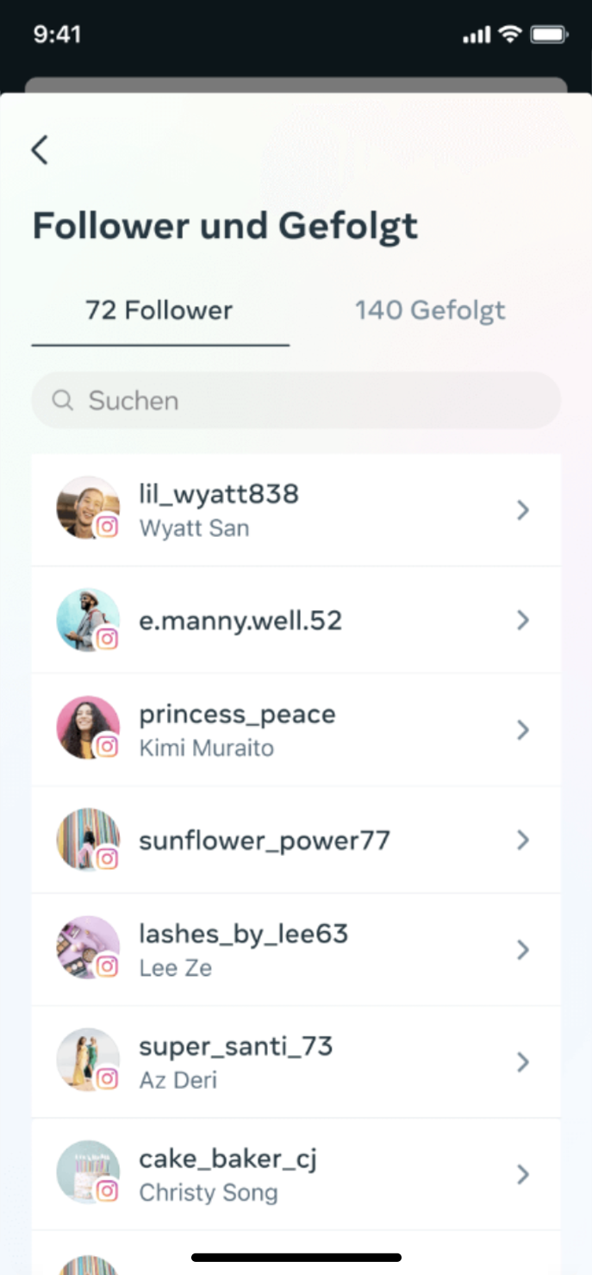
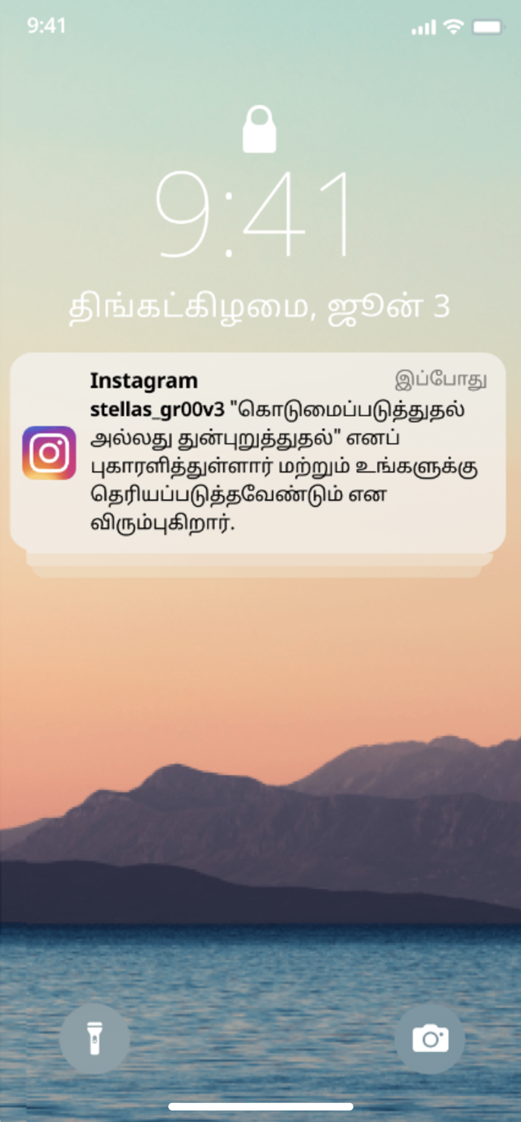
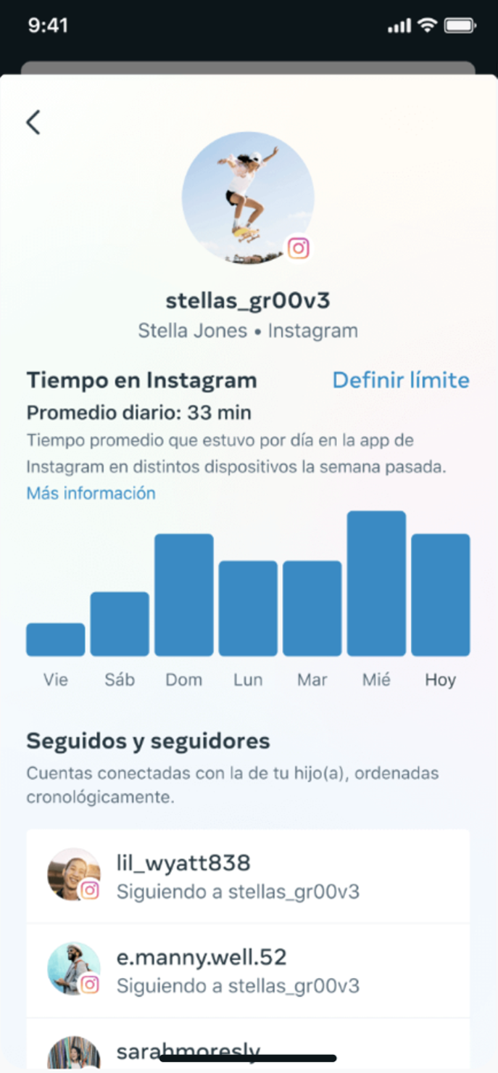
LESSON 3
Age-appropriate experiences
Parental supervision tools on Instagram are now globally available

Slide 30
LESSON 3
Age-appropriate experiences
Private accounts by default for teens under 16

Slide 31
Activity Feed
Top of Home Feed
LESSON 3
Age-appropriate experiences
Highlighting the benefits of private accounts to existing teens

Slide 32
APPENDIX
VR resources for you and your family

Slide 33
APPENDIX
VR resources for you and your family
Resources for you and your family
VR Parent Education Hub

Slide 34
APPENDIX
VR resources for you and your family
Parental supervision in VR
Age-inappropriate content
Financial
Time spent and well-being
Safety in social VR
Existing protections
IARC ratings in Quest Store
Content guidelines for Quest Store
PIN-protected purchases
Quest Safety Centre
Guardian and Space Sense
Reporting tools
Default privacy settings
Quest Chats and VR MSGR protections
View list of apps
View, block, approve purchases, downloads and usage of apps
Block ability for teen to connect to PC, Air Link, Developer Mode
Receive notifications of purchases
View time spent in VR
View friends list
Enable and disable social features
Meta account defaults for teens
New!
Parental supervision

Slide 35
APPENDIX
VR resources for you and your family
Protected app access

Slide 36
APPENDIX
VR resources for you and your family
Default blocking of download or purchase of IARC age-inappropriate apps in the Quest Store

Slide 37
APPENDIX
VR resources for you and your family
Parental supervision

Slide 38
APPENDIX
VR resources for you and your family
Parental dashboard

Slide 39
APPENDIX
VR resources for you and your family
Purchasing notifications and permissions

Slide 40
APPENDIX
VR resources for you and your family
Teen dashboard (read-only view)

Slide 41
APPENDIX
VR resources for you and your family
Ads restrictions and controls for teens
Prohibited ads for under 18s
Only age, gender, location-based targeting No interest-based targeting
Hide, report, see less of certain ads

