Slide 1



Understanding AI
in your daily life
For Adults - Ages 18-35
60 Minutes
4 Interactive Modules
Notes:
SPEAKER NOTES:
Session Duration: 60 minutes Format: 4 x 15-minute focused modules Target: General adults aged 18-35 in MENA region Approach: Practical, everyday application with peer learning
Pre-Session Preparation (10 minutes before start)
Materials Check:
Presentation device and backup materials ready
Offline alternatives prepared (printed examples, discussion guides)
Connectivity level confirmed and appropriate version planned
VERIFY method reference cards printed
Real-world scenario examples localized for your specific audience
Room Setup & Adult Learning Considerations:
Arrange seating to facilitate peer discussion (small groups of 3-4)
Ensure participants can easily see presentation from all angles
Have flip chart or board available for capturing group insights
Create comfortable environment - adults learn best when relaxed and respected
Know Your Audience:
Many participants may feel intimidated by technology
Adults bring rich life experience that should be valued
Some may have had negative experiences with technology
Focus on practical benefits and real-world applications

Slide 2
Outline
01
05
Introduction
Managing AI
AI in Your World Already
Learn How to Use AI
02
06
Engaging with AI
Staying Safe with AI
Can You Tell What’s Real?
Your AI Safety Toolkit
03
07
Creating with AI
AI & Your Future
Create with AI
Your Role in the Middle East’s AI Future
04
08
Designing AI
Wrap-Up & Assessment
Learn How AI Actually Works
AI in Your World Already
Notes:
SPEAKER NOTES:
Session Outline

Slide 3

Introduction
Opening & Icebreaker
Notes:
SPEAKER NOTES:
Welcome & Reality Check
Opening Approach (3 minutes):
"Good morning/afternoon, everyone. Before we dive into AI, I want to acknowledge that you're all experts in something - your life experiences, your work, your communities. Today we're adding one more area of expertise: understanding AI. And I have good news - you're already using AI more than you think."
Establishing Psychological Safety:
"There are no silly questions here, and no one expects you to become a tech expert by the end of today. We're here to learn practical skills that make your daily life easier and safer."

Slide 4

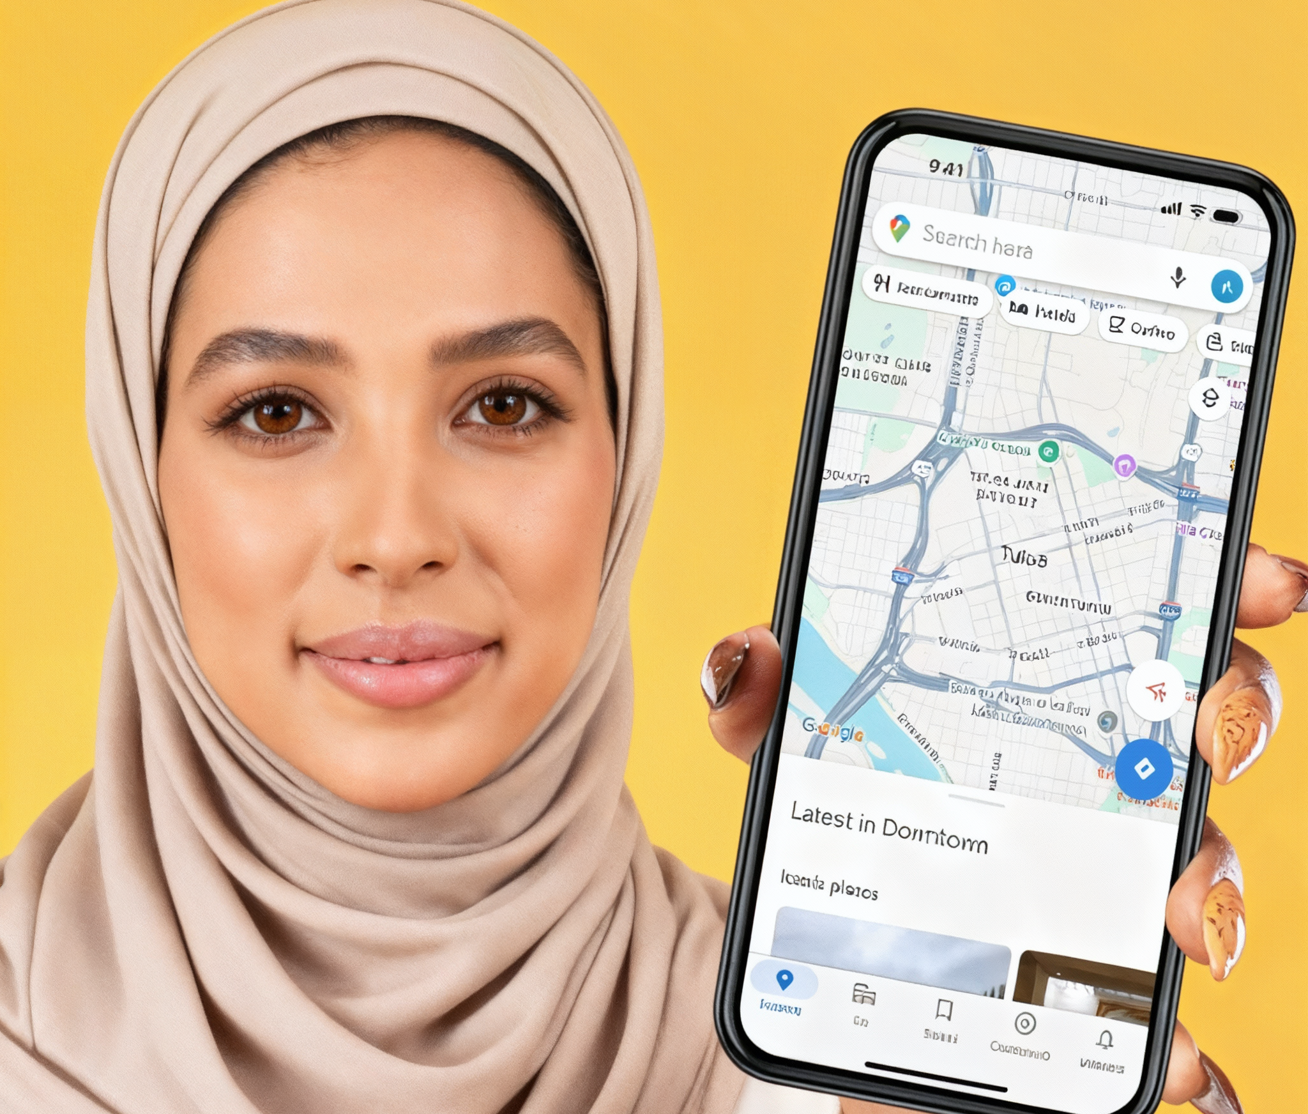
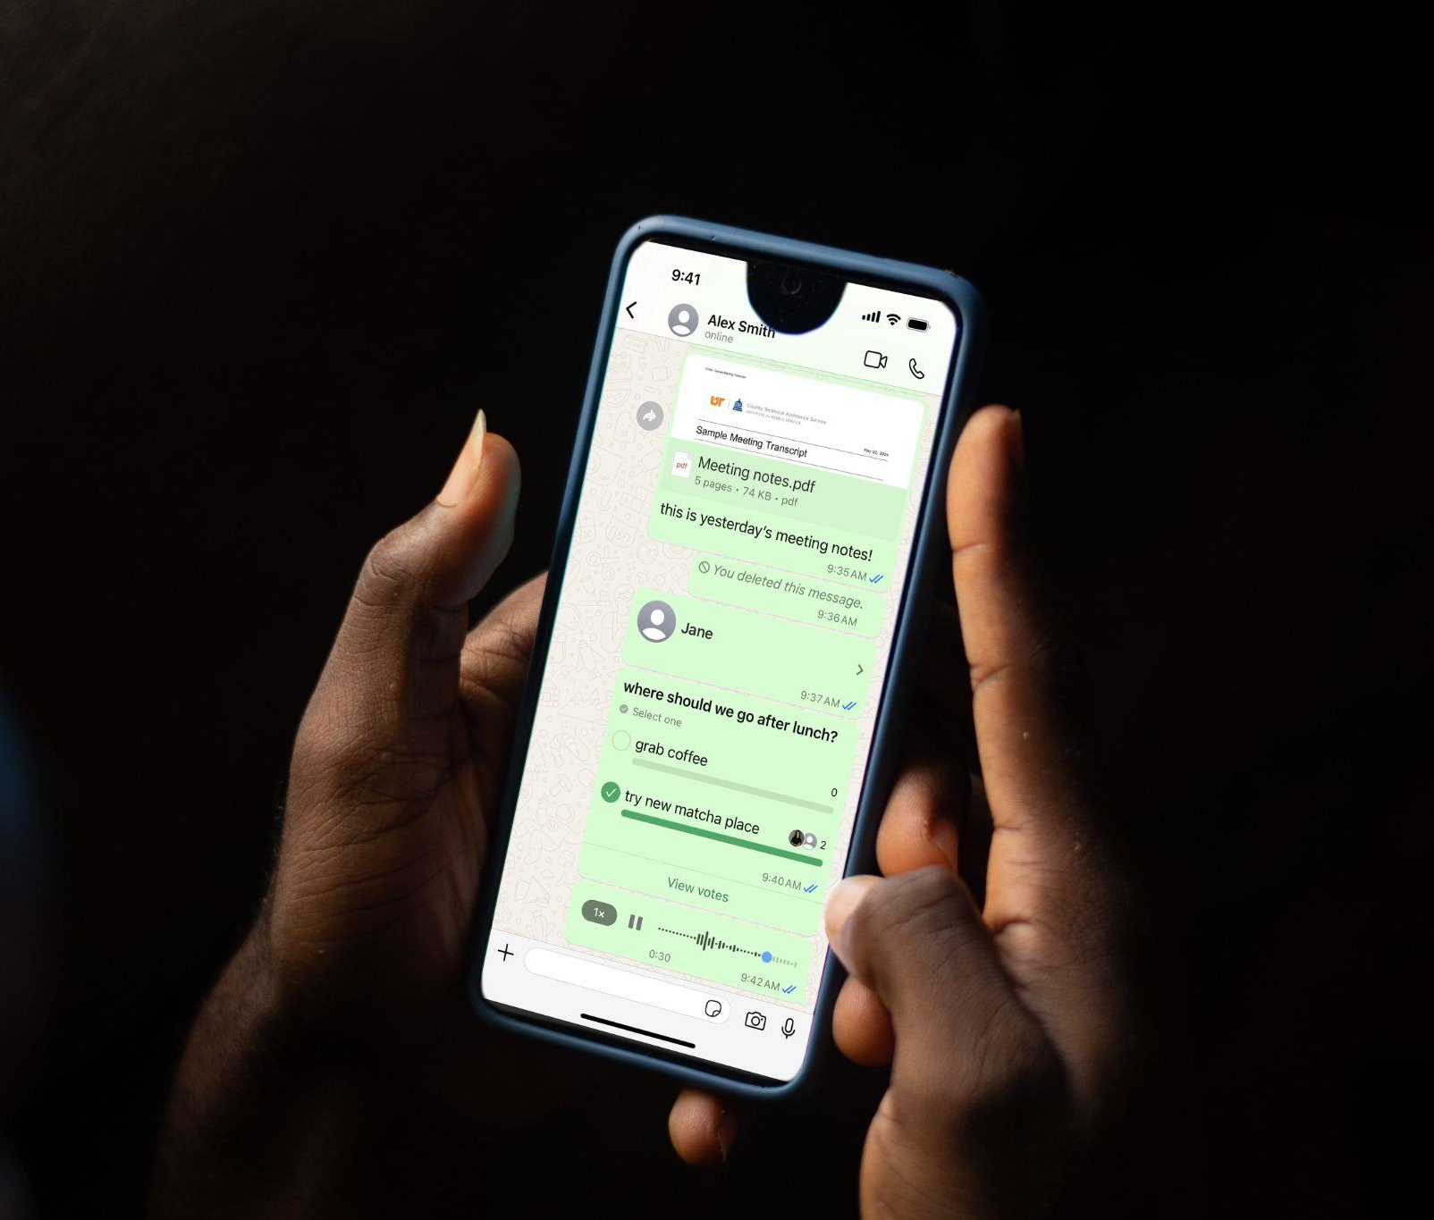
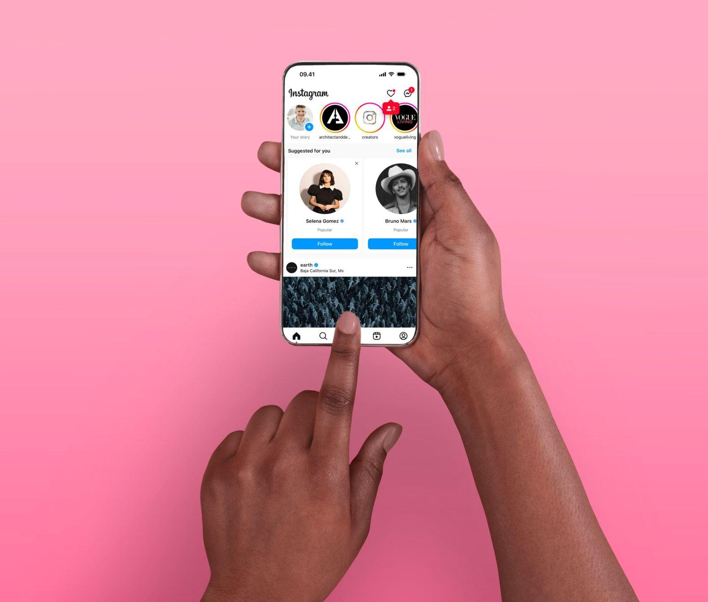

AI is already in your daily life
INTRODUCTION
AI at work
Mobile banking app:
Fraud detection in banking
Google Maps:
Traffic predictions and routing
WhatsApp voice messages:
Speech-to-text conversion
Facebook/Instagram Feed:
Personalized content feeds
Online shopping:
Product recommendations
Understanding AI in your daily life
Notes:
SPEAKER NOTES:
Group Share-Back (4 minutes):
"Let's hear from a few pairs. What technologies came up in your discussions?"
As participants share, reveal AI components:
"Mobile banking apps use AI to detect fraud"
"Google Maps uses AI to find the fastest route and predict traffic in Cairo, Beirut, Amman, Riyadh, Doha, or Dubai.
"WhatsApp voice note transcription uses AI"
"Facebook/Instagram feeds are organized by AI"
Bridge to Learning:
"See? You're not beginners with AI - you're already experienced users. Today we're going to help you become more intentional and safer in how you use it."
Cultural Sensitivity Notes:
Some participants may have limited technology access - frame this positively
Acknowledge that AI skills are increasingly important for economic opportunities across the Middle East.
Respect that some may be skeptical of technology due to past negative experiences

Slide 5

Engaging
With AI
Notes:
SPEAKER NOTES:
Engaging with AI

Slide 6
A brief history of AI
Notes:
SPEAKER NOTES:
AI has evolved over the last few decades. In the next slide, we will explore a brief history or timeliness of AI.

Slide 7





1950s
1956 - 1970s
1980s - 1990s
2000s - 2010s
2020s
ENGAGING WITH AI | A BRIEF HISTORY OF AI
The Dream Begins
Alan Turing asks, “Can machines think?”
AI is Born
Scientists coin the term “Artificial Intelligence” and build simple programs that play games and solve math problems.
Progress Slows
Teaching machines was harder than expected. More data and better computers were needed.
AI Makes a Comeback
The internet and faster processors helped AI learn again—now it could recognize faces, translate languages, and win complex games.
AI is Everywhere
From voice assistants, self-driving cars, Meta’s open-source AI models to the advanced recommendation systems behind Facebook and Instagram—AI is now part of daily life.
Understanding AI in your daily life
Notes:
SPEAKER NOTES:
Here’s a timeline of the development of Artificial Intelligence.
“1950s: Some smart people began to wonder: Can we teach machines to think like humans? A man named Alan Turing came up with a famous question: "Can a machine think?" That’s when the dream of AI began!”
“1956–1970s: At a meeting in 1956, the word “Artificial Intelligence” was born.
Scientists started building simple computer programs that could play games like chess or solve math problems.”
“1980s–1990s: People thought AI would grow fast, but teaching machines was much harder than they expected. They needed more data, faster computers, and better ideas.”
“2000s–2010s: When the internet grew, computers had access to tons of data.
Faster computers helped AI learn again! Now AI could recognize faces, translate languages, and even beat world champions at games like Go!”
“Today: Now AI is everywhere! It helps with Google search, YouTube suggestions, voice assistants, and even self-driving cars! But we also need to use it safely and kindly.”

Slide 8
What is AI and how does it work?
Notes:
SPEAKER NOTES:
Before we proceed, what is AI or Artificial Intelligence?

Slide 9

AI is technology that enables computers and machines to do things that normally require human thinking.
ENGAGING WITH AI
They are;
Computer systems or machines that are designed to perform tasks that typically require human intelligence.
These tasks include learning, reasoning, problem-solving, perception, understanding language, and sometimes even creativity.
Understanding AI in your daily life
9
Notes:
SPEAKER NOTES:
“AI, or Artificial Intelligence, is when computers or machines are made to think and learn like people. They can answer questions, help you find things, or even talk to you—just like a very smart robot friend."

Slide 10




Step 1
Step 2
Step 3
Step 4
ENGAGING WITH AI
Learn from Examples
It studies thousands, if not more, of pictures, texts, and/or sounds.
Practice and Improve
It tries again and again, getting better each time.
Make Predictions or Decisions
It guesses, responds, or solves based on what it has learned.
Help You Do Things Faster
From personalised suggestions to automation, AI supports everyday tasks.
Understanding AI in your daily life
Notes:
SPEAKER NOTES:
“So how does it work?”
“Learn from Examples: AI looks at lots and lots of pictures, words, or sounds—like homework—to understand patterns. For example, it might see 1,000 pictures of cats to learn what a cat looks like.”
“Practice and Get Smarter: Just like you get better when you practice, AI keeps learning by trying things over and over, and checking if it's right.”
“Make Predictions or Decisions: Once it has learned enough, AI can guess what something is, write a sentence, or even talk to you—based on what it has learned.”
“Help You Do Things Faster: AI uses what it knows to help people—like suggesting songs, drawing pictures, or answering questions!”

Slide 11





Key AI Concepts
Machine Learning
Natural Language Processing (NLP)
Artificial General Intelligence (AGI)
Neural Networks
Superintelligence
ENGAGING WITH AI
A method where computers learn patterns from data so they can make decisions or predictions without being explicitly programmed.
Technology that enables computers to understand, interpret, and generate human language.
A hypothetical type of AI that can think, learn, and solve problems across many areas at a human-like level.
Computer systems modeled after the human brain that process information through layers to recognize patterns and make predictions.
A theoretical form of AI that would exceed human intelligence in almost every domain.
Understanding AI in your daily life
Notes:
SPEAKER NOTES:
Key AI Concepts
“Now that we’ve talked about what AI is and how it works, let’s look at a few key concepts you might hear when people talk about AI. Don’t worry — we’ll keep it simple and easy to understand.”
Machine Learning “Machine Learning is basically how computers learn from examples. Instead of being told step-by-step what to do, they look at lots of data — like images, text, or numbers — and start to recognise patterns. Once they see enough patterns, they can make predictions or decisions on their own. It's like training for a sport: the more you practice, the better you get.”
Natural Language Processing (NLP) “NLP is what helps computers understand and use human language. It’s the reason AI can answer your questions, translate languages, summarise long texts, or chat with you. It allows computers to read, interpret, and even generate text that feels natural.”
Artificial General Intelligence (AGI) “AGI is more of a future idea than something that exists today. It would be a type of AI that can think, learn, and solve problems across many different areas at the same level as a human. Right now, AI is good at specific tasks — not everything — so AGI is still just a concept researchers are exploring.”
Neural Networks “Neural networks are computer systems inspired by the human brain. They have layers that pass information forward and help AI recognise patterns — like telling whether a picture is a dog or a cat, or guessing what word should come next in a sentence. Think of them as the ‘brain cells’ of AI models.”
Superintelligence “Superintelligence is another theoretical idea. It would be an AI that becomes smarter than humans in almost every way — creativity, problem-solving, strategy, everything. This doesn’t exist today, but people talk about it when discussing the future of AI.”
“Remember: you don’t need to become AI experts. The goal is to understand these concepts enough so that AI feels less mysterious and more like something you can use and talk about confidently.”

Slide 12

Your AI literacy journey starts here
01
02
03
04
ENGAGING WITH AI
Creating with AI: AI Detection in Media
Spot fake content and deepfakes that could mislead or harm you.
Designing AI: Understanding AI
Learn how AI works – in simple, relatable terms.
You’ll explore 4 practical modules
Managing AI: Everyday AI Tools
Discover how AI can help with daily tasks, work, learning, and creativity.
AI Safety
Learn how to stay safe, protect your data, and guide your family online.
Understanding AI in your daily life
12
Notes:
SPEAKER NOTES:
Learning Roadmap
Adult Learning Approach (3 minutes):
SPEAKER NOTES:
Adults learn best when they can immediately apply what they learn. So everything we cover today has a practical 'how does this help me right now?' answer.
Module Overview:
"We have four focused modules, each building on the last. If you have questions during any module, please ask - your question probably helps others too."
Expectation Setting:
"By the end of today, you'll have concrete skills you can use immediately, and confidence to explore AI tools safely on your own."

Slide 13

Creating
with AI
Protecting Yourself
Notes:
SPEAKER NOTES
Creating with AI - Protecting Yourself (15 minutes)
Learning Objective: Participants can identify potentially harmful AI-generated content and protect themselves and families from misinformation.

Slide 14
Why AI detection matters in your daily life
Notes:
SPEAKER NOTES:
Relevance Establishment (2 minutes):
"Let me start with a question: How many of you have family WhatsApp groups? Keep your hands up if sometimes information gets shared in those groups that later turns out to be false."
Acknowledge the universal experience:
"We've all been there. But now AI can create fake news, fake photos, even fake voice messages that are incredibly convincing. The good news is, there are ways to spot them."

Slide 15

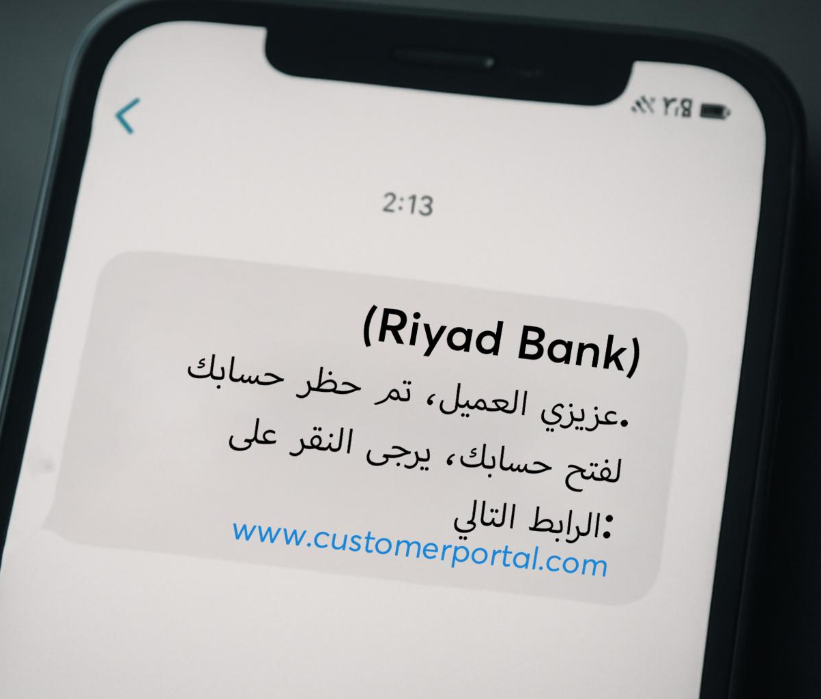


AI-generated content can now look and sound very real
- and that’s a risk
CREATING WITH AI
Fake news about local policies
Scam messages from "your bank"
Spread confusion
Trick you or your family
Affect your finances or safety
Let’s learn how to spot them
False health info circulating in family groups
Fake online ads targeting consumers
Understanding AI in your daily life
Notes:
SPEAKER NOTES:
Real Impact Examples:
"Fake news about government policies that could affect your benefits or taxes in Egypt, Lebanon or Jordan.
"Fraudulent business ads with AI-generated success stories targeting consumers"
"False health information that could hurt your family"
"Scam messages that look like they're from your bank"
Personal Stakes:
"This isn't about being a tech expert - it's about protecting your family and community from being misled or scammed."

Slide 16
Can you spot the AI image?
ACTIVITY
Notes:
SPEAKER NOTES
Setup & Confidence Building (1 minute):
"We're going to practice together. Remember, even experts get fooled sometimes. The goal is to get better at asking the right questions, not to be perfect."

Slide 17


Look at the two images on screen
CREATING WITH AI
One is a real photo
One is AI-generated
Vote: Which one do you think is fake?
Understanding AI in your daily life
Notes:
SPEAKER NOTES
High-Connectivity Version (4 minutes):
Photo Selection Strategy:
Choose images relevant to the Middle Eastern context (public figures, locations, events)
Select AI images with subtle but identifiable flaws
Avoid overly obvious fake images that might make participants feel patronized
Voting Process:
"Look at both photos for 30 seconds. Think about: Do the backgrounds make sense? Do the lighting and shadows match? Does anything feel 'off' even if you can't explain why?"
After voting:
"Before I reveal the answer, can someone share what made them choose their answer? What did you notice?"
Teaching Moment:
"The AI photo has [specific issue - unnatural hands, inconsistent lighting, strange background]. But notice - it's not obvious! That's why we need to be detectives, not just casual observers."
Low-Connectivity Version (4 minutes): Using Printed Examples:
Pass around printed photos for closer inspection
Give participants 2 minutes to examine both
Facilitate discussion about what they notice
Use magnifying glasses if available to show small details

Slide 18
Which message was written by a human?
ACTIVITY
Notes:
SPEAKER NOTES:
Setup (1 minute):
"AI is getting very good at writing, but it often doesn't sound quite human, especially when it comes to how we communicate locally.

Slide 19
Announcement
Announcement
Which one sounds more human? More local? More believable?
CREATING WITH AI
A new metro line will open next month, connecting Heliopolis to downtown Cairo; a new bus route will run from Hamra to downtown Beirut; and a new metro extension will be added to Dubai's Jumeirah Lakes Towers (JLT) network, connecting it to Expo City.
The governor announced this at a community meeting yesterday.
This will help reduce traffic congestion for daily commuters.
The government of Cairo, Beirut, and Dubai has implemented a new integrated transport corridor connecting key commercial areas. Fares have been set in the local currency.
This development, announced at an official meeting, will improve the efficiency of urban mobility.
Let’s break it down together.
Understanding AI in your daily life
Notes:
SPEAKER NOTES:
Read Both Examples Aloud (2 minutes):
Read the human-written example with natural inflection appropriate to your audience
Read the AI example in a more formal tone to highlight the difference
Group Analysis (3 minutes):
"What differences do you hear? Which one sounds like how you or your friends would actually write about transport news?"
Expected Responses & Follow-ups:
"The first one uses local expressions and easy to understand language → "Exactly! AI often misses local expressions that are natural to us"
"The second sounds too formal" → "Right! AI often sounds like it's trying to impress rather than communicate"
"The first feels more personal" → "Good observation! Humans write with emotion and personal stakes"
Practical Application:
"When you see messages about important local news - elections, policies, emergencies - ask yourself: Does this sound like how real people from here would write about it?"

Slide 20
Can you recognize manipulated audio/video content?
ACTIVITY
Notes:
SPEAKER NOTES:
Awareness Without Panic (3 minutes):
"I want you to be aware of something new: AI can now copy voices and faces. But don't worry - there are still ways to protect yourself."

Slide 21
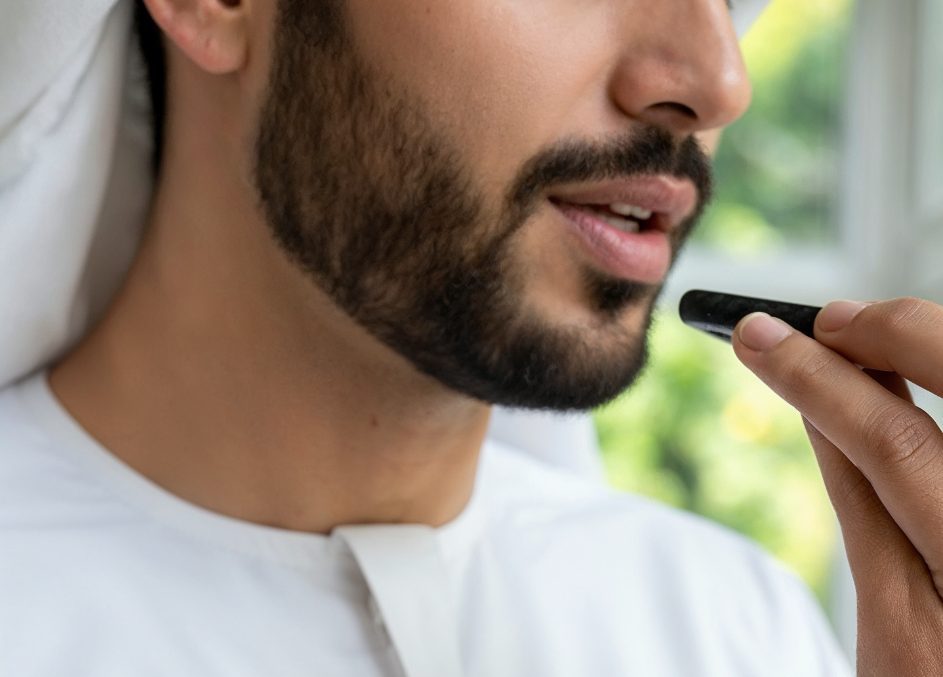

Manipulated content:
Audio and video
CREATING WITH AI
Imagine this
Does it sound human? Local? Believable?
Don’t trust voice notes or videos just because they sound/look real.
Use tools to double-check.
Always verify important information through
multiple sources.
A WhatsApp voice note from your “bank manager” asking for account details.
Awareness = Protection
Understanding AI in your daily life
Notes:
SPEAKER NOTES:
High-Connectivity Demonstration:
Play short example of AI voice generation (keep it brief and non-threatening)
Show how real people can spot inconsistencies
Low-Connectivity Alternative:
Describe the technology and show screenshots
Focus on practical protection strategies
Practical Protection (2 minutes):
"Here's what you need to know: If you get a voice message or video asking for money, personal information, or urgent action - even if it sounds like someone you know - verify through a different method. Call them back, text them separately, ask them something only they would know."
Real-World Application:
"This is especially important for protecting elderly family members who might get fake voice calls claiming to be from banks or government offices in your country."
Module 1 Transition:
"Now you know what to watch for. Next, let's understand how AI actually works, so you feel more confident using it as a tool."

Slide 22

Designing
AI
Notes:
SPEAKER NOTES:
Module 2: Designing AI (15 minutes)
Learning Objective: Participants understand AI capabilities and limitations enough to use it confidently and appropriately in daily life.

Slide 23

What AI really is:
In everyday language
DESIGNING AI
01
02
Think of AI as:
How it learns is like learning to cook:
A super-smart autocomplete (like your texting app — but way more powerful)
Watch lots of people (your mom, aunties, YouTube)
That’s how AI learns—just with way more data and no taste buds!
Practice many times
A pattern expert — it learns from millions of examples
Adjust your recipe
A creative assistant — it mixes ideas, but needs your direction
Eventually, create your own version
Understanding AI in your daily life
Notes:
SPEAKER NOTES:
Demystification Approach (3 minutes):
"AI sounds complicated, but the basic idea is simple. Let me give you an analogy everyone can relate to."
Cooking Analogy Development:
"Think about learning to cook your signature dish - maybe jollof rice, ugali, or bobotie. How did you learn?"
Expected responses: "Watching my mother", "YouTube videos", "Practice", "Trying different recipes"
Connect to AI:
"AI learns exactly the same way, but instead of watching a few people cook, it 'watches' millions of examples. Instead of making a few practice dishes, it practices millions of times. That's why it can get very good very fast."
Key Insight:
"But here's the important part - just like you need to taste and adjust your cooking based on your family's preferences, AI needs humans to guide it and make it useful for real life."
Address Common Concerns (2 minutes):
"Some people worry AI will replace humans. But think about it - even with all those cooking videos online, do you want a robot to cook for your family celebration? Or do you want the love, cultural knowledge, and personal touch that you bring? AI is the same - it's a powerful tool, but it needs your wisdom."

Slide 24



AI is already helping you - everyday
DESIGNING AI
Recommendation AI
Translation AI
Safety AI
YouTube shows Egyptian, Lebanese series, or Gulf TV programs that you might like.
Apps like Noon, Souq(Amazon), Carrefour suggest products based on your browsing
Spotify builds playlists from your music taste
Google Translate for Arabic, French, English…
WhatsApp translates messages from friends abroad
Voice assistants understand local accents
Bank apps alert you to suspicious activity
Spam filters protect your email
Face recognition unlocks your phone or secures your home
You’ve probably used AI today without realizing it.
Understanding AI in your daily life
Notes:
SPEAKER NOTES:
Types of AI You Use Daily
Recognition and Empowerment (4 minutes):
"Let's look at your smartphone like an AI expert would. I'll mention different features - nod if you've used them."
Go through each category with audience participation:
Recommendation AI (1 minute):
"YouTube shows Egyptian, Lebanese series, or Gulf TV programs, Apps like Noon, Souq (Amazon), and Carrefour suggest products you might like, Spotify creates playlists based on your musical taste. Have you noticed this? How accurate are these suggestions for you?"
Translation AI (1 minute):
"Google Translate, WhatsApp translation, voice assistants understanding different Egyptian, Levantine, or Gulf Arabic dialects. Has anyone used these to communicate with people who speak different languages?"
Safety AI (1 minute):
"Bank apps that text you about unusual spending, email that filters spam. These are protecting you automatically. Have you gotten these alerts?"
Behind-the-Scenes AI (1 minute):
"Even simple things like your camera automatically focusing on faces, or your phone's battery lasting longer because it learns your usage patterns."
Empowerment Message:
"You see? You're not an AI beginner - you're an experienced user who's now learning to be more intentional about it."

Slide 25
Generative AI:
AI that creates
Generative AI means AI that creates new content such as text, images, audio, and video.
Notes:
SPEAKER NOTES:
What is Generative AI?
Clear Distinction (3 minutes):
AI tools that help you create different forms of media, such as text, videos, and images, are referred to as 'generative' AI. Generative AI doesn’t just recognize patterns and analyze information; it can create new content based on patterns it has learned from large datasets.

Slide 26




You give it a prompt, it gives you a result:
DESIGNING AI
Text
Audio
Writes messages, articles, emails
Mimics voices, composes music
“Write a message congratulating a friend on their traditional wedding.”
“Make an image of a family celebration in Nairobi or Lagos.”
Images
Video
Creates pictures from your words
Produces realistic video clips
“Help me plan a small business launch.”
Understanding AI in your daily life
Notes:
SPEAKER NOTES:
Examples:
Think of generative AI as a system that learns from many examples and then generates similar content on its own. Generative AI can create:
Text: emails, reports, stories, chat responses
Images: artwork, product designs, illustrations
Audio: music, speech, voice cloning
Video: videos or animations
Code: software programs or scripts
For example, Meta AI is generative AI.
What is Meta AI?
Meta AI is an AI-powered digital assistant that helps users with everyday tasks. It is available within apps like Facebook, WhatsApp, Messenger, and Instagram, and can also be used on its own. Powered by Llama, Meta's language model, is designed to understand what people say and respond in a useful way. Users ask questions, write content, create images, or get help with everyday tasks.
Practical Examples (2 minutes):
Example 1 - Text Generation:
Generative AI can help you create text or written content
If you go to Meta AI and type the following prompt: "Write a message congratulating someone on their traditional wedding ceremony."
The output generated will be a congratulatory message which you can share with the couple
Example 2 - Video Generation
Input to Meta AI: "Generate a short video of a busy city market.”
Output: Short video showing a market scene
Real-World Applications:
Writing professional emails or messages
Creating social media content
Designing simple graphics or flyers
Creating graphics for small business advertising
Set Realistic Expectations:
"It's like having a very knowledgeable assistant who works for free, but sometimes gives wrong answers and needs you to double-check their work."
Additional note to participants: Remember to state that any content generated using AI, particularly content that resembles or depicts real people, is AI-generated when it is shared publicly.
Discussion Exercise: What are the most applicable or impactful uses of AI in your field of work?

Slide 27
AI is powerful but
not human
DESIGNING AI
01
02
AI might write about your culture but it doesn’t understand:
What AI Can Do
What AI Cannot Do
Spot patterns
Feel emotions
The feeling of national cultural days
Generate text, images, and videos
Understand culture or context
The meaning behind local proverbs
Talk and respond
Think like a human
The experience of traditional weddings or events in your country
Learn from large data sets
Always be right
Understanding AI in your daily life
Notes:
SPEAKER NOTES:
AI Limitations - Reality Check
Honest Discussion (5 minutes):
"It's important to understand what AI cannot do, so you don't rely on it for the wrong things."
“Here are a few examples”
“AI is great at finding patterns—like knowing what videos you might like next on YouTube, but it doesn’t get happy, sad, or excited. It doesn’t have feelings like you do.”
“AI can chat with you, write poems, or even help you with homework ideas, but it might not understand why koshari is so special in Egypt, or what a Saudi wedding feels like—it needs people to explain it.”
“AI can recognize faces in photos or understand your voice, like when you say “Hey Google!” but it doesn’t have common sense or know what’s right or wrong on its own.”
“The more examples AI sees, the better it gets—just like practicing makes you better at football or drawing, but it can make mistakes! Sometimes it guesses wrong or gives silly answers—so always double-check.
Typical Example from the Middle East (2 minutes):
"AI might write about Egyptian, Lebanese, Jordanian, or Gulf culture, but it doesn't understand the feeling of community during Ramadan or Eid, the real meaning behind local proverbs and sayings like 'bukra fi al-mishmish' (meaning it might never happen) or 'yalla habibi', or the lived experience of Cairo's traffic jams, Beirut's Corniche, or Dubai's metro during rush hour. This human understanding is irreplaceable
Practical Implications (1 minute):
"Use AI for information, ideas, and first drafts. But for important decisions - especially about family, money, health, or relationships - you need human wisdom, local knowledge, and cultural understanding."
Module Transition:
"Now that you understand what AI can and can't do, let's explore how to use it practically in your daily life."

Slide 28

Managing AI
Practical AI tools for everyday life
Notes:
SPEAKER NOTES:
Module 3: Practical AI Tools for Everyday Life (15 minutes)
Learning Objective: Participants can identify and use AI tools to solve common daily challenges while maintaining appropriate human judgment.

Slide 29


Let AI help you write clearly and confidently
MANAGING AI
Professional Communication
Personal Use
Write job application emails
Write birthday or condolence messages
Draft polite complaint letters
Translate messages for friends or family abroad
Create clear WhatsApp business messages
Draft announcements or celebration posts
AI gives you structure.
You bring the heart.
Understanding AI in your daily life
Notes:
SPEAKER NOTES:
Communication & Writing Help
Practical Value Proposition (2 minutes):
Many people wish they were better at writing professional emails or formal letters. AI can help with this, while you focus on the context.
We are going to explore a live demonstration shortly but in the meantime, think about all the different ways AI can help you write better whether its professionally or personally.
Some simple ways outlined here include:
Writing job applications and essays
Drafting letters and business messages
Writing congratulatory messages to friends and family
Translating content from one language to another
Ask the audience for other ways they think they can use AI to generate text.

Slide 30

Generating text with Meta AI
ACTIVITY
Notes:
SPEAKER NOTES:
Live Demonstration
Let’s try a quick demonstration using Meta AI to generate text.

Slide 31
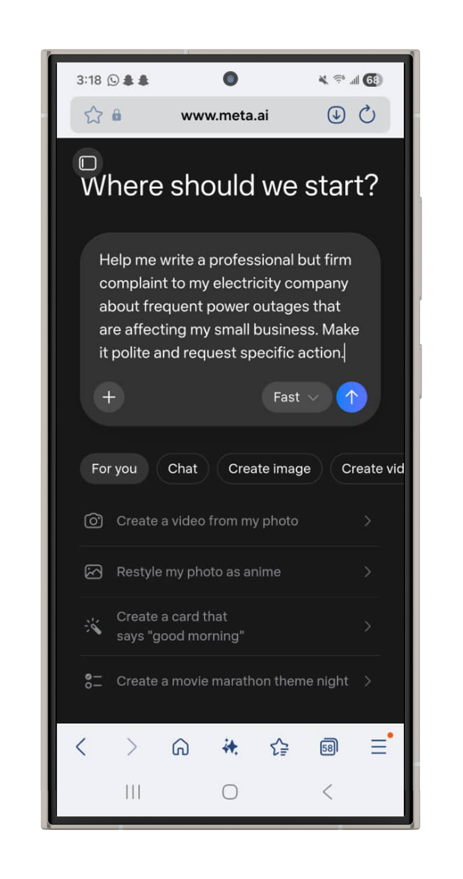
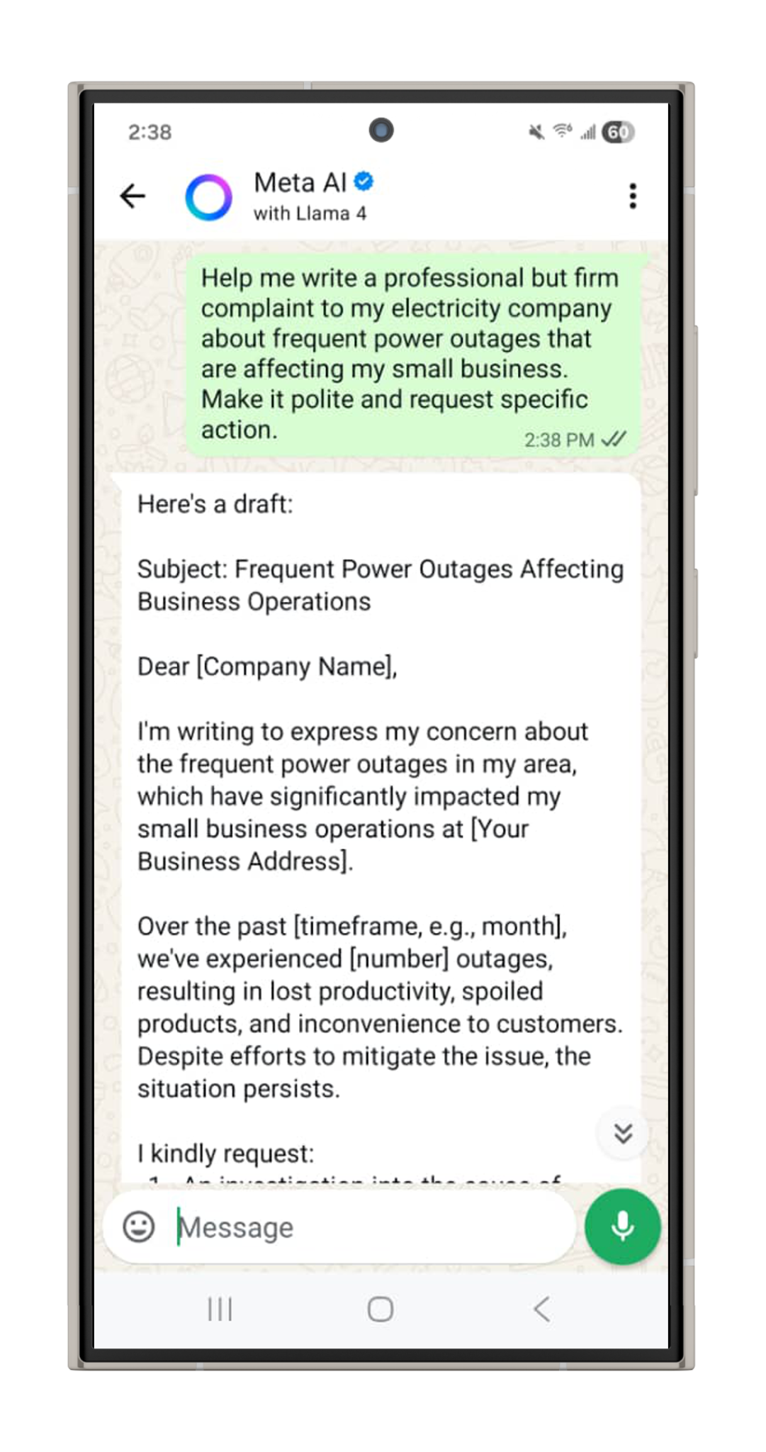
Use Meta AI to write a professional email.
MANAGING AI
Prompt Example
Help me write a professional but firm complaint to my electricity company about frequent power outages that are affecting my small business. Make it polite and request specific action.
Next Steps
1
Go to Meta AI on your phone/ computer browser or WhatsApp
2
Enter the prompt into Meta AI
3
Review the generated text
4
Edit or refine the prompt to improve the result
Meta AI on web
Meta AI on WhatsApp
Understanding AI in your daily life
Notes:
SPEAKER NOTES:
Live Demonstration
High-Connectivity Option: Go to Meta AI on your computer or phone browser, or open WhatsApp on your phone and search for 'Meta AI' in your contacts.
Now, the first step when working with any AI tool is creating a prompt. A prompt is the instruction or request you give to an AI system or tool to tell it what you want it to do or generate. The clearer and more specific your prompt is, the better the response will be.
To make this practical, let’s use a real-life situation. Imagine you need to write a message about a problem you’re experiencing—for example, complaining about poor electricity service or asking your landlord to repair a damaged fence.
Example Prompt: "Help me write a professional but firm complaint to my electricity company about frequent power outages that are affecting my small business. Make it polite and request specific action."
Once we submit the prompt, Meta AI will generate a draft message that you can edit, refine, or send
Low-Connectivity Alternative (5 minutes):
Show pre-written examples of AI-assisted communication
Compare "before" and "after" versions
Discuss how to improve AI writing with personal details
Practice identifying which parts need human touch
This short exercise shows how generative AI can support everyday communication, helping us save time, improve the quality of our writing, and express our ideas more clearly.
Whether you’re writing emails, requests, complaints, reports, or even creative content, AI tools like Meta AI can act as a helpful assistant that turns simple instructions into well-structured messages.
The key takeaway is simple: when you give AI a clear prompt, it can help you communicate more effectively and solve everyday problems faster.
Key Teaching Points:
AI gives you structure and professional language
You provide personal details and cultural context
Always read and edit before sending
The relationship and follow-up are still human responsibilities
Instructions for Facilitators
Share your screen while going through the live demonstration to show the process of inputting prompts and getting outputs.

Slide 32




MANAGING AI
Solving everyday challenges with AI
Plan a Wedding on a Budget
Learn a New Skill
Market a Small Business
Conduct Research
Find local service providers and get ideas for food menus (such as koshari, kabsa, mansaf)
Compare prices, build a guest list
Personalized learning plans for digital, creative, or trade skills
Get explanations, practice exercises
Generate social media captions and hashtags
Design flyers or business bios
Summarize articles on health, economics, policies, etc
Prepare questions for your doctor, lawyer, policymakers, etc
Understanding AI in your daily life
Notes:
SPEAKER NOTES:
Daily Problem Solving
Group Problem-Solving Activity (8 minutes):
"Let's practice thinking about AI as a brainstorming partner. I'll give you real-life situations, and we'll explore how AI could help."
Scenario-Based Learning: Divide into groups of 3-4, assign scenarios (4 minutes):
Scenario 1: Wedding Planning
Challenge: Planning a traditional wedding for 100 people on a tight budget
AI Applications: Venue comparison, menu planning, decoration ideas, budget tracking
Human Elements: Cultural traditions, family dynamics, local vendor relationships
Scenario 2: Learning New Skills
Challenge: Adult wants to learn computer skills for better job opportunities
AI Applications: Personalized learning plan, practice exercises, progress tracking
Human Elements: Motivation, hands-on practice, networking with other learners
Scenario 3: Small Business Marketing
Challenge: Local business needs to attract more customers
AI Applications: Social media content ideas, flyer design, customer communication
Human Elements: Understanding local customers, building trust, personal service
Group Sharing (4 minutes):
Each group shares their best AI application idea
Discuss what AI couldn't handle in each scenario
Emphasize the AI-human partnership model
Key Insight:
"Notice how in every case, AI helps with the technical or creative grunt work, but you provide the local knowledge, personal relationships, and cultural understanding that make solutions actually work."

Slide 33



Let AI
spark your creativity
MANAGING AI
Family & Community Events
Poetry & Writing
Cultural Content
Create posters, invites, or social media posts
Decorate with AI-generated ideas for birthdays, weddings, or cultural holidays
Write a short poem for someone special
Craft a story or tribute message
Describe local traditions
Generate ideas for community presentations
Create visuals of traditional foods: pounded yam, sukuma wiki, biltong
Understanding AI in your daily life
Notes:
SPEAKER NOTES:
Creative Projects
AI can help you properly build out your more creative ideas or pursuits. This can include creating visuals for events, getting ideas for presentations, or writing stories or books.
We are going to explore another demonstration shortly but a good reminder is that AI often doesn't understand our specific cultural celebrations, traditional foods, or local customs. That's where your knowledge makes AI outputs actually useful and appropriate.
For example, after typing in your prompts and getting ideas:
"AI might suggest generic party food, but you know what your community actually enjoys eating"
"AI might miss important cultural protocols for invitations or announcements"
"AI doesn't understand the timing of local events or religious considerations"
It is important that you include appropriate context and cultural knowledge where possible to make sure you get the best output.
Empowerment Message:
"Your cultural knowledge isn't a limitation - it's your superpower when working with AI."

Slide 34
Generating images using Meta AI
ACTIVITY
Notes:
SPEAKER NOTES:
Image Generation Demonstration
Let’s look at another quick demonstration, this time showing how Meta AI can generate images.

Slide 35
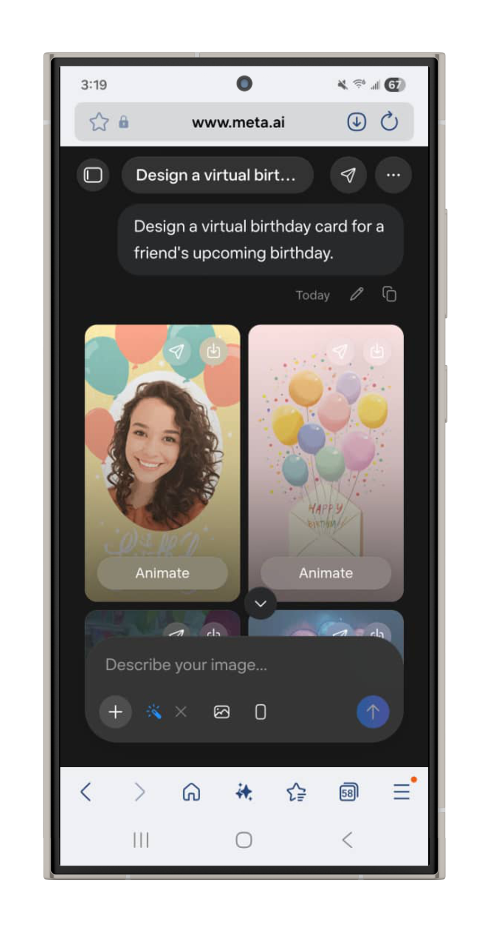
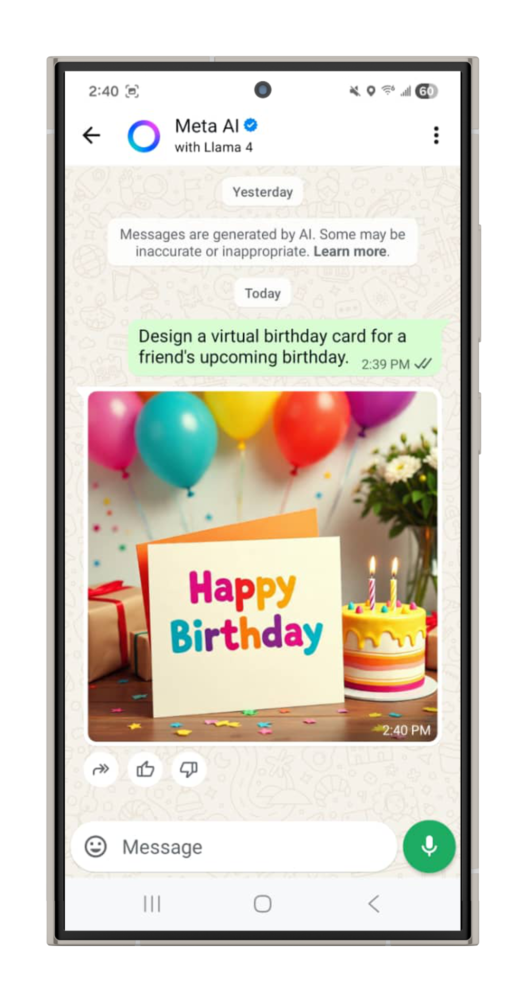
Let’s use another demonstration to show how you can generate images using Meta AI
MANAGING AI
Prompt Example
Design a virtual birthday card for a friend's upcoming birthday.
Next Steps
1
Go to Meta AI on your phone/ computer browser or WhatsApp
2
Enter the prompt into Meta AI
3
Review the generated images
4
Edit the prompt to improve the results (if needed)
5
Select your most preferred option
Meta AI on web
Meta AI on WhatsApp
Understanding AI in your daily life
Notes:
SPEAKER NOTES:
Image Generation Demonstration
High Connectivity Option
Earlier we used AI to create text. Now we’ll see how the same tool can create visual content from a simple description.
Just like before, the process starts with a prompt. In image generation, the prompt describes what you want the AI to create.
For this example, imagine you want to create a quick birthday card for a friend but don’t have design skills or design software. Meta AI can help generate one for you.
Here is the prompt we’ll use:
Example Prompt "Design a virtual birthday card for a friend's upcoming birthday."
Now let’s walk through the steps.
First, go to Meta AI using your phone or computer browser. You can also access it through WhatsApp by searching for “Meta AI” in your contacts.
Next, enter the prompt into Meta AI and submit it.
Within a few moments, the AI will generate several image options based on your request.
Take a moment to review the generated images. You may see different styles, colors, or layouts.
If the result isn’t exactly what you want, you can edit or refine your prompt. For example, you could ask for a specific style, color theme, or message on the card.
Finally, choose the version you like the most. You can then download it and share it digitally.
Low-Connectivity Option:
Show examples of AI-generated creative content
Discuss how to improve them with personal knowledge
Practice writing prompts for future use
This example shows how AI can help with creative tasks, even if you don’t have design experience.
With just a simple description, tools like Meta AI can help you generate visuals, explore ideas, and create personalized content in seconds.

Slide 36
Generating videos using Meta AI
ACTIVITY
Notes:
SPEAKER NOTES:
Video Generation Demonstration
Let’s look at one more example of how AI can help create content—this time using AI to generate videos.

Slide 37
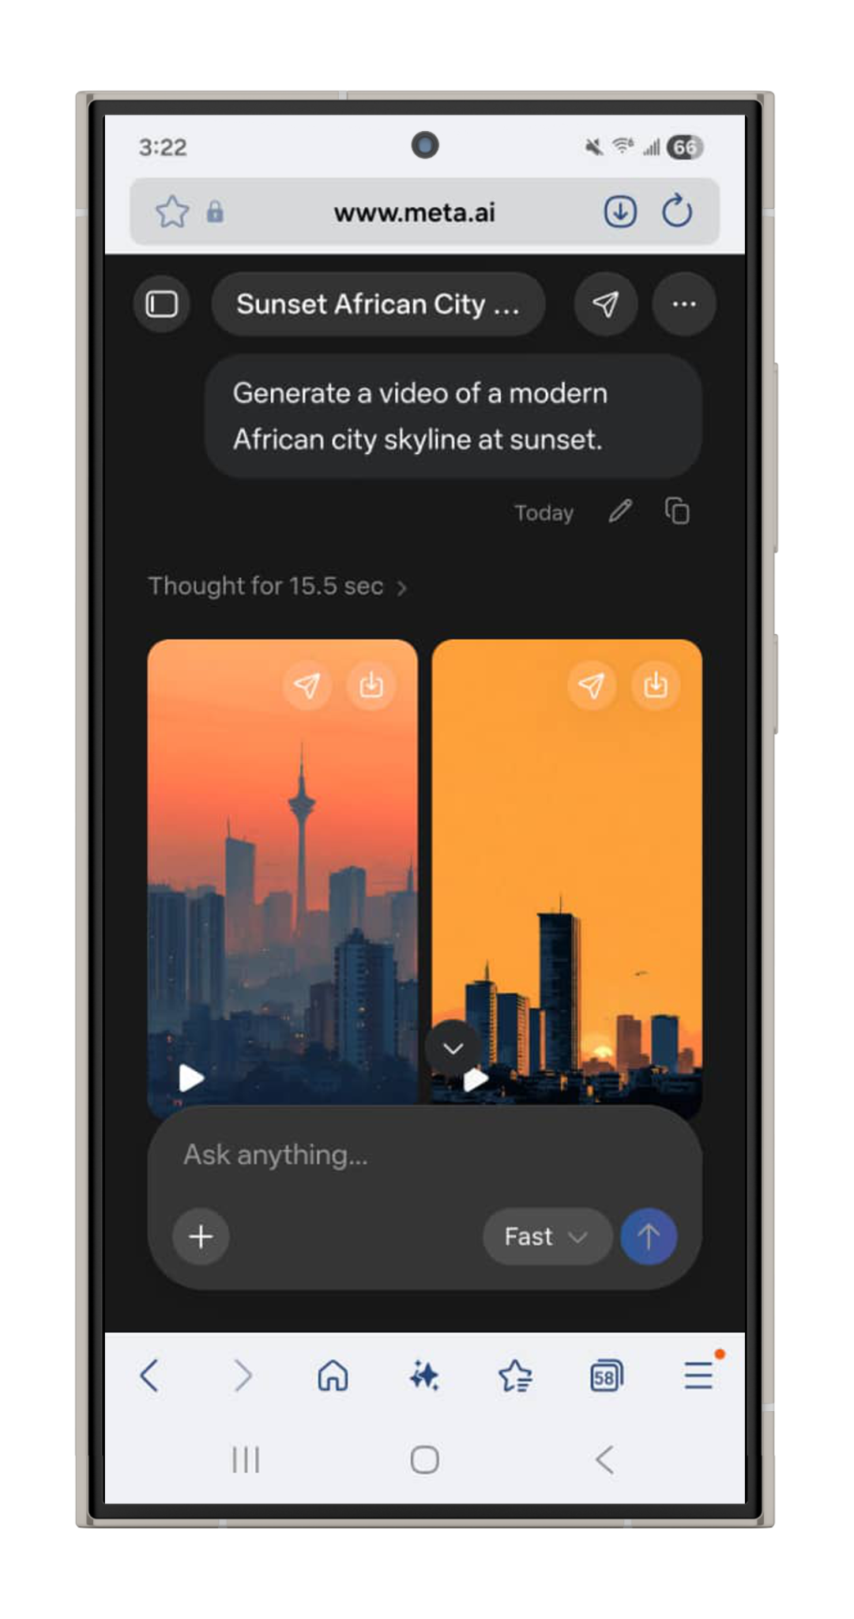
You can also use AI tools like Meta AI to generate videos.
MANAGING AI
Prompt Example
Generate a video of a modern African city skyline at sunset.
Next Steps
1
Go to Meta AI on your phone/ computer browser or WhatsApp
2
Enter the prompt into Meta AI
3
Review the generated videos
4
Edit the prompt to improve the results (if needed)
5
Select your most preferred option
Meta AI on web
Understanding AI in your daily life
Notes:
SPEAKER NOTES:
Video Generation Demonstration
High Connectivity Option
Just like with text and images, AI tools can also create short videos based on a simple written prompt. This means that instead of recording or editing footage yourself, you can describe what you want to see and the AI will generate it.
Again, the process begins with a prompt, which tells the AI what kind of video to create.
For this demonstration, we will use a simple example:
Example Prompt "Generate a video of a city landscape."
You may include some additional details, such as:
Where is it located? (city center, neighborhood street, coastal town)
Time of day (morning, afternoon, evening)
What is in the scene? (skyscrapers, bridges, roads)
What actions are happening? (people walking, cars, and buses on the streets)
Now let’s go through the steps together.
First, go to Meta AI on your phone or computer browser. You can also open WhatsApp and search for “Meta AI” in your contacts.
Next, enter the prompt into Meta AI, including the details and submit it.
The AI will then generate one or more short video clips based on the description you provided.
Take a moment to review the generated videos and observe how the AI interpreted the prompt.
If the video is not exactly what you expected, you can refine the prompt. For example, you might specify additional details such as the type of city or the atmosphere, e.g a modern city skyline at sunset or a busy nighttime city street with lights.
Finally, choose the version you like best.
AI can make video creation faster and more accessible, even for people without video production experience. You can visualize different ideas, create content, and experiment with different styles.
Additional note to participants: Remember to state that any content generated using AI, particularly content that resembles or depicts real people, is AI-generated when it is shared publicly.

Slide 38



Let AI
spark your creativity
MANAGING AI
Language Learning
Skill Development
Information Research
Practice English or local languages
Learn professional or technical vocabulary
Explore formal vs. informal communication
Get simple explanations for complex topics
Build personalized study plans
Generate practice questions
Summarize long articles or documents
Break down policies, contracts, or health information
Research purchases (phones, housing, loans)
Understanding AI in your daily life
Notes:
SPEAKER NOTES:
Learning & Information
Lifelong Learning Approach (2 minutes):
"Many adults want to keep learning but feel intimidated by formal education. AI can be like having a patient tutor available 24/7."
Practical Applications:
Language Learning (1 minute):
Practice English conversations for job interviews
Learn formal vs. informal communication styles
Understand professional vocabulary in your field
Skill Development (1 minute):
Get complex topics explained in simple terms
Create personalized practice exercises
Break down overwhelming subjects into manageable steps
Information Research (1 minute):
Summarize long government documents or policies
Understand banking or insurance terms
Research before major purchases (cars, appliances, housing)
Critical Safety Reminder:
"AI is excellent for learning and research, but for important decisions about your money, health, or legal matters, always verify with human experts. Use AI to prepare better questions for professionals, not to replace professional advice."
Module Transition:
"You now know how AI can help you daily. But to use it safely, you need to know how to protect yourself and your family..."

Slide 39
How to use Meta AI directly on WhatsApp
ACTIVITY
Notes:
SPEAKER NOTES:
Using Meta AI in WhatsApp
“Now we’re going to look at one of the simplest ways to use Meta AI — directly inside WhatsApp. This means you don’t need a new app or a browser to access Meta AI.”

Slide 40
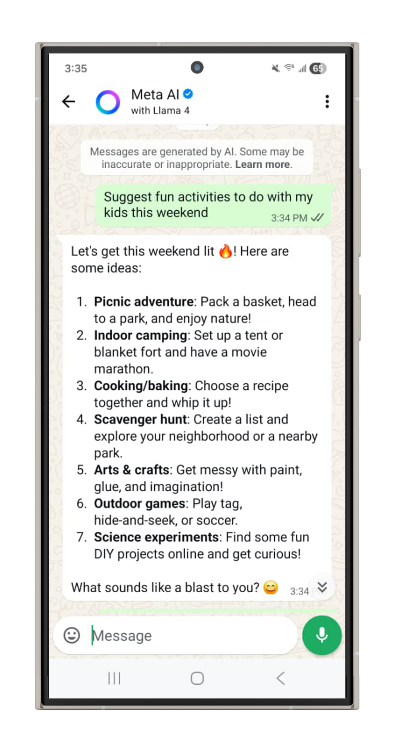
You can use Meta AI directly on your WhatsApp to learn new topics, get quick answers, and suggestions.
MANAGING AI
Prompt Example
Suggest fun activities to do with my kids this weekend.
Next Steps
1
Open WhatsApp on your phone
2
Search for Meta AI in your contacts
3
Open the chat and type in your prompt
4
Review the results
Understanding AI in your daily life
Notes:
SPEAKER NOTES:
High-Connectivity Demonstration (2–3 minutes)
Live Walkthrough:
Open WhatsApp and search for Meta AI in my contacts. Once the chat is open, you can start asking questions right away.”
“Think of this as having a smart assistant in your pocket — you can ask for ideas, get quick answers, or plan everyday activities.”
Live Prompt Example:
“Let’s try a practical question together: Suggest fun activities to do with my kids this weekend in Dubai.
Demonstration:
Send the prompt to Meta AI in WhatsApp
Read a few suggestions aloud
Ask participants which ideas they like or would try
Follow-Up Prompting:
“Now let’s ask a follow-up question, like: Can you suggest free outdoor options? Notice how Meta AI remembers the context of our conversation.”
Wrap-Up Message:
“Meta AI works best when you treat it like a conversation. You can ask follow-up questions, refine your request, and keep going until the response fits your needs.”

Slide 41

AI safety & protection
Notes:
SPEAKER NOTES:
Module 4: AI Safety & Protection (15 minutes)
Learning Objective: Participants can protect themselves and their families from AI-related risks using practical verification and privacy strategies.

Slide 42
AI SAFETY & PROTECTION
Verify before
you trust or share
A simple way to check information before you trust or share it
V
E
R
I
F
Y
Verify the Source
Examine the Details
Research Elsewhere
Investigate with Tools
Focus on Impact
Yield to Experts
Who created it? Is it trustworthy or official?
Are there spelling errors, strange photos, or dramatic language?
Look for the same info on trusted news or government websites.
Use reverse image search or fact-checking sites.
Could this harm someone if it’s false?
Ask a doctor, lawyer, or other professional when it’s serious.
Understanding AI in your daily life
Notes:
SPEAKER NOTES:
The VERIFY Method
Mnemonics Introduction (2 minutes):
"You need a simple system you can remember and teach to your family. VERIFY is designed to be easy to remember and use, even when you're busy or emotional."
Step-by-Step Teaching (6 minutes):
V - Verify the Source (1 minute):
"Before you believe or share anything, ask: Who created this? Is it from an organization or person you know and trust? If you can't identify the source, be extra careful."
Example:
"If you see news about changes to government benefits, check if it's from official government websites, a trusted news sources, or verified social media accounts."
E - Examine the Details (1 minute):
"Look carefully at the content. Are there spelling mistakes? Does the language sound natural? Do photos look realistic? Trust your instincts if something feels 'off.'"
Practical Tip:
"If something makes you very angry or very excited, that's when you most need to slow down and examine it carefully."
R - Research Elsewhere (1 minute):
"Don't rely on just one source. Search Google for the same story. See if multiple trustworthy sources report the same information."
Explanatory Tip:
"Search using specific terms such as: 'Ministry of [Country's] Fuel Subsidy Announcement 2025' or 'Bank Name + Official Statement’.
"I - Investigate with Tools (1 minute):
"Use reverse image search on suspicious photos. Check fact-checking websites. Ask people you trust who might know more about the topic."
Tool Demonstration:
Show how to reverse image search on phone and computer
Mention local fact-checking resources like Fatabyyano, Misbar, and the Arab Fact-Checkers Network) if available
F - Focus on Impact (1 minute):
"Before sharing, ask yourself: Could this hurt someone if it's wrong? Could it cause panic, damage someone's reputation, or lead people to make bad decisions?"
Examples:
Health misinformation that could delay medical treatment
False business information that could hurt someone's livelihood
Fake emergency information that could cause unnecessary panic
Y - Yield to Experts (1 minute):
"For important decisions about health, money, legal issues, or safety, consult human experts. Use AI and online information to prepare better questions, but get final advice from qualified professionals."
Practice Application:
"Let's practice with a simple example: If someone shares a message claiming banks will close all accounts next week unless you update your information immediately, how would you use VERIFY?"
Walk through each step with the group

Slide 43
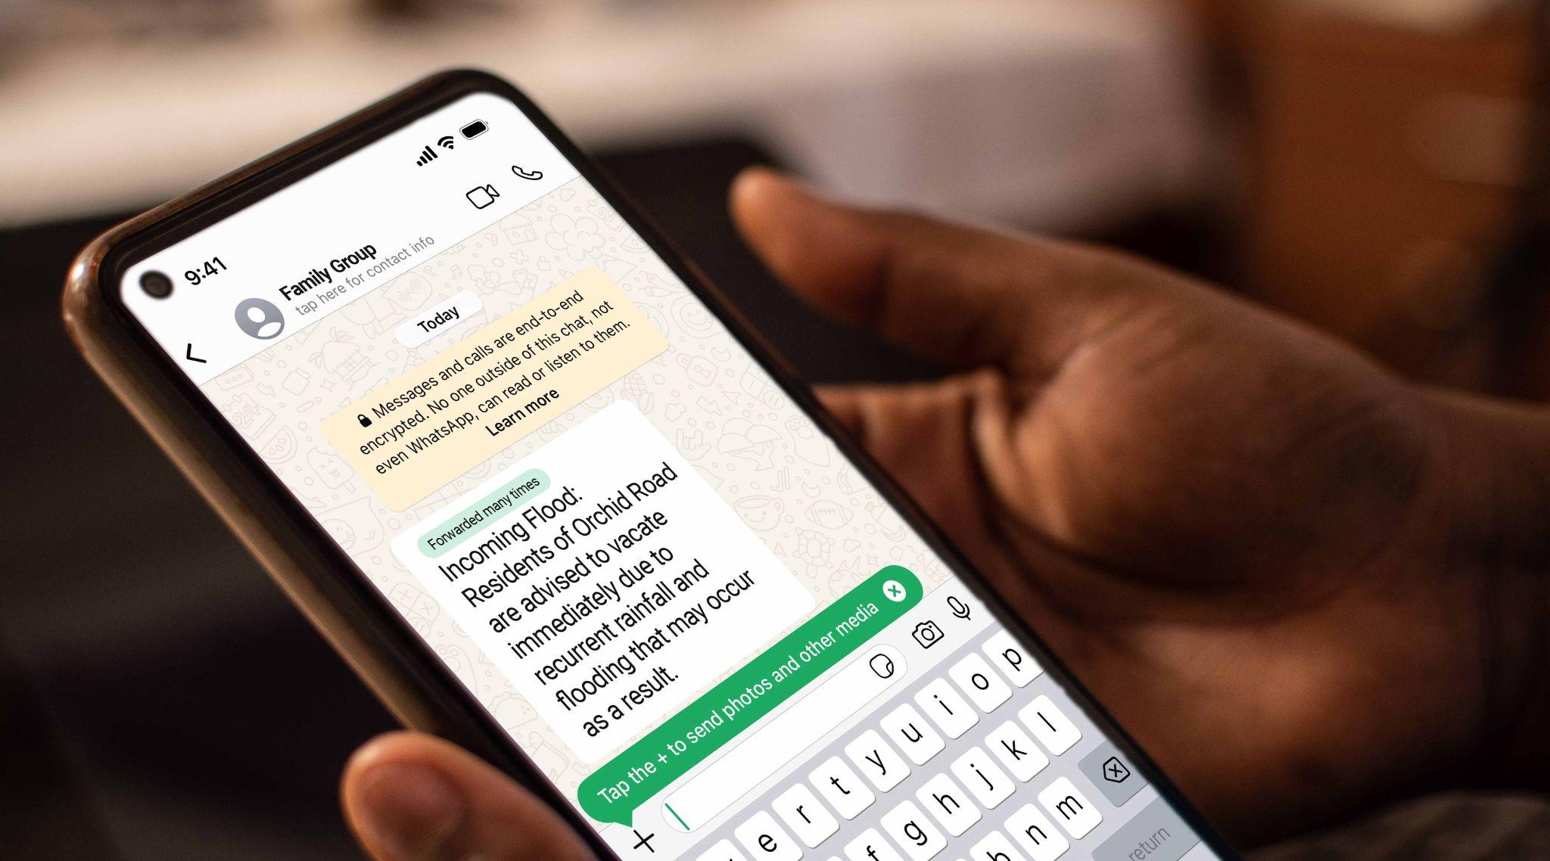


AI SAFETY & PROTECTION
What would you do? VERIFY in action
Scenario 1
Scenario 2
Scenario 3
Family WhatsApp Group
Online Shopping Deal
Health Article from a Friend
Your uncle shares a message claiming a new government policy affects your area. It looks official and asks you to forward it.
What do you do?
You see a Facebook ad offering brand-new phones at unusually low prices. The reviews look great, but the pictures seem too perfect.
What do you check?
A friend sends you a link to a home remedy that claims to cure a serious condition. It looks scientific. Your relative has that condition.
What steps do you take?
Use VERIFY
to guide your response.
Understanding AI in your daily life
Notes:
SPEAKER NOTES:
Real-World Safety Scenarios
Scenario-Based Learning (7 minutes):
"Let's practice with situations that could really happen to you or your family members."
Scenario 1: Family WhatsApp Group (2.5 minutes): Setup:
"Your uncle, who you trust and who usually shares accurate information, forwards a message to your family WhatsApp group. It has a government-looking logo and claims there's a new policy affecting your area. The message asks everyone to forward it to warn others. You're not sure if it's true."
Group Discussion Process:
Give participants 1 minute to discuss in pairs
Ask for their VERIFY method applications
Guide them through each step if they miss any
Emphasize the emotional challenge: "This is hard because you trust your uncle, but even trusted people can accidentally share false information"
Teaching Points:
Source: Government logo doesn't mean government-created
Details: Official announcements usually come through official channels
Research: Check government websites and known news sources
Impact: False policy information can cause unnecessary stress and poor decisions
Scenario 2: Online Shopping Safety (2.5 minutes): Setup:
"You see an amazing deal on Facebook - brand new smartphones for much cheaper than store prices. The seller's profile looks real, has good reviews, and shows photos of happy customers with their purchases. But the photos of the phones look almost too perfect."
Discussion Guide:
Let groups work through VERIFY method
Focus on practical protective actions
Address the emotional element: "Good deals are exciting, but scammers know this"
Key Teaching Points:
Reverse image search on product photos
Check if reviews and customer photos seem authentic
Verify business registration or physical location
Use secure payment methods that offer buyer protection
Scenario 3: Health Information (2 minutes): Setup:
"A friend shares an article claiming a simple, inexpensive home remedy can cure a serious health condition that affects your family member. The article looks professional, mentions scientific studies, and has testimonials from people who say it worked."
Critical Teaching Points:
Health misinformation can have serious consequences
Professional-looking doesn't mean medically accurate
Always consult healthcare providers for medical decisions
Use VERIFY method, but prioritize expert consultation

Slide 44

AI is powerful but
not human
AI SAFETY & PROTECTION
01
02
Red Flags
Safe to Share with AI Tools
Not Safe to Share
AI apps asking for too many permissions
General location (e.g., your city or country)
Bank account numbers or internet banking details
Free tools asking for sensitive info
Creative prompts (e.g., “Write a poem about Ramadan or National Day”)
Government ID or passport info
Apps that pressure you to act immediately
Public info and general questions
Private conversations, voice notes, or images of others
Your data is important. Be mindful of how you share it.
Photos of your home, children, or ID documents
Understanding AI in your daily life
Notes:
SPEAKER NOTES:
Privacy Protection
Practical Privacy Education (4 minutes):
"Privacy protection isn't about being paranoid - it's about being smart with your personal information."
When Using AI Tools (2 minutes): Do NOT Share:
National ID numbers, or other government identification
Banking details or PINs
Photos of official documents
Exact home addresses or daily routines
Safe to Share:
General location (Cairo, Beirut, Amman, Riyadh, Doha, Dubai, not specific address)
General interests and preferences
Non-sensitive photos and creative content
Learning and work-related questions
Red Flags to Watch For (2 minutes):
"Trust your instincts. If something feels wrong, it probably is."
Warning Signs:
Apps asking for permissions they don't need (why does a calculator need your contacts?)
Pressure to download or sign up immediately
Offers that seem too good to be true
Requests for sensitive information via unofficial channels
The Middle Eastern Context Consideration:
"Be especially careful with apps or services that aren't well-established in Egypt, Lebanon, Jordan, or the Gulf States. Some international services may not follow the same privacy standards we expect, and some may not have local customer support if something goes wrong."

Slide 45


Be the digital guardian in your community
AI SAFETY & PROTECTION
Teach Your Family and Friends
When You See Harmful Content
Share the VERIFY method
Don’t forward it - even to “warn others”
Help older relatives check messages
Report it on the platform
Message people privately if they’re affected
Your digital habits protect your entire network.
Teach children about fake content and AI tools
For serious threats or scams, contact local authorities
When you check before sharing, you’re not just being careful - you’re building a safer internet for everyone.
For intimate image threats, contact helplines and report to stopNCII.org
Understanding AI in your daily life
Notes:
SPEAKER NOTES:
Protecting Your Family
Community Responsibility Approach (2 minutes):
"Your AI literacy doesn't just protect you - it protects your whole network. You become a trusted source of digital wisdom for your family and community."
Teaching Others (1 minute):
Share VERIFY method with family members
Help elderly relatives recognize suspicious content
Teach children about AI content they might encounter online
Be patient - remember how you felt before learning these skills
When You Encounter Harmful Content (1 minute): Action Steps:
Don't share it further (even to warn people - this can spread it more)
Report it on the platform using official reporting tools
Inform affected people directly through private messages
Contact authorities for serious threats or scams
Building Community Resilience:
"When you fact-check before sharing, when you help others verify information, when you report harmful content - you're not just protecting yourself. You're helping build a safer, smarter digital community for all."

Slide 46

AI and your future
Notes:
SPEAKER NOTES:
Learning Objective: Participants feel empowered to pursue AI-related opportunities and see themselves as creators, not just consumers, of AI technology.

Slide 47





You can build a career in AI
AI is growing
across the world
AI Researchers
Data Scientists
AI Artists
AI Teachers
AI Entrepreneurs
AI & YOUR FUTURE
Which of these careers sounds most exciting to you—and why?
Shape AI advancements by researching and analyzing information that can help progress AI developments
Help companies solve real problems using data.
Create digital art for movies, music videos, and TikTok filters
Become an educator or trainer for the next generation of AI professionals
Build AI apps to solve local problems in agriculture, education, health, etc
Understanding AI in your daily life
Notes:
SPEAKER NOTES:
Relevance Establishment (2 minutes):
"AI isn't just happening in Silicon Valley or Beijing - it's creating real job opportunities right here in the Middle East. And you don't need to be a tech genius to participate in this growing field."
Career Pathways Overview (5 minutes):
AI Researchers & Specialists (1 minute): "Professionals like Dr. Latifa Al-Abdulkarim are leading global conversations about making AI fair and inclusive. Right now, researchers across the Middle East are working on AI that understands our languages, recognizes our faces accurately, and solves problems unique to Middle Eastern contexts."
Data Scientists & Analysts (1 minute): “Companies like Careem in the UAE, STC Pay in Saudi Arabia, and NOON in Egypt employ data professionals who use AI to detect fraud, predict customer needs, and improve services. These are learnable skills - many data scientists started in fields like accounting, statistics, or business analysis."
AI Business Applications (1 minute): "There's growing demand for people who can help Middle Eastern businesses adopt AI tools - consultants who advise banks on chatbots, specialists who help retailers optimize inventory, professionals who train staff on AI tools. Your business experience is valuable here."
AI-Enhanced Creative Work (1 minute): "Artists and digital creators on the continent are using AI to improve local media content, and support advertising. Graphic designers, writers, and marketers who understand AI tools have a competitive advantage. Don’t be left out."
AI Teachers & Trainers (1 minute): "As AI grows in the Middle East, there's huge demand for people who can teach others - not just in universities, but in companies, community centers, and online platforms. If you have teaching experience or enjoy helping others learn, this could be your pathway into AI."
AI Entrepreneurs & Innovators (1 minute): "Adults across the Middle East are building AI-powered businesses - apps that help small businesses with accounting, platforms connecting informal workers with opportunities, solutions improving healthcare access in underserved areas. They're solving Middle Eastern problems with Middle Eastern solutions."
Skills Translation Exercise (2 minutes):
"Let's think about your current skills. If you work in:"
Customer service → You understand user needs (valuable for training AI chatbots)
Sales or marketing → You know persuasive communication (valuable for AI content tools)
Administration → You manage information (valuable for data preparation work)
Teaching or training → You explain complex ideas simply (valuable for AI education roles)
Interactive Discussion: "What skills from your current work could transfer to AI-related careers? Let's hear from a few people."
Practical Pathways (2 minutes):
You Don't Need to Start Over: "Many AI careers don't require you to become a programmer. You can:"
Add AI skills to your current role (use AI tools to work more efficiently)
Transition gradually (learn AI applications in your industry)
Specialize in AI training or support (help others in your company adopt AI)
Consult or freelance (advise small businesses on AI tools)
Getting Started:
Free online courses teach AI basics
Professional certificates available in months, not years
Many roles value your life experience and local knowledge
Start by mastering AI tools relevant to your current work
Empowerment Message (1 minute):
"The AI field needs people who understand the Middle Eastern contexts - our markets, our challenges, our cultures. Your knowledge of how things actually work here in the Middle East is valuable. You're not behind - you're exactly who the AI industry in the Middle East needs."
Reality Check: "This isn't about overnight success or getting rich quick. It's about recognizing that AI is creating new opportunities, and your existing skills and knowledge can help you access them. Start where you are, use what you have, learn what you need."

Slide 48
What skills do you need in an AI world?
Notes:
SPEAKER NOTES:
Relevance Establishment (1 minute):
"You don't need to become a computer programmer to thrive in an AI-enabled workplace. The most valuable skills are ones you likely already have - they just need to be applied in new ways."

Slide 49




You don’t have to be a coder to thrive with AI
AI & YOUR FUTURE
Critical Thinking
Question information, evaluate sources, and make sound judgments.
Creativity
Use AI to support your imagination—not replace it. Create content, solve problems, and bring new ideas to life.
Here are 4 powerful skills that make YOU valuable in the AI future.
How could you use these skills in your school, family, or community?
Digital and Data Literacy
Understand how tech works, what data is and how to use or interpret it safely and responsibly.
Computational Thinking
Breaking down problems into smaller steps, spotting patterns, providing instructions, and creating logical processes that an AI system can follow.
Understanding AI in your daily life
49
Notes:
SPEAKER NOTES:
Core Skills Overview (7 minutes):
Critical Thinking & Judgment (2 minutes):
"AI can process information quickly, but it can't apply wisdom, cultural context, or ethical judgment. Your ability to evaluate information critically becomes more valuable, not less."
Practical Applications:
Evaluating AI-generated content before using it in professional settings
Questioning assumptions in AI recommendations
Identifying when AI suggestions don't fit your specific context
Recognizing bias or errors in AI outputs
Middle Eastern Context Example: "When AI suggests business strategies or provides market analysis for the Middle East, your understanding of local economic realities, informal sector dynamics, and cultural factors helps you know what to accept and what to adapt. AI doesn't understand that many transactions in the Middle Eastern markets happen through relationships and trust-building, not just data."
Effective Communication (1.5 minutes):
"AI can draft messages, but human communication skills matter more than ever. You need to know what to ask AI, how to refine its outputs, and how to communicate with empathy and cultural sensitivity."
Why This Matters:
Writing clear prompts to get useful AI outputs
Editing AI-generated content to sound authentic and appropriate
Explaining complex ideas to colleagues who may not understand AI
Maintaining human connection in increasingly digital workplaces
Example: "AI might write a professional email, but you know whether to use a formal language or code-switch between languages in multilingual settings. You understand when to use WhatsApp versus email, when a voice call builds better relationships than text."
Adaptability & Continuous Learning (1.5 minutes):
"AI tools change rapidly. The most successful professionals aren't those who know everything, but those who can learn new tools quickly and adapt their workflows."
Practical Approach:
Stay curious about new AI tools relevant to your industry
Don't fear making mistakes while learning - everyone is learning together
Share knowledge with colleagues - teaching others reinforces your own learning
Focus on understanding principles, not memorizing specific tools
Encouragement: "If you learned to use smartphones, mobile money, or social media, you already have proven adaptability. AI tools are just the next step in your digital journey."
Cultural & Local Knowledge (1.5 minutes):
"Your understanding of the contexts, languages, markets and social dynamics in the Middle East is incredibly valuable. AI needs human experts who can guide it to work effectively in diverse Middle Eastern settings."
Why This Is Your Advantage:
AI trained primarily on Western data often misses nuances of the Middle East
You understand what solutions actually work in your community
You know which cultural considerations AI should respect
You can identify when AI suggestions are inappropriate for local contexts
Real-World Value: "Companies expanding AI services in the Middle East need people who understand: How do informal markets actually work? What are the trust-building protocols in different communities? How do multilingual families communicate? What are the real barriers people face with technology access? This knowledge makes you invaluable."
Ethical Awareness (0.5 minutes):
"Understanding the ethical implications of AI - privacy, fairness, transparency - helps you use AI responsibly and advocate for proper AI use in your workplace."
Questions to Keep in Mind:
Does this AI application respect people's privacy?
Could it disadvantage certain groups?
Are we being transparent about using AI?
What are the consequences if the AI makes mistakes?
Interactive Reflection - "My Skills Inventory" (2 minutes):
Individual Activity (1.5 minutes): "Take a moment to think about - or jot down if you have paper:"
What's one critical thinking skill you use regularly in your work or life?
What local knowledge do you have that AI couldn't easily learn?
What's one new skill you've successfully learned in the past five years?
How could these existing strengths help you work effectively with AI?
Group Share (0.5 minutes): "Would anyone like to share one strength they identified? Let's hear from 2-3 people."
Empowerment Message (1 minute):
Key Takeaway: "The skills that make you successful with AI aren't technical - they're human. Your judgment, your cultural knowledge, your communication abilities, your capacity to learn - these are what matter most."
Realistic Perspective: "You're not starting from zero. You're building on a foundation of life experience, professional knowledge, and cultural understanding. AI is a powerful tool, but you're the one who brings wisdom, context, and purpose to how it's used."
Bridge to Next Section: "Now that you understand what skills matter, let's look at practical ways you can start building your AI capabilities, right from where you are today."

Slide 50

Wrap-up &
moving forward
Notes:
Knowledge Check
Confidence-Building Assessment (5 minutes):
"Let's see how much you've learned. This isn't a test - it's a way to reinforce what you now know."
True/False Assessment (3 minutes): Instructions: "Show thumbs up for true, thumbs down for false, sideways thumb if you're not sure."

Slide 51
Let’s see what you remember
01
02
03
04
05
WRAP-UP & MOVING FORWARD
Show Thumbs Up (True), Thumbs Down (False), or Sideways (Not Sure)
AI-generated content is always obviously fake.
I should verify information before sharing it in my family group.
AI can help write professional emails, but I still need to personalize them.
Free AI tools are always safe to use with personal information.
AI is just a tool - the wisdom and judgment come from me.
Understanding AI in your daily life
Notes:
SPEAKER NOTES:
Question 1: "AI-generated content is always obviously fake" - FALSE
Follow-up: "That's why we need the VERIFY method - AI is getting very sophisticated"

Slide 52
Let’s see what you remember
01
02
03
04
05
False
WRAP-UP & MOVING FORWARD
Show Thumbs Up (True), Thumbs Down (False), or Sideways (Not Sure)
AI-generated content is always obviously fake.
I should verify information before sharing it in my family group.
AI can help write professional emails, but I still need to personalize them.
Free AI tools are always safe to use with personal information.
AI is just a tool - the wisdom and judgment come from me.
Understanding AI in your daily life
Notes:
SPEAKER NOTES:
Question 2: "I should verify important information before sharing, especially in family groups" - TRUE
Follow-up: "Even when trusted family members share it - they might be unknowingly sharing false information"

Slide 53
Let’s see what you remember
01
02
03
04
05
False
True
WRAP-UP & MOVING FORWARD
Show Thumbs Up (True), Thumbs Down (False), or Sideways (Not Sure)
AI-generated content is always obviously fake.
I should verify information before sharing it in my family group.
AI can help write professional emails, but I still need to personalize them.
Free AI tools are always safe to use with personal information.
AI is just a tool - the wisdom and judgment come from me.
Understanding AI in your daily life
Notes:
SPEAKER NOTES:
Question 3: "AI can help me write professional emails, but I should always review and personalize them" - TRUE
Follow-up: "AI gives you structure, you provide the heart and cultural context"

Slide 54
Let’s see what you remember
01
02
03
04
05
False
True
True
WRAP-UP & MOVING FORWARD
Show Thumbs Up (True), Thumbs Down (False), or Sideways (Not Sure)
AI-generated content is always obviously fake.
I should verify information before sharing it in my family group.
AI can help write professional emails, but I still need to personalize them.
Free AI tools are always safe to use with personal information.
AI is just a tool - the wisdom and judgment come from me.
Understanding AI in your daily life
Notes:
SPEAKER NOTES:
Question 4: "Free AI tools are always safe to use with personal information" - FALSE
Follow-up: "Remember our privacy guidelines - be selective about what you share"

Slide 55
Let’s see what you remember
01
02
03
04
05
False
True
True
False
WRAP-UP & MOVING FORWARD
Show Thumbs Up (True), Thumbs Down (False), or Sideways (Not Sure)
AI-generated content is always obviously fake.
I should verify information before sharing it in my family group.
AI can help write professional emails, but I still need to personalize them.
Free AI tools are always safe to use with personal information.
AI is just a tool - the wisdom and judgment come from me.
Understanding AI in your daily life
Notes:
SPEAKER NOTES:
Question 5: "AI is just a tool - the wisdom and judgment come from me" - TRUE
Follow-up: "This is the most important point - you remain in control"

Slide 56
Let’s see what you remember
01
02
03
04
05
False
True
True
False
True
WRAP-UP & MOVING FORWARD
Show Thumbs Up (True), Thumbs Down (False), or Sideways (Not Sure)
AI-generated content is always obviously fake.
I should verify information before sharing it in my family group.
AI can help write professional emails, but I still need to personalize them.
Free AI tools are always safe to use with personal information.
AI is just a tool - the wisdom and judgment come from me.
Understanding AI in your daily life
Notes:
SPEAKER NOTES:
Check if students got all questions correctly
Provide an opportunity to ask questions

Slide 57

Quick Scenario Check
WRAP-UP & MOVING FORWARD
Someone shares a message in your family WhatsApp group about free government benefits.
What’s the first thing you do?
Apply the VERIFY method
Understanding AI in your daily life
57
Notes:
SPEAKER NOTES:
Scenario Check (2 minutes):
"Quick scenario: Someone shares exciting news in your family WhatsApp group about free government benefits in your country. What's the first thing you do?"
Expected Response: Use VERIFY method, starting with verifying the source
If incorrect: Gently guide back to VERIFY method without making anyone feel bad

Slide 58
Keep practising.
Stay curious. Help others.
WRAP-UP & MOVING FORWARD
This Week
This Month
Ongoing
Practice the VERIFY method on 1 message or post
Be the fact-checker in your WhatsApp or Facebook group
Stay curious, but cautious
Always protect your data
You now have the tools to be a smart, safe, and confident AI user.
Use AI for 1 real task (e.g., email, learning, event planning)
Try 1 new AI tool that could help with work, school, or business
Remember: AI is a tool. You are the wisdom behind it.
Share 1 thing you learned today with someone in your family
Teach a friend or elder how to use AI safely
Understanding AI in your daily life
Notes:
SPEAKER NOTES:
Actionable Next Steps (5 minutes):
"Learning doesn't stop here. Here's how to keep building your AI literacy:"
This Week - Immediate Actions (2 minutes):
Practice VERIFY: "Choose one piece of content you see online this week and walk through the VERIFY method. It could be news, social media posts, or messages in your family groups."
Try One AI Tool: "Pick one practical application we discussed - maybe writing a professional email or researching something you're curious about. Start small and safe."
Share Knowledge: "Teach one thing you learned today to someone in your family. Maybe the VERIFY method or how to spot AI-generated content."
This Month - Building Habits (2 minutes):
Become a Fact-Checker: "Start being the person in your social media groups who gently asks 'Has anyone verified this?' before information gets shared widely."
Explore Gradually: "Try one new AI tool each week, always keeping our privacy guidelines in mind."
Help Others: "Look for opportunities to help family members or friends navigate AI safely. Your knowledge can protect your whole community."
Ongoing - Lifelong Learning (1 minute):
Stay Curious: "AI technology changes rapidly. Keep learning, but always apply the safety principles we discussed today."
Trust Yourself: "You now have the tools to be an informed digital citizen. Trust your judgment and don't let technology intimidate you."
Build Community: "Connect with others who are also learning about AI. Share experiences and learn from each other."
Final Empowerment Message:
"You came here today as people who use technology. You're leaving as people who understand AI, can use it wisely, and can protect your families and communities. That's not just personal growth - that's contributing to your country's digital future."
Closing:
"Thank you for your engagement and thoughtful questions. Remember: AI is not something happening to you - it's something you can understand, use wisely, and help shape for your community."

Slide 59
Notes:
Troubleshooting Guide for Facilitators
If Participants Seem Overwhelmed:
Slow down and focus on one practical application
Remind them they already use AI successfully
Emphasize that perfection isn't the goal - improvement is
Share your own learning experiences with technology
If Participants Are Skeptical of AI:
Acknowledge their concerns as valid
Focus on safety and protection strategies
Emphasize human control and judgment
Share how AI can solve problems they already face
If Technology Fails During Session:
Switch immediately to discussion-based alternatives
Use printed materials and peer learning
Focus on concepts rather than demonstrations
Turn tech failure into a teaching moment about backup plans
If Participants Have Widely Different Tech Skills:
Use peer teaching - pair more experienced with less experienced
Focus on concepts that apply regardless of specific tools
Acknowledge different starting points without judgment
Provide multiple examples for different comfort levels
If Sensitive Topics Arise:
Acknowledge concerns without dismissing them
Redirect to practical safety strategies
Offer to discuss specific situations privately after session
Focus on empowerment rather than fear
Time Management Tips:
Each module has natural break points for questions
Priority order: AI Detection, Safety, Understanding, Practical Tools
Assessment section can be shortened if needed
Always end with empowerment message, even if other content is condensed
Cultural Sensitivity Reminders:
Respect varying levels of technology access and experience
Use examples that reflect diverse economic backgrounds
Be aware of language preferences and literacy levels
Acknowledge that some participants may face additional barriers to technology access

