Slide 1
Notes:
Speaker Notes:
The lessons and activities in this section help learners explore their identities, engage with others (both individuals and the larger collective) online in empathic, ethical, and positive ways, and counteract the risks the digital world may come with to protect their physical and mental health.

Slide 2
Notes:
Speaker Notes:
LESSON OBJECTIVE
Students will consider how publicly available online information helps form others’ opinions about them. They will identify audiences for different types of online communication, consider what information they want to appear when someone searches for their name, and learn various ways to respond to internet content about them they do not like.
ESTIMATED TIME
1 Hour 30 Minutes
ESSENTIAL QUESTION
Based on information about you online, how can you shape the ways other people perceive you?
MATERIALS
“What Should you Do?” Handout
“What Should you Do?” Handout - Educator’s Copy
PREPARATION
Print one handout per student.
Students will need internet access for this lesson.
There are several opportunities to localize content to your students’ experience and local context. These opportunities are flagged as “Teacher’s Notes” throughout. We suggest you read through the lesson ahead of time and prepare the examples before the lesson begins.
OPTIONAL: ISTE DIGCITCOMMIT COMPETENCY
INCLUSIVE: I am open to hearing and respectfully recognizing multiple viewpoints and I engage with others online with respect and empathy.

Slide 3
Notes:
Speaker Notes:
Who Knows your Secrets?
Part 1
TELL YOUR STUDENTS
What is a secret you have about yourself? Keep this secret in your mind. You won’t have to share this secret with anyone or write it down.
Now answer these questions in your own mind — don’t speak your answers out loud or write them down:
How many people in this room know the secret?
How many people in your neighborhood know the secret?
How many people that you have never met face to face know the secret?

Slide 4
Notes:
Speaker Notes:
TELL YOUR STUDENTS
Imagine that you had to write down that secret on a piece of paper and one random person in this group was to read it. Here are some more questions — again, answer them only in your mind, not out loud or in writing. After one week goes by:
How many people in this room would now know the secret?
How many people in your neighborhood would now know the secret?
How many people that you have never met face to face would now know the secret?

Slide 5
Notes:
Speaker Notes:
Part 2
TELL YOUR STUDENTS
You need to think of people who are likely to see a secret or other piece of information about you as “the audience” for that information. Having a better sense of the audience may help you more easily determine the information you feel comfortable sharing and what to not share with others.
An audience is made up of a person or a group of people that can access a particular piece of information. With new technologies today, audiences can grow very quickly. Because of this potential for rapid audience growth, it’s difficult — if not impossible — for you to know or limit the audience for your online information and activities. While it’s great that audiences can grow quickly when you want to share your work with a lot of people, it’s not great when this happens with information that you want to keep private.
Unfortunately, private information — especially embarrassing information — is often exciting to people when they see it, so once this type of information is out there online, it can be very challenging to control who sees this content.
Whenever you share information online (even just directly with one person, like in a text or private message), you should be prepared for the possibility that it may spread well beyond the audience you intended to reach.

Slide 6
Notes:
Speaker Notes:
Part 3
ASK YOUR STUDENTS
When you post a status update, photo, or other information on social media, who is your intended audience?
Does it depend on the social media platform? Or the context?
TELL YOUR STUDENTS
It depends on your privacy settings as well as the social media platform you choose, but your audience could include just your closest friends/followers/connections or be broad enough to include anyone who uses that social media platform or anyone who searches for you online. But no matter who the audience is, information can be copied and posted somewhere else, someone can take a photo/screenshot of the content, or information can be shared through in-person and online conversations.
ASK YOUR STUDENTS
Who is your intended audience when you add content on social media?
Who is your intended audience when, for example, you post on someone else’s Facebook timeline or when you add content to another person’s social media account (e.g., by commenting on one of their photos, tagging them in a post or photo)?
TELL YOUR STUDENTS
This will depend on both your and their privacy settings, but often the content will be visible to their friends/followers/connections, which will include people you don’t know — this might include their family members or administrators, or teachers at their school.
ASK YOUR STUDENTS
When you send a message (e.g., text, email, private/direct message on social media), who is your intended audience?
TELL YOUR STUDENTS
Your audience is the person you’re sending it to but be careful — others might see it as well.
ASK YOUR STUDENTS
How can your message reach people other than the person you sent it to? Possible ways include through photos/screenshots, forwarding, and in-person phone sharing.
In which cases might reaching a larger audience be useful? Possible examples include hoping to spread a message to a large audience, mobilizing people, or raising awareness.
In which cases could reaching a bigger audience than intended be problematic? Sharing beyond the intended audience can get you in trouble, cause embarrassment, reputational harms.
What are some situations where maintaining a good online reputation might be important? Possible examples include school/college/university applications, job applications, and making new friends.

Slide 7
Notes:
Speaker Notes:
Researching your Reputation
Part 1
CLASS INTERACTION
The teacher chooses a public figure (e.g., someone in the music/film/TV industry, political figure, business leader) who will be familiar to the students. Look up the person’s name on an online search engine and, with students, examine a few of the items that come up (please project search results on a screen). Also, explore the public figure’s social media presence. After spending a few minutes exploring, ask two students to act out a hypothetical interaction between the public figure and a fan.
ASK YOUR STUDENTS
How does it feel encountering someone who knows a lot of information about you?
How would you feel if that information was incorrect?
How many people can access this information?
How can you control what information about you is available online?

Slide 8
Notes:
Speaker Notes:
Part 2
TELL YOUR STUDENTS
People you meet will use search engines to obtain more information about you. What they find, good or bad, is going to impact what they think about you. If you want to be able to have control over how they perceive you, it is important for you to know what information they are likely to see.
These people include future employers and school/ college/university admissions officers. Admissions officers may not inform applicants of whether they looked them up online and/or used the information they found online to help make admissions decisions.
Part 3
CLASS INTERACTION
Organize students into pairs.
TELL YOUR STUDENTS
Brainstorm three things you would want to come up when someone searches for your name online. How likely do you think it is that these things will actually appear in the search results? Share with your partner.
ASK YOUR STUDENTS
What did you and your partner come up with?
Raise your hand if you have searched for your name online. What did you see? What photos come up? Were you able to find information about yourself, or are there other people in the world who share your name?
TEACHER’S NOTE
If they have a common name, ask students to add a piece of information to their searches, such as their hometown or their school's name.
You can also ask students to Google themselves/search for their name online during this activity if computers or mobile devices with internet access are available.
ASK YOUR STUDENTS
When you search for your name online, ask these four questions:
What are the first few results?
Are you comfortable with this information?
What do the other results suggest about who you are as a person? As a student? As an employee?
What impression might someone who doesn’t know you develop upon seeing these results? What impression might they have if they clicked and read the information contained in the first few results?

Slide 9
Notes:
Speaker Notes:
Responding to Complex Information
CLASS INTERACTION
Pass out the “What should you do?” resource. Organize students into pairs. Ask students to discuss the scenarios on the worksheet and come up with two strategies/solutions for each scenario and think about the potential consequences of their actions. Give them 15 minutes to do this.
TEACHER’S NOTE
The handouts are intended to teach students to think critically about their online behaviors and how they treat others. The names and situations in the handouts can be further localized to reflect common names and activities in the area you are teaching. For example:
Ethiopia: Samira, Meskerem, Hiwot, and Lidya
Kenya: Chebet
Zambia: Yonah and Abigail
ASK YOUR STUDENTS
What should you do when someone posts content about you that you don’t like and/or find inappropriate in that context?
What should you think about before posting content about someone else?

Slide 10
Notes:
Speaker Notes:
Responding to Negative Information
Part 1
ASK YOUR STUDENTS
If you find negative information about yourself when you search for your name online (e.g., through a search engine or on social media), can you do something about it?
What are some examples of content you might not want others to see?
Part 2
TELL YOUR STUDENTS
There are different approaches as to what can be done if you encounter online content about yourself that you don’t like, depending on the context and the type of information, among other factors. One approach is “counter-speech,” which means to draw attention/give more visibility to positive stories about yourself by creating and managing content that reflects you in a positive light. You can do this, for example, by creating a social media presence when appropriate, starting a blog, or registering a website based on your name.
A second approach includes different measures to have negative content removed. For instance, if you see content you do not like (e.g., a photo of you), you can try to reach out directly to the individual who posted it (particularly on social media and/or messaging apps) to ask him or her to remove the content.
Many platforms also provide interfaces to flag information that you feel is annoying or not interesting; content (e.g., photos, videos, text-based posts) that shows you in a negative/unflattering light; content that shouldn’t be on the platform (e.g., seems offensive, violent or prohibited); and content that appears to be a scam. The platform then checks it against its terms of service and community norms.
In some cases, you might have legal remedies and can, for instance, file a lawsuit in a court of law, depending on jurisdiction and applicable law (e.g., in some cases of invasion of privacy or false statements that damage someone’s reputation). Some countries have specific laws that require platforms to take down certain types of unlawful content upon notification (e.g., Kenya Information and Communications Act (Amendments of 2019)).
Teacher’s Note
This example is intended to educate students about the laws governing social media platforms and data in their country. The laws governing social media platforms and data protection can be further localized to reflect your student’s local context in the area you are teaching. For example:
Kenya: The Kenya Information and Communications Act (Amendments of 2019) specifically regulates social media networks/platforms.
Nigeria: In Nigeria, every citizen has a right to data privacy as derived from Section 37 of the 1999 Constitution. This is an actionable right, meaning that you can sue when this right has been breached.
Zambia: In Zambia, the Cyber Security and Cyber Crimes Bill, 2021.
Please also note that sometimes attempting to suppress/remove/correct content might inadvertently draw greater attention to it.

Slide 11
Notes:
Speaker Notes:
Part 3
TEACHER’S NOTE In Part 3, discuss any laws and regulations around data protection in your country or region that may be relevant for your students. This example is intended to educate students about the laws governing social media platforms and data in their country, so they can be more informed digital citizens. For example:
Kenya: Kenya's first data protection law went into force on the 25th November 2019. The Act gives effect to Article 31(c) and (d) of the Constitution of Kenya, 2010 which enshrines the right to privacy. The Act provides for the data subject's right to the correction of false or misleading data, to deletion of false or misleading data, and to updating their data, similar to the GDPR in the European Union. The data controller or processor has an obligation to provide means for the data subject to make requests for rectification. The message in Section 26, 27, 29, and 30 is needed for informed consent before data processing. A data subject has to be informed of their data collection, and all the parties the data has been or will be transferred to, including details of the safety precautions put in place. Kenya 's national policy on data protection informs on the management of personal data in the information lifecycle and the commitment of the Kenya Government to protect the personal data including personal sensitive data.
Nigeria: There is data protection regulation in Nigeria called the Nigeria Data Protection Regulation (NDPR) issued by the National Information Technology Development Agency (NITDA) in January 2019 to regulate and check the collection, processing, and storage of the data of Nigerian citizens and residents. The regulation also applies to all natural persons residing in Nigeria or residing outside Nigeria but of Nigerian descent. While the NDPR does not have a list of derogations (an exemption from or a relaxation of a rule or law), your right to privacy under the Nigerian 1999 Constitution can be waived for the public interest, national security, public health, and the defense of a legal claim. So, while Section 37 of the Constitution provides that the privacy of citizens, their homes, correspondence, and telephone conversations communications are hereby guaranteed and protected, Section 45 of the Constitution provides that the right to private life can be dispensed with for public interest and for the protection of the rights and the freedoms of other persons. There are also other pieces of legislation that have various sections that speak to data protection for citizens of Nigeria, an example is Section 8 of the Child Rights Act of 2003 and The Consumer Protection Framework of 2016. All of these are aimed at ensuring that your right to have your data kept safe, to have your data used for lawful purposes, to obtain information about how your data is being used, and to have personal data corrected and/or deleted are upheld.
Zambia: In Zambia, we have our own rights which stipulate that we have a right to not let our data be stored online and have the right to ask for it to be taken down.

Slide 12
Notes:
Speaker Notes:
Assignment
TELL YOUR STUDENTS
Now that we have talked about how publicly available online information helps form opinions about other people let’s apply what you’ve just learned. Over the next 30 minutes, individually, engage in the following activity.
Choose a public figure (e.g., someone in the music/film/TV industry, political figure, business leader). Search for publicly available information about that person online and explain, in a short paragraph, how this information has helped you form an opinion about this person. If you could provide this individual with four recommendations about how content about them could be available online differently (e.g., a change in privacy settings, a change in audience, a change in the substance of the content) and/or not be available at all (e.g., deleted, have taken down) to improve how this person presents themselves/is perceived by others online, what would they be?
Give students 30 minutes to finish the assignment.

Slide 13
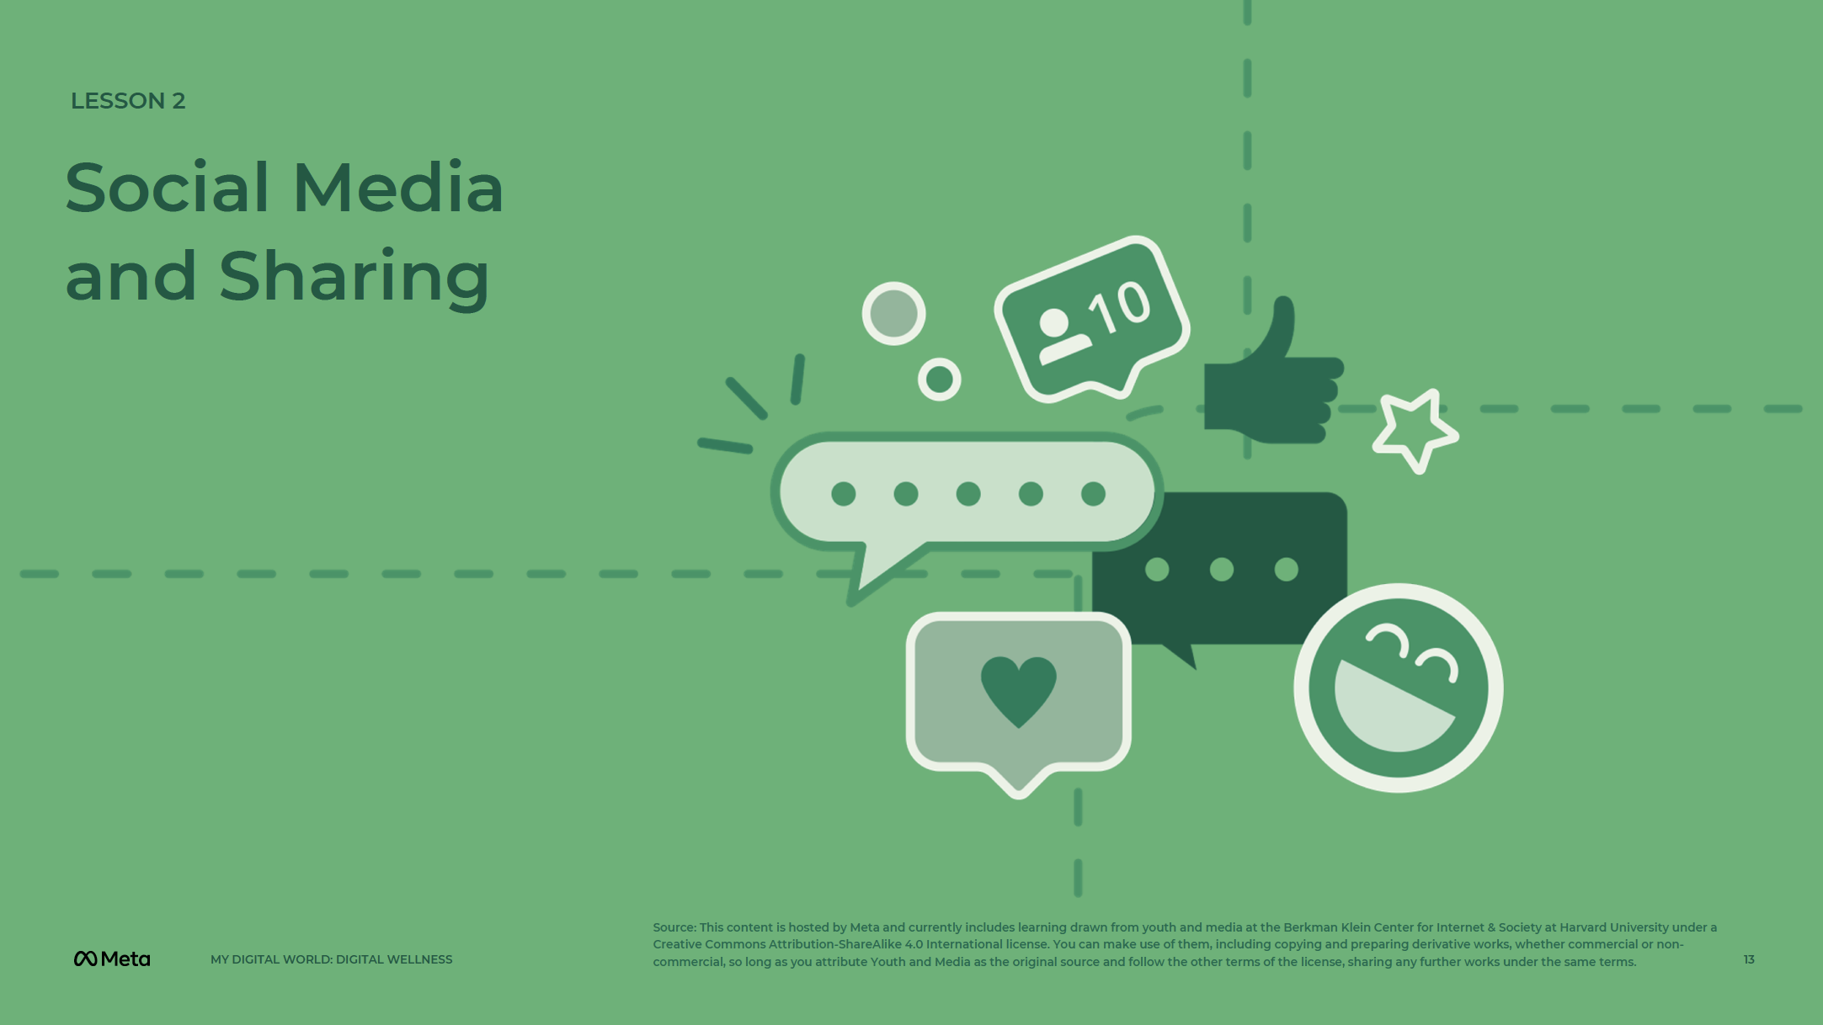
13
Notes:
Speaker Notes:
LESSON OBJECTIVE
Students will think about privacy in terms of how they share information and communicate with others online, specifically regarding social media use. They will be able to explain tradeoffs in privacy in the context of social media and learn how to use online privacy settings effectively.
ESTIMATED TIME
1 Hour 30 Minutes
ESSENTIAL QUESTION
What is the potential reach of the content you post on social media?
PREPARATION
Tape AGREE and DISAGREE signs to opposite sides of the room.
A viral media clip relevant to your community.
There are several opportunities to localize content to your students’ experience and local context. These opportunities are flagged as “Teacher’s Notes” throughout. We suggest you read through the lesson ahead of time and prepare the examples before the lesson begins.
OPTIONAL: ISTE DIGCITCOMMIT COMPETENCY
INCLUSIVE: I am open to hearing and respectfully recognizing multiple viewpoints, and I engage with others online with respect and empathy.
ALERT: I am aware of my online actions and how to be safe and create safe spaces for others online.

Slide 14
Notes:
Speaker Notes:
Social Media Use
TEACHER’S NOTE
Before this activity, tape the “AGREE” and “DISAGREE” signs on opposite sides of the room.
TELL YOUR STUDENTS
Let students know that once you read out each statement, they should stand close to one side or the other depending on how strongly they feel; students may also stand in the middle of the two signs if they are unsure/undecided.
CLASS INTERACTION
In between statements, ask students to explain their position and engage the group in short discussions about each topic.
TELL YOUR STUDENTS
I’m going to read out a statement. If you agree 100%, move to the “AGREE” sign. If you disagree completely, move to the “DISAGREE” sign. If you’re unsure or don’t agree/disagree completely, move toward the middle in a position that best represents your view.
I have an account on a social media platform like Facebook, Twitter, Snapchat, or Instagram.
I use social media every day.
My social media profile — on the social media platform I use the most — is public.
I have different friends/followers/connections (in other words, a distinct audience) on the various social media platforms I use.
My generation has a different way of thinking about information shared on social media platforms when compared with adults.
I use different social media platforms for posting specific types of content.

Slide 15
Notes:
Speaker Notes:
Part 1
TELL YOUR STUDENTS
A social media platform is an online platform you can use to connect with people and interact with them.
ASK YOUR STUDENTS
What are some social media platforms you’ve heard of?
Part 2
TEACHER’S NOTE
Before the following activity, tape the “AGREE” and “DISAGREE” signs on opposite sides of the room.
CLASS INTERACTION
Let students know that once you read out each statement, they should stand close to one side or the other depending on how strongly they feel; students may also stand in the middle of the two signs if they are unsure/undecided. In between statements, engage the group in short discussions using the questions below each statement.
TELL YOUR STUDENTS
I’m going to read out a statement. If you agree 100%, move to the “AGREE” sign. If you disagree completely, move to the “DISAGREE” sign. If you’re unsure or don’t agree/disagree completely, move toward the middle in a position that best represents your view.
For this activity, think about the social media account you use the most.
ASK YOUR STUDENTS
My social media profile is set to public.
Does this change the way you post things online? How so? Or if not, why not?
My social media profile is for friends/people I know really well only.
Why did you make this decision?
Would you post different things if everyone could see it? What kind of things?
I have a friend/follower/connection on social media who I have never met in real life.
Why did you friend/follow/connect to this person? Was it someone you met online or never before?
How would you describe the relationship?
Because you solely interact online, does it influence how you interact? What are some of the benefits to this type of interaction? What are possible challenges?
I accept every friend/follower/connection request I get.
What is a benefit of this approach? What are possible challenges?
Do friend/follower/connection requests matter when it comes to your privacy? If so, how? If not, why not?
Whenever I meet new people, I send them a friend/follower/connection request.
Why is this a good/bad idea?

Slide 16
Notes:
Speaker Notes:
ASK YOUR STUDENTS
Online, I’m friends with/followers of/connected to my parents/guardians or teachers.
Does this change the way you post?
Do the adults in your life ever make comments on what you post online?
What are possible benefits and/or challenges of being friends/followers of/connections with your parents/guardians or teachers?
I have deleted friends/followers/connections.
Why did you make this decision?
Some of the stuff on my profile can be seen by friends of friends/people I am not directly connected to on social media.
Which things?
I have looked at and/or changed my privacy settings.
Why or why not?
Were these privacy settings easy or confusing? What would make these settings easier to view/change?

Slide 17
Notes:
Speaker Notes:
How Big is Your Network?
Part 1
TELL YOUR STUDENTS
Now, let’s talk about the potential scope of your online audience on social media. There are two main ways of sharing content (e.g., photo, video, text-based post) with an audience. Content can be shared with a default audience, which can be just your friends/followers/those you are connected to or it can include friends of friends as well. In addition, your initial audience can share the content with their friends/followers/those they are connected to.
You can likely choose your immediate audience, but it’s much more difficult to control with whom your audience reshares/reposts/retweets content.
ASK YOUR STUDENTS
Assume that you share content with your friends/followers/those you are connected to and that the same content also gets shared with their friends/followers/those they are connected to. How many people do you think you’re sharing with?

Slide 18
Notes:
Speaker Notes:
Part 2
CLASS INTERACTION
Write the following equations/results on the board.
TELL YOUR STUDENTS
Let’s do a little math. If, for example, you have two friends/followers/connections on a social media platform and each of them has three friends/followers/connections, then how many people, at maximum (some friends/followers/connections may probably overlap) can see the content you share on the platform?

Slide 19
Notes:
Speaker Notes:
TELL YOUR STUDENTS
Answer: 2 + 2 x 3 = 8

Slide 20
Notes:
Speaker Notes:
TELL YOUR STUDENTS
If you have 10 friends/followers/connections on a social media platform and each of them has 10 friends/followers/connections, then how many people, at maximum, can see the content you share on the platform?

Slide 21
Notes:
Speaker Notes:
TELL YOUR STUDENTS
Answer: 10 + 10 x 10 = 110

Slide 22
Notes:
Speaker Notes:
TELL YOUR STUDENTS
If you have 300 friends/followers/connections and they each have 300 friends/followers/connections, how many people, at maximum, can see the content you share on the platform?

Slide 23
Notes:
Speaker Notes:
TELL YOUR STUDENTS
Answer: 300 + 300 x 300 = 90,300
These calculations were based on the assumption that your immediate audience shares content with their immediate audience, but no additional sharing happens after that. However, in many cases, content can be shared well beyond those immediate two audiences.
Part 3
ASK YOUR STUDENTS
How do you feel about the possibility that so many people you possibly don’t know (you might know some of your friends’ friends) could easily learn about what you do online? What might be some of the negative and/or positive aspects of this?
Why does this matter?
Does this change the way you think about sharing things online? Why or why not?

Slide 24
Notes:
Speaker Notes:
Sharing Online
Discussion 1
TELL YOUR STUDENTS
You may share things online for an intended audience, but when you make content public, it may gain unexpected attention. Media shared online can go “viral,” spreading quickly over social media, being replicated and possibly remixed.
ASK YOUR STUDENTS
Can anyone think of an example of viral media?
If not, ask them to think about memes, remixes, or popular videos they’ve seen and/or shared with their friends.
CLASS INTERACTION
Show a recent example aligned with your/students’ local/regional context to further solidify the concept.
TEACHER’S NOTE The viral content example can be localized to reflect your student’s local context in the area you are teaching. This example is intended to show viral content online to teach students that once content is online, it can be challenging to control who sees it. For example:
Ghana: #TakoradiGirls, a famous kidnapping cases of three girls.
Kenya: A local artist by the name of Embrambamba posted a video where he was captured rolling in the mud and doing spine-chilling stunts. Since this act was very unique, his videos went viral and even earned him an opportunity to be interviewed on a Kenyan TV program called, "The Trend.” https://www.facebook.com/benson.kimathi.7/videos/3651558584967261
Nigeria: This popular Twitter meme went viral. It started out as a post by a Twitter user who had no idea it was going to go viral. https://twitter.com/EvansTed101/status/1391101386801229829
Zambia: A video went viral of a fake Kevin Hart in Zambia. https://www.facebook.com/BET/posts/kevin-hart-has-a-zambian-look-alike-on-tiktok-named-john-that-goes-by-the-userna/10157655665450404/
Discussion 2
TELL YOUR STUDENTS
Viral media can be good if you want to draw attention to your work. However, unwanted attention can potentially include harassment and cyberbullying. A private video that gets leaked or shared without your permission could be damaging to your reputation.
ASK YOUR STUDENTS
What are some ways that content about you online can be shared beyond your intended audience and how could this potentially impact you and/or your reputation?

Slide 25
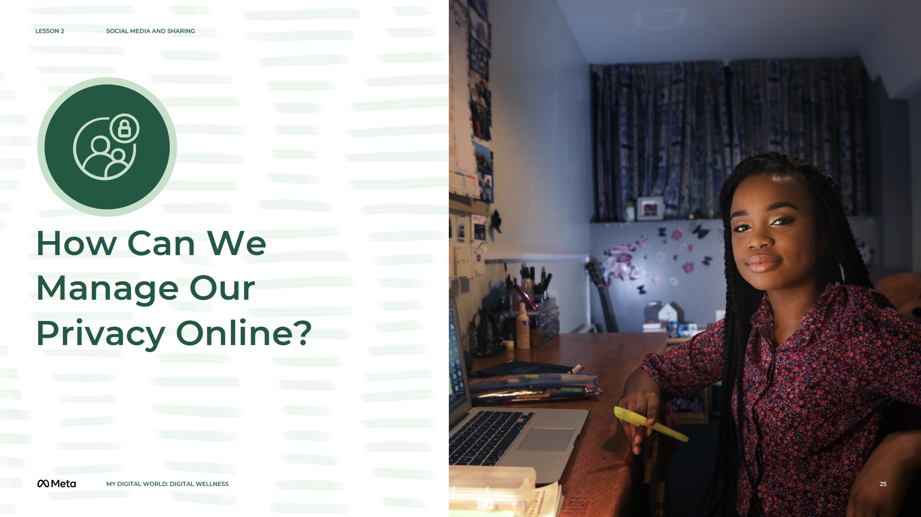
Notes:
Speaker Notes:
Privacy Options for Social Media Platforms
Part 1
TELL YOUR STUDENTS
Now that we’ve talked about some reasons why you might not want everything you do online to be public, let’s talk about how we can manage our privacy online.
Part 2
CLASS INTERACTION
In between questions, elaborate on the discussion using the statements following each question.
ASK YOUR STUDENTS
Does it make sense to have different privacy settings for different types of information? You may consider different pieces of information as having different levels of privacy. You may want to share a photo of your face, a tweet about your political or religious beliefs, or a story of a funny video with different audiences.
What about different privacy settings for different people? For example, do your parents/guardians and friends get to see the same thing on your social media account(s)? Students may not want their family to be able to comment on their posts but may want their friends to react.
Would you ever go back and review everything you have been tagged in? Why or why not? You may want to remove any embarrassing content (e.g., a photo from a bad hair day, a post about you that you don’t want to be shared). On certain social media platforms, such as Facebook, you can change your settings so that you have to approve something before it appears on your profile. Do you think that is a good idea? Why or why not? Some examples include It allows you to help prevent embarrassing content from being attached to your social media account. However, it does not stop the person posting the content from sharing it on their account with their friends/followers/people they are connected to.
Why might someone want to limit who can look them up? Can you give an example? You may not want strangers/people you don’t know well to friend/follow/connect with you on social media or send you unsolicited messages.
Are you friends with/followers of/connected to your parents/guardians online? Teachers? Other adults? Does this change the type of content you share or with whom you share content? Do parents/guardians or teachers need to be friends with/followers of/connected to you to see your profile?
Students should consider whether their own privacy settings allow the general public to see their social media profiles. Help them think about other ways that parents/guardians or teachers can view their profiles.
What about different privacy settings for different social media platforms? On Twitter, are your tweets public or private? How many people can view your Snap stories?
How many people can access your Instagram feed? Can others look at your videos on YouTube? Can people see your photos on Facebook, beyond your profile picture? If students don’t know, tell them there are privacy settings for this.
Do you tweet under your real name or a pseudonym? Why? Students may not want the general public to know what their real name is. In this situation, they may want to use a pseudonym.

Slide 26
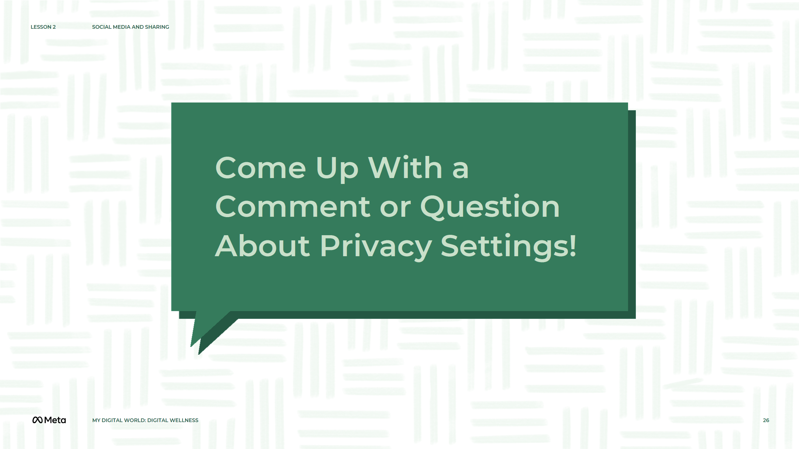
Notes:
Speaker Notes:
Part 3
CLASS INTERACTION
Organize students into pairs.
TELL YOUR STUDENTS
We know that privacy settings can be kind of confusing. In your pairs, take a few minutes to come up with a question or comment about privacy settings.
CLASS INTERACTION
Give students five minutes to come up with a question or comment about privacy settings. Ask them to share with the whole group and answer each question proposed. Solicit answers from other students before giving your answer. If computers or mobile devices with internet access are available, demonstrate how to manage privacy settings online.

Slide 27
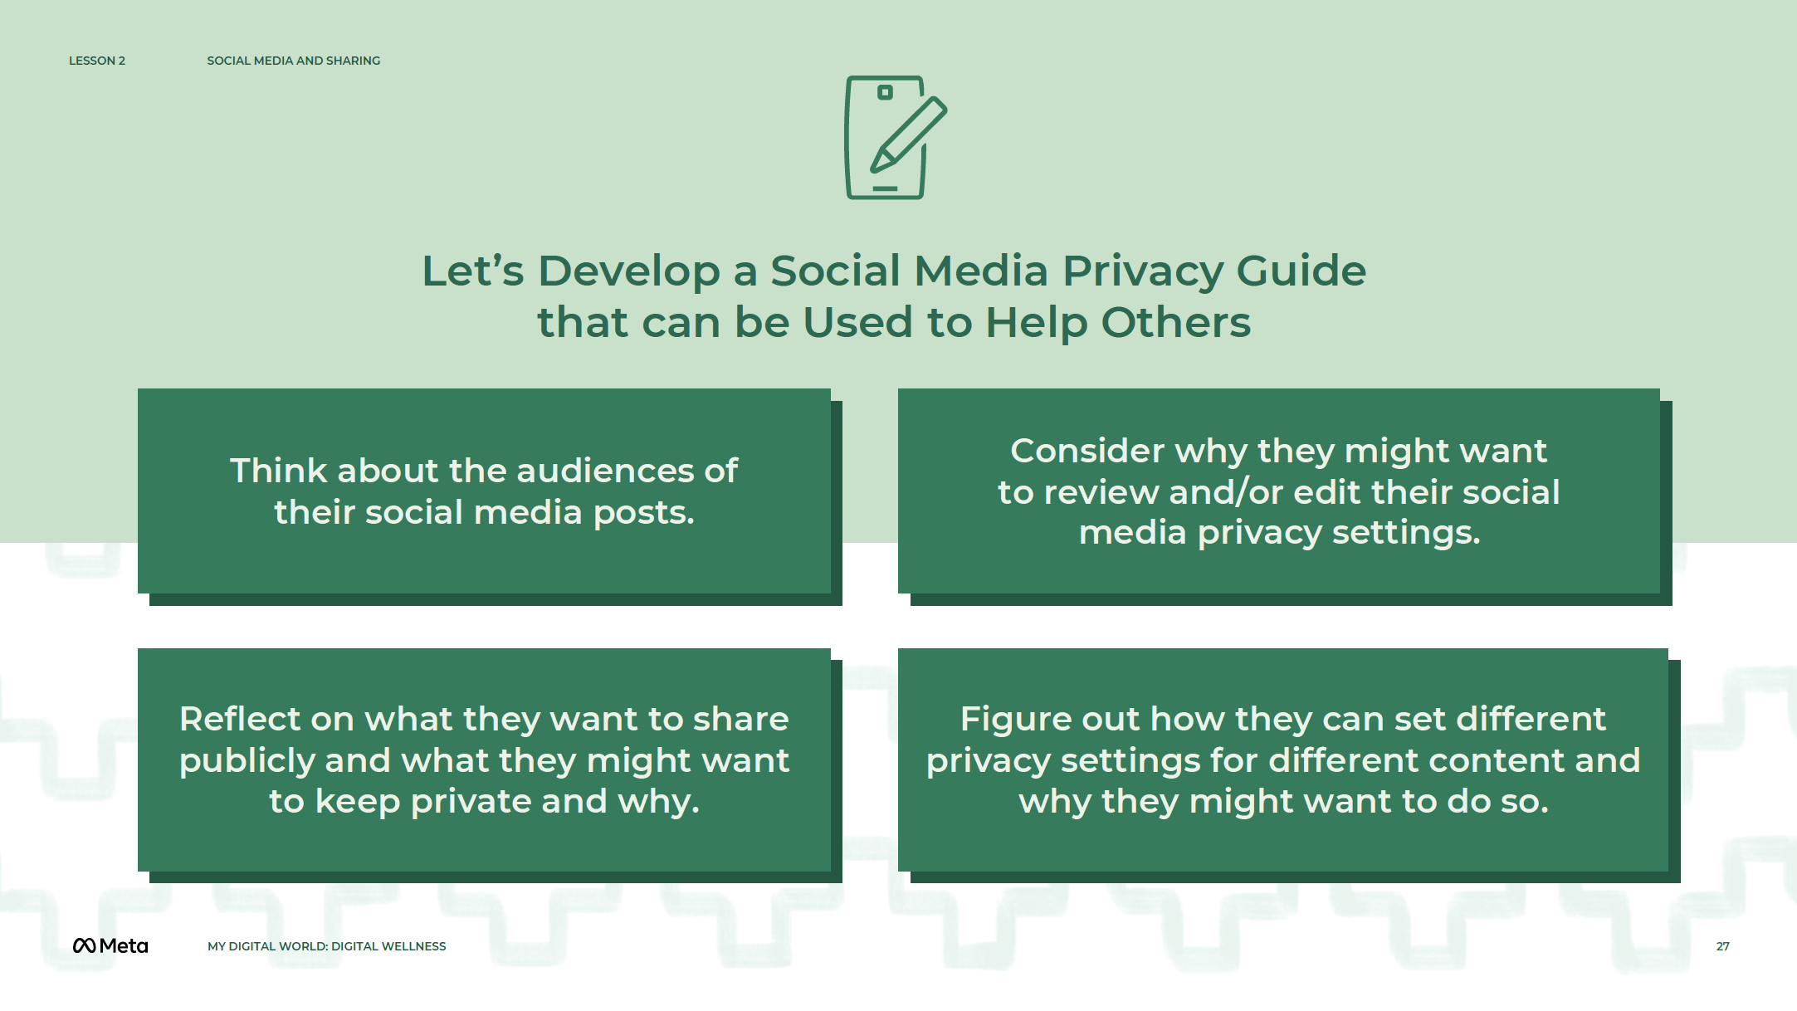
Notes:
Speaker Notes:
Assignment
TELL YOUR STUDENTS
Now that we have talked about social media privacy let’s extend that by developing a guide that could be used to help others learn what you’ve just learned.
Over the next 30 minutes, individually, create a short guide to help others:
Think about the audiences of their social media posts.
Reflect on what they want to share publicly and what they might want to keep private and why.
Consider why they might want to review and/or edit their social media privacy settings.
Figure out how they can set different privacy settings for different content and why they might want to do so.
This guide can be any format you’d like. You can write out a step-by-step text guide, fashion it like a “user’s manual,” incorporate pictures or a flowchart, or use any other method you think would help others learn these things; feel free to be creative!
In the guide, make sure to also:
Show readers how to review and change privacy settings on a social media platform.
Provide an answer to a question about privacy settings you believe to be important, based on the previous group discussion.
TEACHER’S NOTE
Encourage students to select different platforms so that, collectively, more platforms are covered. Give students 30 minutes to finish the assignment.

Slide 28
Notes:
Speaker Notes:
LESSON OBJECTIVE
Students will be able to identify one type of personal information they can manage online, one form of information they can’t control online, and one thing they can do about some aspect of their personal information online not directly controlled by them.
ESTIMATED TIME
15 Minutes
ESSENTIAL QUESTION
How much control do you have over the information about you online?
PREPARATION
Students will need internet access for this lesson.
OPTIONAL: ISTE DIGCITCOMMIT COMPETENCY
INCLUSIVE: I am open to hearing and respectfully recognizing multiple viewpoints and I engage with others online with respect and empathy.
ALERT: I am aware of my online actions and how to be safe and create safe spaces for others online.

Slide 29
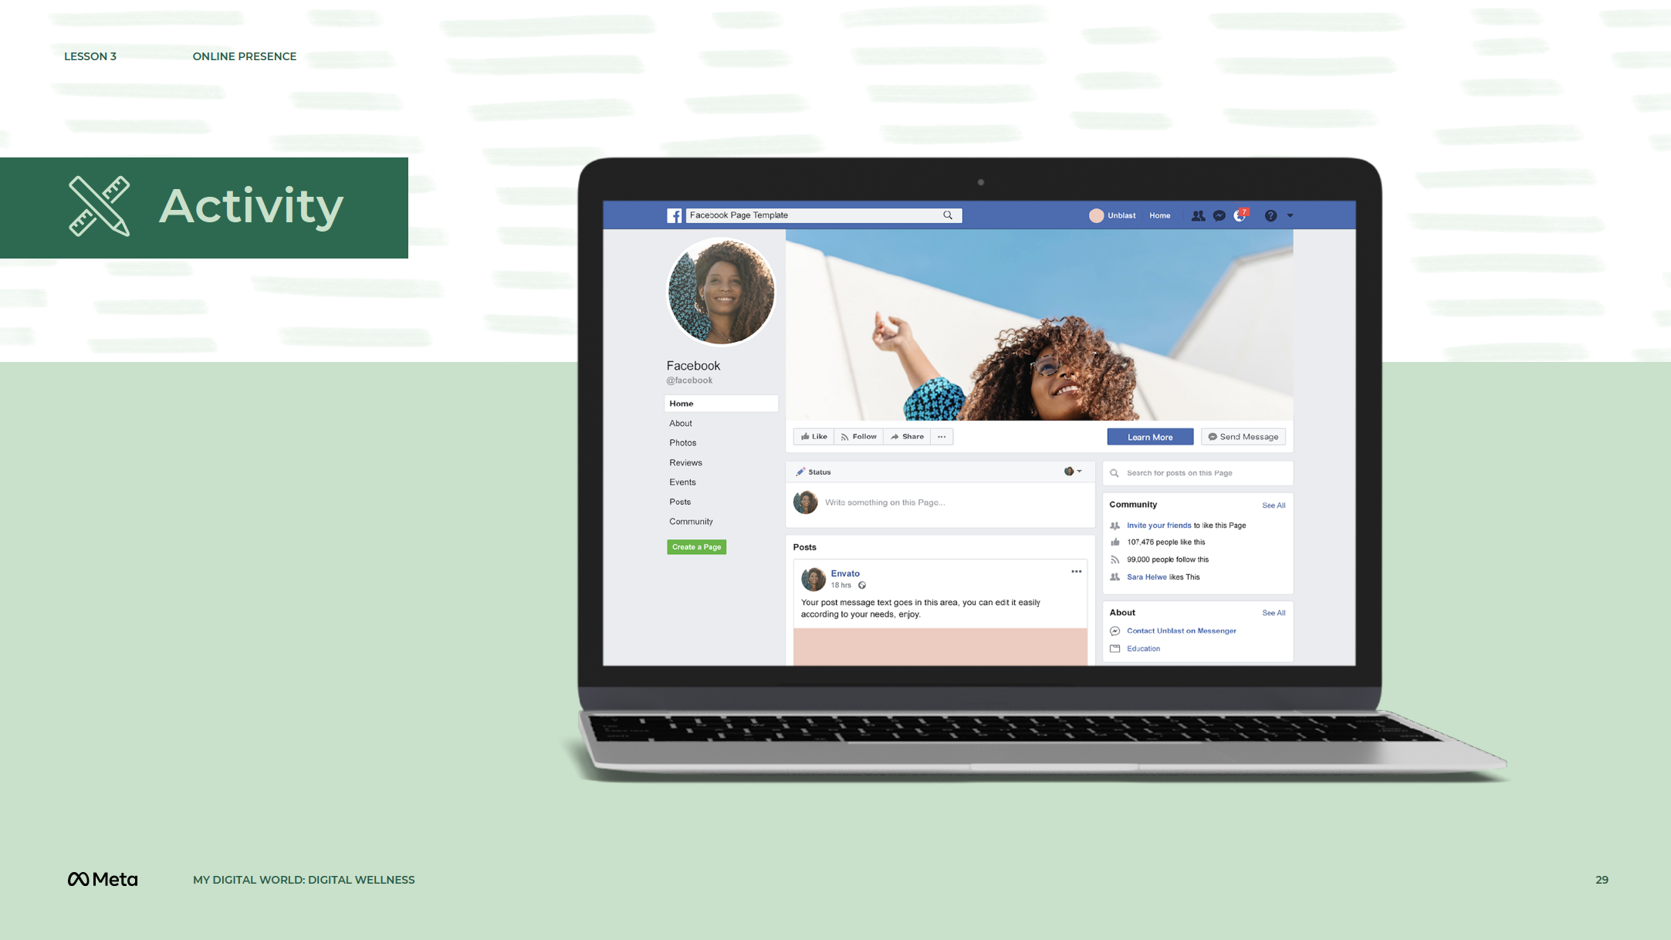
Notes:
Speaker Notes:
Online Profiles and Storytelling
TELL YOUR STUDENTS
The public information that is available about you online comes from many sources. You can control some of those sources, like the content you share (e.g., photos, videos, text-based posts) on your social media profiles.
Now think about your own social media profile(s).
ASK YOUR STUDENTS
What is the story that people might take away from reading your profile?
Who writes that story?
How might you manage that information?
What can you influence with respect to online content about you? What can’t you control?
TELL YOUR STUDENTS
Look at one of your personal social media profiles (Facebook, Instagram, Snapchat, Twitter, WeChat, etc.) or the social media profile of a public figure (e.g., someone in the music/film/TV industry, political figure, business leader). Pick several pieces of content (e.g., photos, videos, text-based posts) that are visible on the profile.
ASK YOUR STUDENTS
Who created the posts? Why?
What are some of the comments?
Who was the target audience for each post?
What information was left out?

Slide 30
Notes:
Speaker Notes:
ASSIGNMENT
Ask students to write a few paragraphs based on the posts they reviewed in the previous activity and answer the following questions:
What is one type of content that you/the account owner DO/DOES primarily control?
Suggested responses: Your username, status updates, posts/shares/tweets, the photos or videos you upload to your stories or moments, comments you make on the content other people share on social media.
What is one type of content that you/the account owner DO/DOES NOT primarily control?
Suggested responses: Comments other people make on the content you share on social media (e.g., your stories, moments, status updates, tweets), the content others share on social media, how friends/followers/those you are connected to share online content you have uploaded.
What is one thing you can do about content that someone else has written about you that you do not like for some reason (i.e., this information is NOT in your direct control)?
Suggested responses: Untag yourself; reach out to the person who shared the content and ask them to remove it; block the user; if you fear for your safety, tell a trusted adult; depending on the platform, you may be able to report the content and/or the user if it’s harassment or bullying.

Slide 31
Notes:
Speaker Notes:
LESSON OBJECTIVE
Students will examine the role of perspective when evaluating information linked to their online presence or the online presence of others. They will gain awareness of the relevant contextual factors (e.g., time, cultural, social, local/regional/global) that impact one’s online presence. Additionally, students will consider the implications of the information they put online on their relationships with family, friends, and authority figures (e.g., teachers, employers).
ESTIMATED TIME
60 Minutes
ESSENTIAL QUESTION
What information online helps shape how others view you?
MATERIALS
“Hiwot’s Social Media Profile” Handout
Projector for Rubin Vase Illusion
Pencils
Paper
PREPARATION
Print one handout per student.
Students will need internet access for this lesson.
There are several opportunities to localize content to your students’ experience and local context. These opportunities are flagged as “Teacher’s Notes” throughout. We suggest you read through the lesson ahead of time and prepare the examples before the lesson begins.
OPTIONAL: ISTE DIGCITCOMMIT COMPETENCY
INCLUSIVE: I am open to hearing and respectfully recognizing multiple viewpoints and I engage with others online with respect and empathy.

Slide 32
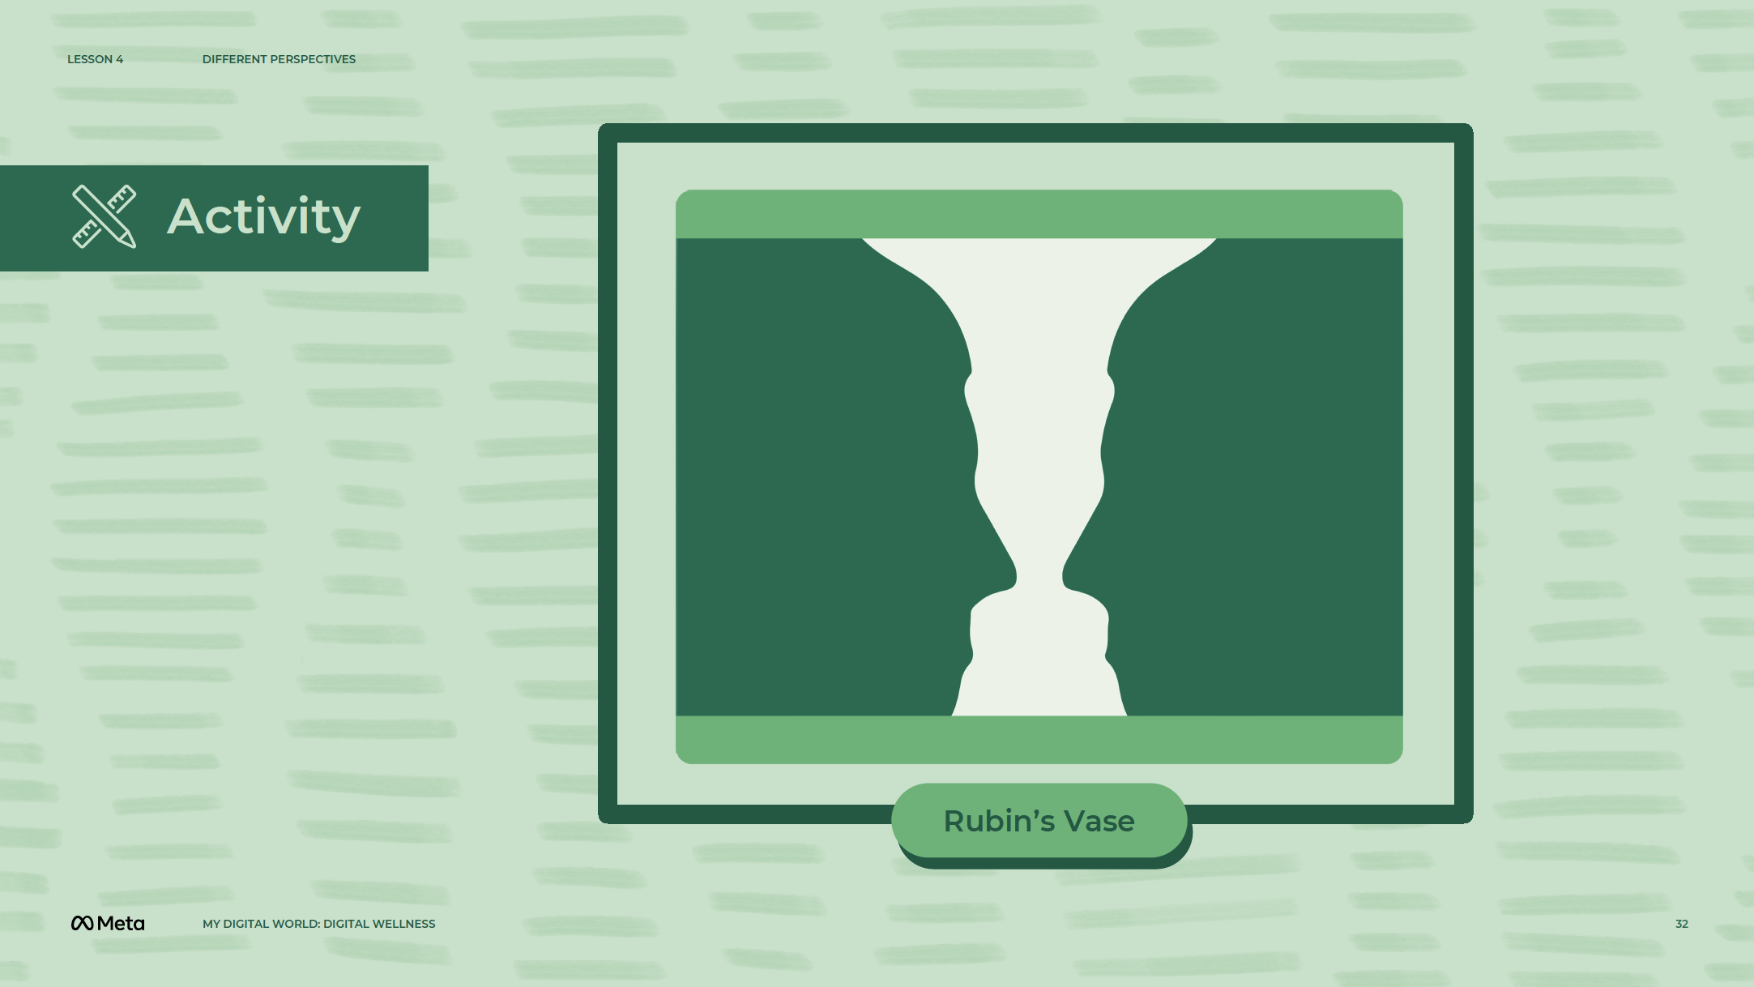
Notes:
Speaker Notes:
What is Perspective?
Part 1
IMAGE CLASS INTERACTION
Project the Rubin Vase Illusion image on a projection screen. While asking questions, ask students to come up and point out which image they see.
ASK YOUR STUDENTS
What do you see when you look at this image?
How many of you see the vase?
How many of you see the two faces?
Can you see both at once?
What you see can depend on your perspective.
What do you think perspective is?
CLASS INTERACTION
Write down student definitions on the board.
TELL YOUR STUDENTS
Perspective is a particular attitude toward something — a point of view.

Slide 33
Notes:
Speaker Notes:
Part 2
TELL YOUR STUDENTS
Here’s another example. Let’s say our friend Abdul just made it onto the school football team. When he tells his mom, he says, “I made it onto the football team!” His mother is very proud of him. When Abdul tells his best friend, Raviv, that he made it onto the team, Raviv says that he is very happy for Abdul.
Abdul also tells his friend Amed he made it onto the football team. Amed, however, had also tried out and Abdul got his spot. So, Amed is not so happy. Abdul is also a member of the science club and now he has to miss science meetings so he can go to football practice. When he tells Amina, the president of the science club, she isn’t very happy either.
All of these different people in Abdul’s life heard the same piece of information: Abdul made it onto the football team.
ASK YOUR STUDENTS
Why do they all react differently?
Why do their different perspectives and their various relationships to Abdul, matter?
Can you think of any other examples of how various people might view the same situation differently?
Why does perspective matter?
Teacher’s Notes: The example above can be further localized to reflect your student’s local context in the area you are teaching. For example:
Ethiopia: Tsehay (F), Gebre (M) Bisrat (M) and Genet (F) instead.
Ghana: Use names like Kofi (M), Kojo (M), Kweku (M) Akua (F) Afua (F) Nana (F)
Kenya: Use names like Luanda (M), Charles (M) Akinyi (F) Muthoni (F) instead.
Nigeria: Use names like Abdul (M), Ade (M), Chioma (F), and Amina (F) instead.
Zambia: Use names like Chanda (M), Patrick (M), Radhia (F) and Valerie (F) instead.

Slide 34
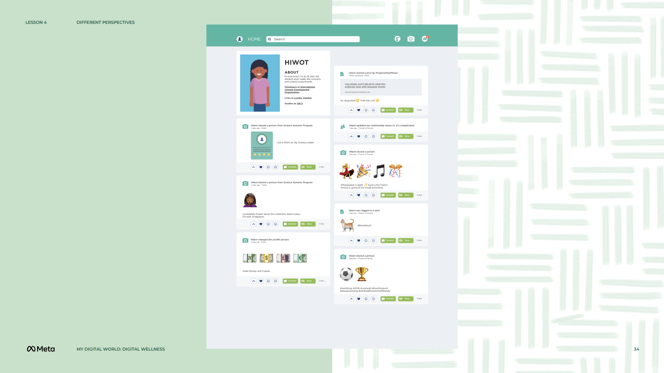
Notes:
Speaker Notes:
Part 3
CLASS INTERACTION
Divide students into groups of three or four. Give each group paper and pens or pencils.
TELL YOUR STUDENTS
I’m going to hand each group a resource with Hiwot’s fabricated social media profile and a slip of paper. On the slip of paper is the name of someone in Hiwot’s life. As a group, imagine that you are looking at this social media profile through the eyes of the person on the slip of paper.
Who do you think Hiwot is? What assumptions can you make? What does she like? What does she dislike? What has she commented on? What are your perceptions of Hiwot, based on your perspective?
You will have 10 minutes. Be prepared to present at the end!
Ask each group to present. Potential roles/people in Hiwot’s life:
Hiwot’s mother, who is concerned for her daughter’s safety
Hiwot’s best friend, who looks up to her
A girl at a neighboring school, who doesn’t know Hiwot
Hiwot’s teacher
A potential boss who is considering Hiwot for a job
Teacher’s Notes: This example is intended to show students how different people might interpret the same social media profile in order to get them to think critically about how they portray themselves online. The example above can be further localized to reflect your student’s local context in the area you are teaching. For example:
Ethiopia: Use names like Msekerem or Hiwot instead.
Kenya: Use names like Atieno or Lemanyanh instead.
Nigeria: Use names like Abraham or Abdul instead.
Zambia: Use names like Mulenga instead.
ASK YOUR STUDENTS
What were some of the differences in the ways that you perceived and evaluated Hiwot?
Why do you think those differences exist?
Do you think that all of these evaluations are accurate? Why/why not?
Can you think of times when this happened in your life — when the same information was interpreted differently by different people?
ASK YOUR STUDENTS
How many of you have had disagreements with your parents/guardians? Friends?
How many of you use social media platforms? Do you think about how other people perceive your social media profiles?
Have you ever deleted content or untagged yourself in content shared on social media (e.g., photos, videos, text-based posts)? Why?

Slide 35
Notes:
Speaker Notes:
Reflections on Perspective
TELL YOUR STUDENTS
Think about the different ways that people in your life know you.
ASK YOUR STUDENTS
Do you ever act differently around different people?
Do you talk the same way to your parents/guardians or teachers as you do to your friends? Why/why not?
TELL YOUR STUDENTS
We’re all slightly different people depending on where we are and who we’re with.
As part of this activity, we are going to discuss how you present yourself online, especially on social media and how others may perceive you in different ways depending on their perspective.
ASK YOUR STUDENTS
Do you present yourself differently online to different people?
For example, on one platform (e.g., Facebook), you might use your real name, but do you use your real name for everything you do on the Internet?
What are platforms where you don’t always go by your real name or platforms that you use anonymously? Why?
Do you think that the information you’ve shared online about yourself shows the whole picture of who you are?
Do you think your social media profiles tell the entire story? Do you want them to?
How might people view you if they only had access to some of your information?
For example, would your parents’/guardians’ perspective change if they saw everything you did on one platform but not on another?
Do you ever keep your posts private? Why?
TELL YOUR STUDENTS
We talked a lot about perspective today.
ASK YOUR STUDENTS
Based on our conversation, what is one thing you learned about perspective today?
What is another way that perspective affects how we evaluate information? Can you name a recent current event where this was relevant?
How is perspective important not just in our personal lives, but on the news as well?

Slide 36
Notes:
Speaker Notes:
Assignment
TELL YOUR STUDENTS
Take a photo/screenshot of any social media post (i.e., a photo, video, or text-based post) (it does not have to be their own). Identify three roles in relation to the individual’s social media post (e.g., friend, family member, teacher) and, for each role, in a short paragraph describe how the individual might think about this post.
TEACHER’S NOTE
In the last 10 minutes, divide students into pairs and have them share with their partner at least two ways they believe perspective is important in the context of the post they chose.

Slide 37
Notes:
Speaker Notes:
LESSON OBJECTIVE
Students will examine their online identities and the content they create and share related to their goals (e.g., career-related, academic, interests they would like to pursue). They will explore how to manage an online persona that considers subject, platform, name, visual representation, and privacy settings.
ESTIMATED TIME
30 Minutes
ESSENTIAL QUESTIONS
How do digital technologies impact your interests and goals?
How do you convey these interests and goals to others online?
MATERIALS
“My Online Identity” Handout
PREPARATION
Print one handout per student.
There are several opportunities to localize content to your students’ experience and local context. These opportunities are flagged as “Teacher’s Notes” throughout. We suggest you read through the lesson ahead of time and prepare the examples before the lesson begins.
OPTIONAL: ISTE DIGCITCOMMIT COMPETENCY
INCLUSIVE: I am open to hearing and respectfully recognizing multiple viewpoints and I engage with others online with respect and empathy.

Slide 38
Notes:
Speaker Notes:
My Online Identity
Discussion
TELL YOUR STUDENTS
Let’s take a minute to think about how we interact with different people depending on who they are. You may act differently around your friends than your family members or your teachers at school. You also may act differently depending on the setting or occasion — one way with friends at school and a different way with the same friends when you spend time together outside of school.
We may be all slightly different people depending on where we are and who we’re with. You have a similar ability to manage how you and your content will appear publicly online and it can be helpful to start thinking about how you’d like others to view you on the internet.
Public figures (e.g., those in the music/film/TV industry, political figures, business leaders) do this all the time. By carefully constructing every part of their brand and public presence, from social media content (e.g., photos, videos, text-based posts) to interviews, they are trying to appeal to as many fans or customers as possible. You don’t have to be a public figure with a billion-dollar marketing strategy. But it is useful to think about who might be looking at your online presence and plan how you appear online for the future.

Slide 39
Notes:
Speaker Notes:
Interaction
CLASS INTERACTION
Organize students into pairs.
ASK YOUR STUDENTS
What content do you currently make and/or share online (e.g., videos, music, remixes, blogs, designs, animations)?
What inspires you to make or share this content?
Why do you do it? What content do you have your real name and image associated with?
Is there any content that you would not want to be publicly associated with you? Why not?
CLASS INTERACTION
Give students seven minutes to discuss. And ask the groups to share out.

Slide 40
Notes:
Speaker Notes:
ASK YOUR STUDENTS
Before we can talk about your future online presence, let’s talk about your future goals. Discuss with your partner:
Where and what do you want to be in a few years, and how did you first come up with that idea? It’s okay if you have more than one idea or one career that currently interests you.
What other personal goals do you have that are not related to your career goal(s)?
What might you do online to help you achieve your future career goals or personal goals?

Slide 41
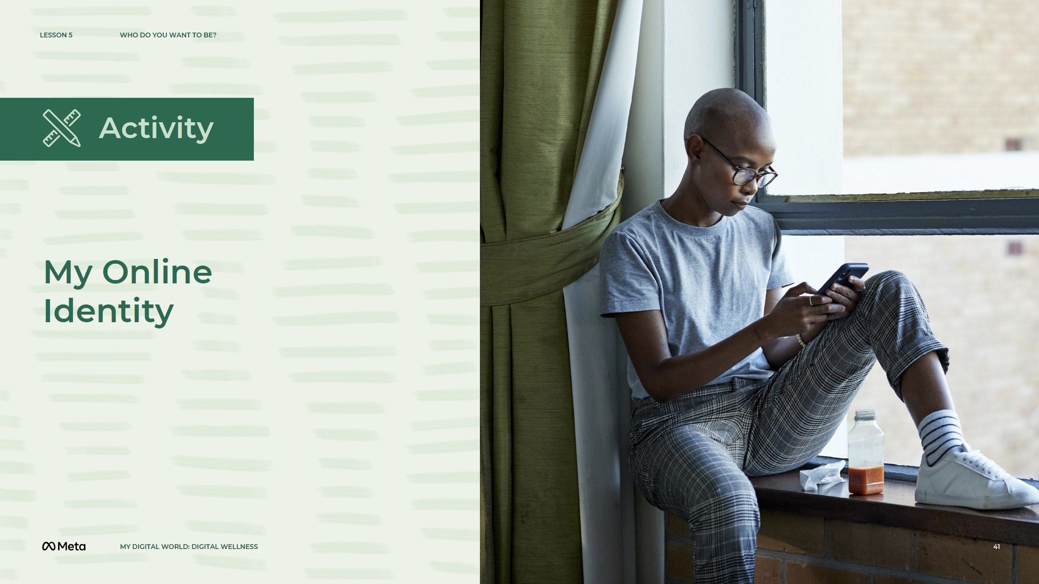
Notes:
Speaker Notes:
CLASS INTERACTION
Pass out the “My Online Identity” resource to students.
TELL YOUR STUDENTS
What you do online can help you explore your current interests and also help you discover future passions. Take a few minutes to fill out this resource and reflect on your aspirations in the context of how you present yourself online. Remember that everyone’s online identity may well be different and your own identity will likely evolve based on how your goals and interests change in the future.

Slide 42
Notes:
Speaker Notes:
Assignment
TELL YOUR STUDENTS
Now that we have reflected on how you view yourself and your interests, let’s think about how you would like to highlight aspects of your identity to others.
Imagine that you are creating a new social media presence that focuses on a particular aspect of your identity. You will be starting from scratch and you will have total liberty to adjust all of the privacy settings and craft content in any way you wish. In a written paragraph, discuss how you might structure this new social media presence to portray your chosen image to your friends and followers. In particular, speak to the following concepts:
Type of account and platform (e.g., social media, blog)
Type of content (e.g., photos, videos, text-based posts)
What would you put in the “About Me” section?
What kinds of images would you use?
What would you set your privacy settings to? Would any of these settings depend on the type of content you share?

Slide 43
Notes:
Speaker Notes:
LESSON OBJECTIVE
Students will compare and contrast the ways they respond to a close friend in distress (versus themselves) and consider how they might adjust what they say to themselves when they are struggling.
ESTIMATED TIME
20 Minutes
ESSENTIAL QUESTIONS
What is self-compassion?
Why should I practice self-compassion?
MATERIALS
A Quiet Place to Practice
PREPARATION
Reflection before the practice.
Take a moment to try this practice for yourself using a personal or professional challenge you’re facing right now. Choose something mildly or moderately challenging, rather than an overwhelming one. Did this practice alter the way you feel about the challenge or about yourself?
How do you think self-compassion is relevant to your students’ lives, both in and out of school? Would they agree?
Does this practice privilege your values over theirs in any way? For example, do you believe that being kind to yourself is more motivating than being hard on yourself, whereas students and parents do not?
If your beliefs differ, is it possible to honor these differences in a way where none are viewed from a deficit lens?
OPTIONAL: ISTE DIGCITCOMMIT COMPETENCY
INCLUSIVE: I am open to hearing and respectfully recognizing multiple viewpoints and I engage with others online with respect and empathy.

Slide 44
Notes:
Speaker Notes:
CLASS INTERACTIONS
Before beginning this activity, take a few deep breaths. Remind students that they are encouraged but not required to participate. (They are welcome to sit quietly if they choose not to participate.)
TELL YOUR STUDENTS
We will purposely generate a little tension or stress in our minds and bodies by thinking of a challenging situation, so we can then learn how to use self-compassion.
Play the audio recording for your students or lead them through the practice with the transcript below.
Think of a situation in your life that is difficult or causing you stress. Please choose a situation that is not the worst or most difficult in your life, but something that is causing you some discomfort. When you think of this situation, can you feel the experience in your body, perhaps discomfort such as tightness in the chest or gripping in the stomach? Now, say to yourself: “In this moment, a part of me is struggling.” This is mindfulness. You might choose to say, “Whoa, this feels awful,” or “This sucks,” or maybe, “This is stress.”
Now say to yourself: “This kind of struggle is a part of life.” This is common humanity. Lots of other people struggle in this same way.
You might choose to say, “Other kids feel this way too,” or “I’m not alone with this feeling,” or “This is a part of being a teen and so many other kids struggle just like me.” Or “All teens feel this at some time or another…!”
Now, offer yourself a kind and soothing, supportive touch — maybe a hand on your heart or another gesture that feels right for you. Feel the warmth of your hand coming through to your body. Now, say to yourself: “May I be kind to myself.” Remember that as teens, you’re going through so many transitions — your brains are changing, your bodies are changing, you may be in a new school or thinking about college, so many pressures and so many changes. So be gentle with yourself.
For more personal language, ask, “What do I need to hear right now?” Or if you have trouble finding what words to say, ask yourself, “What would I say to a good friend who was going through this? Can I say those words to myself?”
May I give myself the compassion that I need.
May I accept myself as I am.
May I learn to accept myself as I am.
May I forgive myself.
May I be strong.
May I be safe.
May I be peaceful.
May I know that I deserve love.
And if the “May I” feels strange to you or like you are asking permission, you can always leave that out and just say “I wish to accept myself just as I am,” or “Strong,” or “Accept myself,” simply notice what you’re feeling.
ASK YOUR STUDENTS
Ask students one or more of the following questions:
What does it feel like to comfort yourself in this way? What is it like to think that you can actually begin to notice when you’re struggling and begin to offer yourself kind words?
Did anything change when you put your hand on your heart?
What is it like to know that you can actually treat yourself with more kindness?
Can you think of a situation where this would be useful to you?
Consider the three components of self-compassion — which were most meaningful to you and important to acknowledge?
Mindfulness (“This is a moment of suffering.”)
Common humanity (“I am not alone in my suffering.”)
Self-kindness (physical touch or soothing voice; “May I be kind to myself.”)
ASSIGNMENT
Reflection after the practice:
What worked or didn’t work for you in leading this practice? How did the students respond to the practice? Would you change anything for next time?
Do you notice whether students are responding to mistakes or failure or other challenges in life with a different attitude after engaging in this practice?
What adjustments were made to the practice based on student and family input? How did it go?
Did students discuss how this practice might relate to or be helpful or unhelpful in their lives?

Slide 45
Notes:
Speaker Notes:
LESSON OBJECTIVE
Students will:
Define gratitude and give an example of a time they felt grateful.
Understand that there are many types of things we can feel grateful for.
ESTIMATED TIME
30 Minutes
ESSENTIAL QUESTIONS
What does it mean to be grateful?
How can we express gratitude?
MATERIALS
Sticky notes
Pencils
Four signs, posted in different corners of the room, which say, “Things We Own,” “Kind Actions,” “Nature,” and “Other Important Things”
For extension: writing paper/drawing materials
PREPARATION
Reflection before the practice:
Take a moment to breathe deeply, close your eyes or soften your gaze and think of something you are grateful for. How did this moment make you feel?
How do you think gratitude is relevant to your students’ lives, both in and out of school? Would they agree?
What are your beliefs about gratitude and how it is expressed? Do they differ from your students’ and their families’ beliefs about gratitude?
Does this practice privilege your values over theirs in any way? For example, some cultures find saying “thank you” an insult because doing something for others is considered a duty.
If your beliefs differ, is it possible to honor these differences in a way where none are viewed from a deficit lens?
OPTIONAL: ISTE DIGCITCOMMIT COMPETENCY
INCLUSIVE: I am open to hearing and respectfully recognizing multiple viewpoints and I engage with others online with respect and empathy.

Slide 46
Notes:
Speaker Notes:
ASK YOUR STUDENTS
Think of someone that you said “Thank you” to recently. Take a few moments to think about this silently. Now turn to a partner and talk about who you thought of and why.
CLASS INTERACTION
Students will break into pairs.
ASK YOUR STUDENTS
When pairs have finished speaking, ask:
Who can share an example of a time you said “Thank you” to someone and why?
Does anyone know what the word “gratitude” means?
TELL YOUR STUDENTS
Explain that “gratitude” refers to the feeling we have when we appreciate other people for being kind or for doing caring things. Give an example of your own life, such as: “I feel grateful when someone held the door for me this morning because I was carrying heavy bags.”
Discuss how we can also feel gratitude when we appreciate tangible things that we have, things that someone gives us, or things that are part of our daily life that we may not give much thought to. Give an example from your own life, such as: “I felt grateful for my dinner last night, because I was really hungry, and it was delicious.”
Demonstrate how many people also feel grateful for things in the natural world. Give examples of this, such as: “I feel grateful for the rain that gives us water to drink and helps plants grow.”
Discuss how sometimes we feel gratitude for things we cannot directly see or touch, but which are nonetheless important, such as health, our heritage or traditions, fairness, ideas that inspire us, or just being alive. Give another example from your own life, such as: “I feel grateful when I get to learn something new, because learning makes my mind grow.”
Explain that we often show gratitude by saying “Thank you” to someone.
(Note: Some students may come from homes or cultures where verbally expressing gratitude is not the norm. Encourage students to share other ways their family or community may express gratitude. For some cultures, people show gratitude for a great meal by rubbing their feet and arms with their wet hands immediately after eating the meal.
When we feel gratitude, we typically say that we are “thankful” or “grateful.”

Slide 47
Notes:
Speaker Notes:
CLASS INTERACTION
Give a sticky note to each student. Ask them to jot down a short note about a time they felt grateful and what they were grateful for or who they were grateful to (this may be the same idea that they shared or a new one). Point out the four signs in the four corners of the room.
TELL YOUR STUDENTS
Look at your sticky note and think about which of the four signs, “Things We Own,” “Kind Actions,” “Nature” and “Other Important Things,” best describes what you wrote. Move silently and stand near the sign that describes your idea. If your idea doesn’t match one of the signs, stand in the center of the room. Any students in the center may come up with a new category. Share what you wrote within your group.
CLASS INTERACTION
If there is only one student in the center of the room, ask them to share what they wrote and the new category. Discuss the new gratitude category as a class. Ask for one or two volunteers from each group to give an example of the type of gratitude indicated by their sign or new category.
When examples from each group have been shared, tell the groups to move together clockwise to stand next to a new sign. Have students again discuss things that they feel grateful for that would be described by this new sign (they do not need to write these down). Ask for an example or two from each group.
If time allows, continue the clockwise rotation until everyone has moved through all four (or five) stations.
ASK YOUR STUDENTS
Which examples were easy to think of? Why might that be?
Which examples were hard to think of? Why might that be?
What examples of gratitude did you hear that surprised you?
What did you learn about gratitude from this activity?

Slide 48
Notes:
Speaker Notes:
ASSIGNMENT
Ask students to reflect on how it felt to think about things or people they are grateful for. How might they encourage others to practice gratitude?
EXTENSIONS
Have students write a paragraph or draw an illustration of what they are grateful for. Post these on a bulletin board. Encourage students to look at any tangible “things” that were discussed. Who are the people who gave them those things? Think about the people that helped to make them. Include those people in your gratitude!

Slide 49
Notes:
Speaker Notes:
The lessons and activities in this section help learners explore their identities, engage with others (both individuals and the larger collective) online in empathic, ethical, and positive ways, and counteract the risks the digital world may come with to protect their physical and mental health.

