Slide 1



MY DIGITAL WORLD
Youth online safety and well-being

Slide 2
Table of contents
INTRODUCTION
LESSON 1: TOOLS FOR MANAGING TIME ON INSTAGRAM
LESSON 2: OPTIONS FOR TEENS TO CONTROL THEIR EXPERIENCE ON FACEBOOK, MESSENGER, INSTAGRAM AND WHATSAPP
LESSON 3: PARENTAL SUPERVISION
LESSON 4: AGE ASSURANCE
SEXTORTION HUB
APPENDIX

Slide 3


Introduction

Slide 4

We have designed our technologies with young people in mind. We want them to have power and control over their own experiences, including what content they engage with and who can contact them.
INTRODUCTION
Youth online safety and well-being

Slide 5

Preventing harm
Empowering young people and helping support their well-being
INTRODUCTION
Our main goals are
1
2
3
Help parents and guardians guide their teens' online experience

Slide 6
Responsible empowerment
Age-appropriate safeguards
Innovation
INTRODUCTION
Principles guiding our approach to young people
We strongly believe in the importance
of responsibly empowering young people to enjoy the many benefits
our platform provides.
We recognise that youth require additional safeguards for their safety, privacy and well-being. Our approach towards this is expansive, including our investment in parental supervision tools for Instagram , virtual reality (VR) and AI characters.
We continue to explore innovative technologies to provide great experiences for young people, help keep them safe online and solve the defining challenges for our industry.

Slide 7


Teen Accounts is Meta’s experience for teens on Facebook and Instagram. Teen Accounts have built-in protections which limit who can contact them, the content they see, and the time they spend online.
Notes:
We launched Teen Accounts last year - fundamentally reimagined the experience for teens. They’re now available to teens on Instagram globally have rolled out to Facebook and Messenger too.

Slide 8
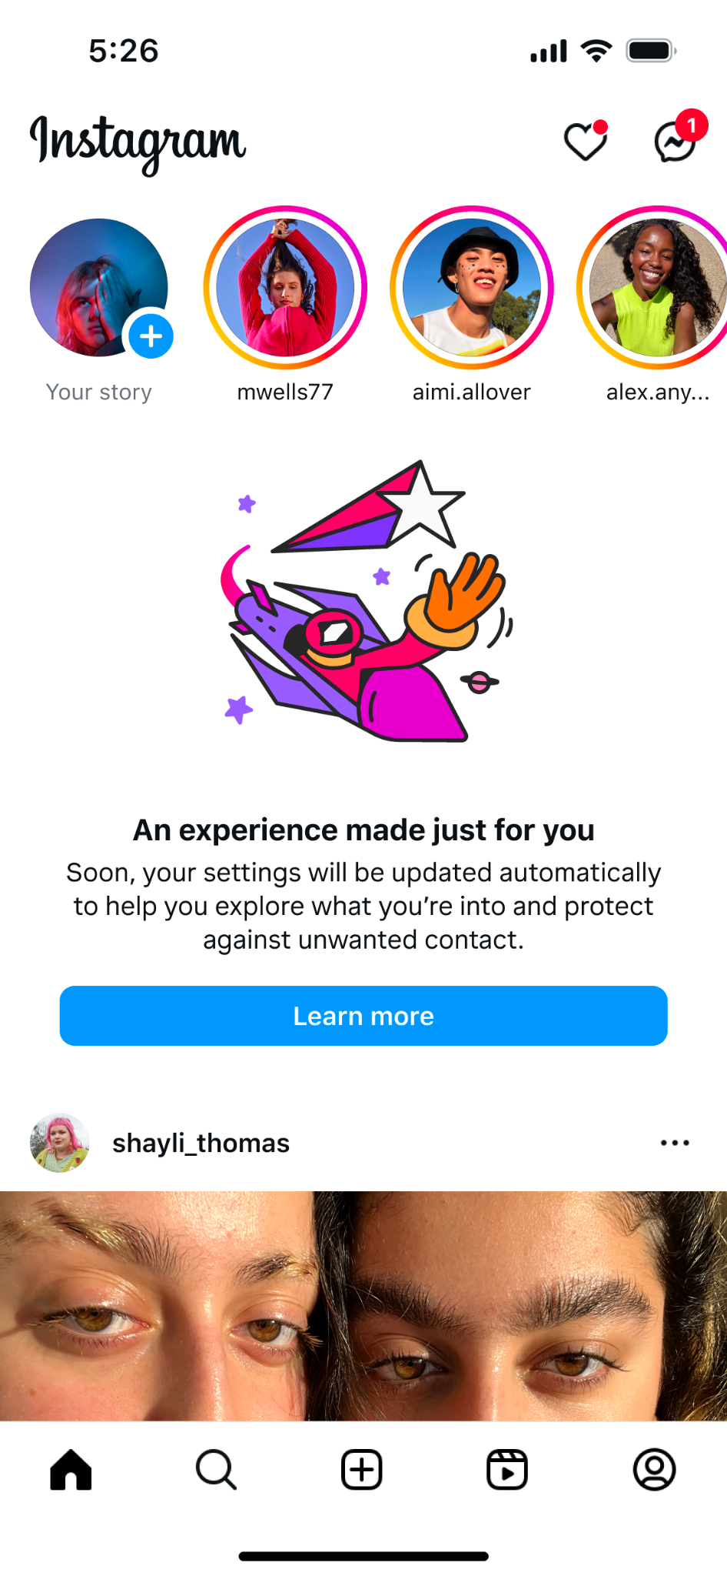
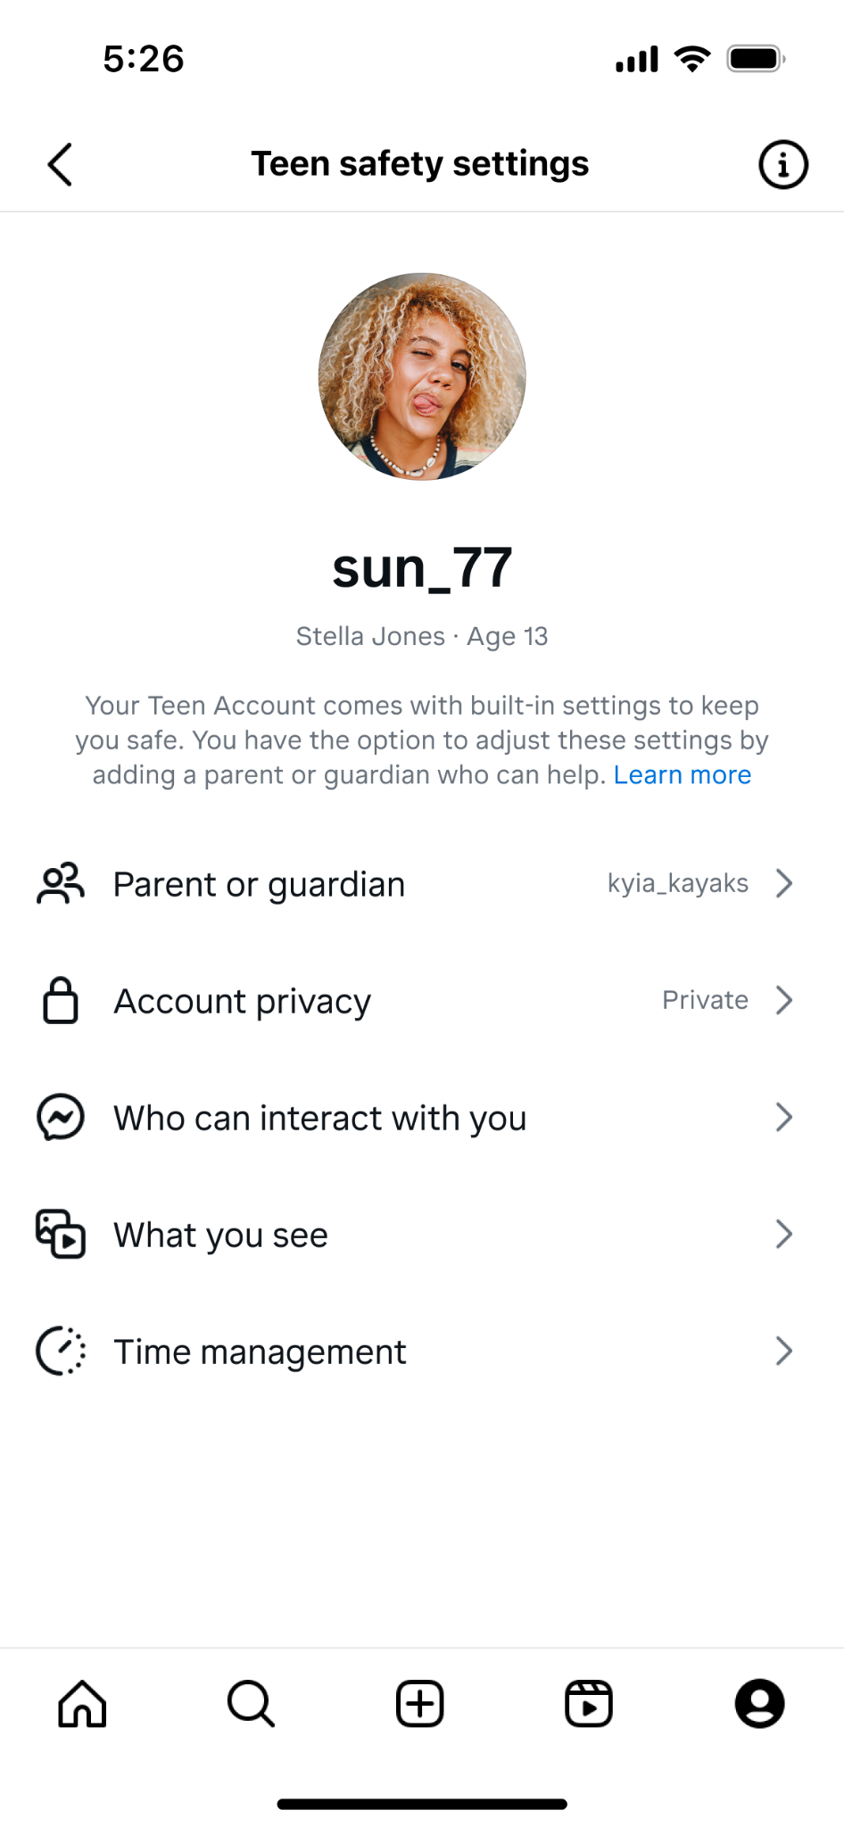
Why Teen Accounts?
Addresses the largest concerns reported by parents - globally - around their teen’s use of social media apps:
Unwanted contact
Inappropriate content
Screen time
Notes:
Teen Accounts have built-in automatic protections that were specifically designed to address the top 3 concerns we heard from parents about their teen’s social media use: unwanted contact from people their teens don’t know; inappropriate content; and how much time they spend online.
Teen Accounts were designed to address these 3 concerns by automatically being defaulted into:
Private accounts; this means teens need to approve any new followers, and only those approved followers can see and engage with their content.
The strictest message settings; meaning teens can only be messaged by people they follow or are otherwise already connected to
The strictest setting of our Sensitive Content Control, which controls how much sensitive content you see in your recommendations.
We also remind teens to leave the app after 60 mins, and Sleep Mode is on by default, muting notifications and sending auto-replies to DMs between 10pm and 7am.
Teens under 16 need a parent’s permission to make any of these settings less strict.

Slide 9
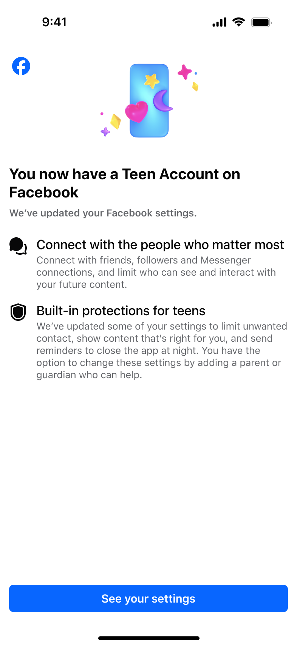
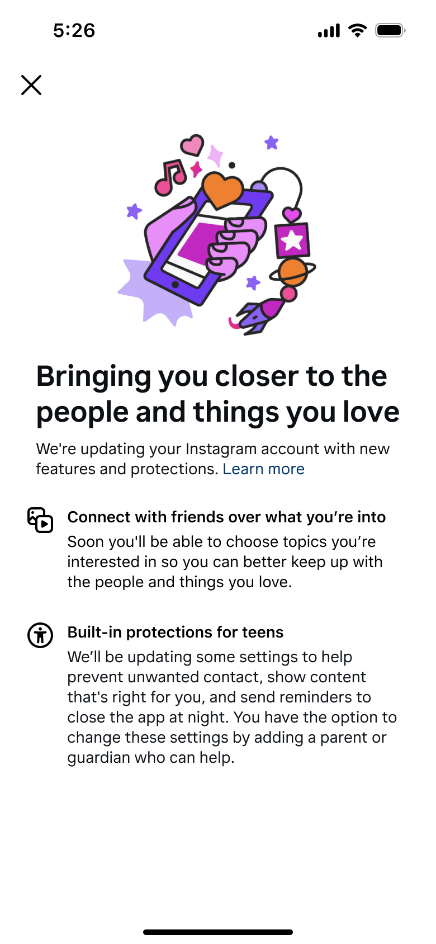
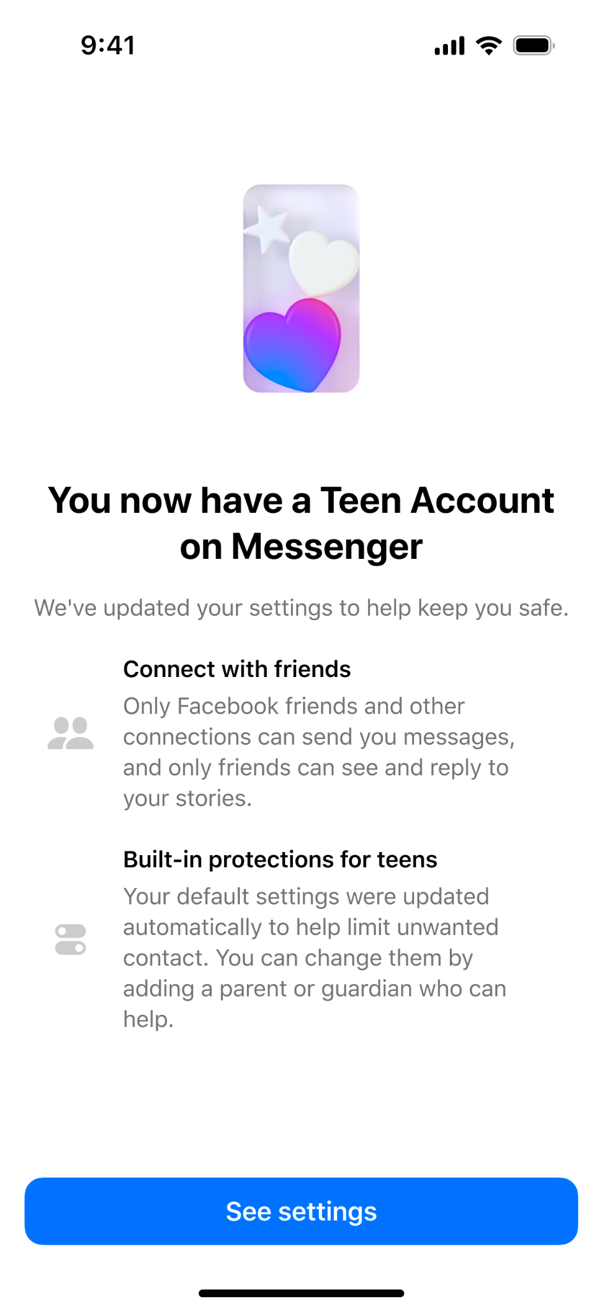
Teen Accounts by the Numbers
Since launching on Instagram last year, we’ve placed hundreds of millions of teens across the world in Teen Accounts on Instagram, Facebook, and Messenger.
We’re also encouraged that 97% of teens aged 13-15 have stayed in these built-in restrictions, while 94% of US parents surveyed say Teen Accounts are helpful for parents, and 85% believe Teen Accounts make it easier for them to help their teens have positive experiences on Instagram.
Notes:
Hundreds of millions of teens around the world are now in Teen Accounts, we shared that 97% of under 16s have stayed in these built-in restrictions
Parent also like teen accounts. 94% of US parents say Teen Accounts are helpful for parents, and 85% believe Teen Accounts make it easier for them to help their teens have positive experiences on Instagram.
But as we said at the time, we didn’t want to stop at the launch of Teen Accounts. We always intended to build on them, and to continue listening to teens and parents to understand what else we could do to create the best possible experience for teens on Instagram, while giving parents peace of mind.

Slide 10


LESSON 1
Tools for managing time on Instagram

Slide 11
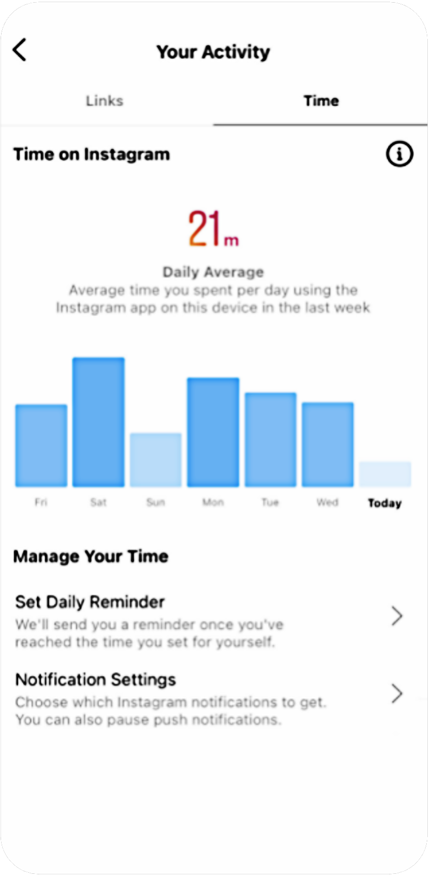
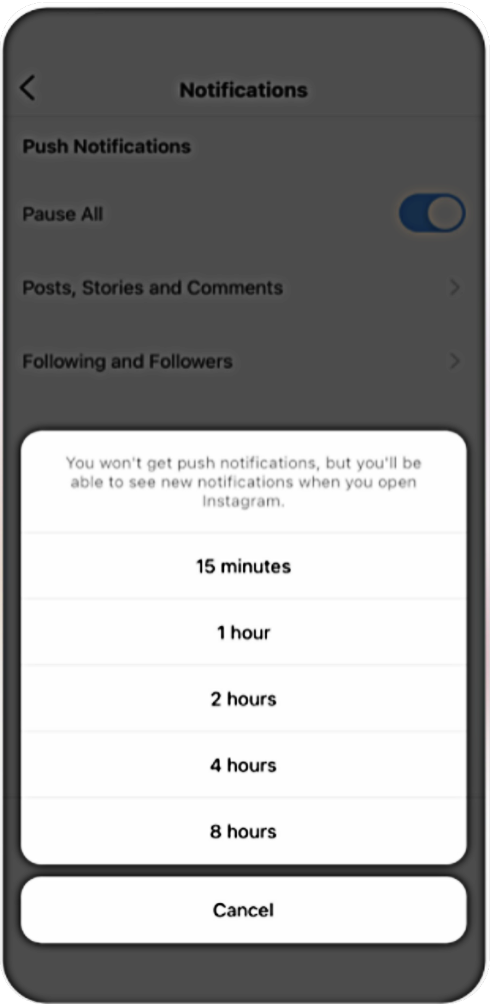
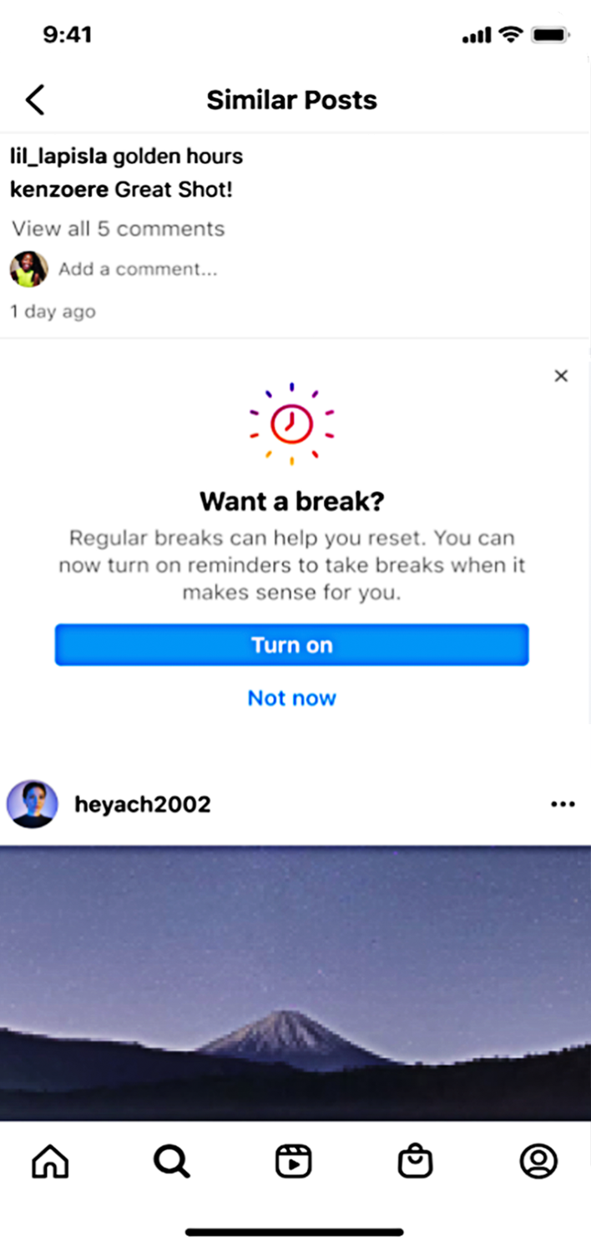
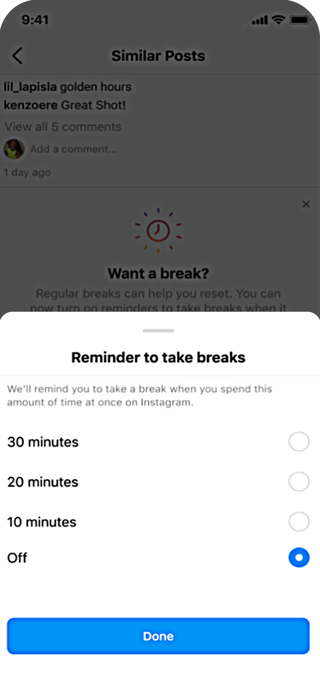
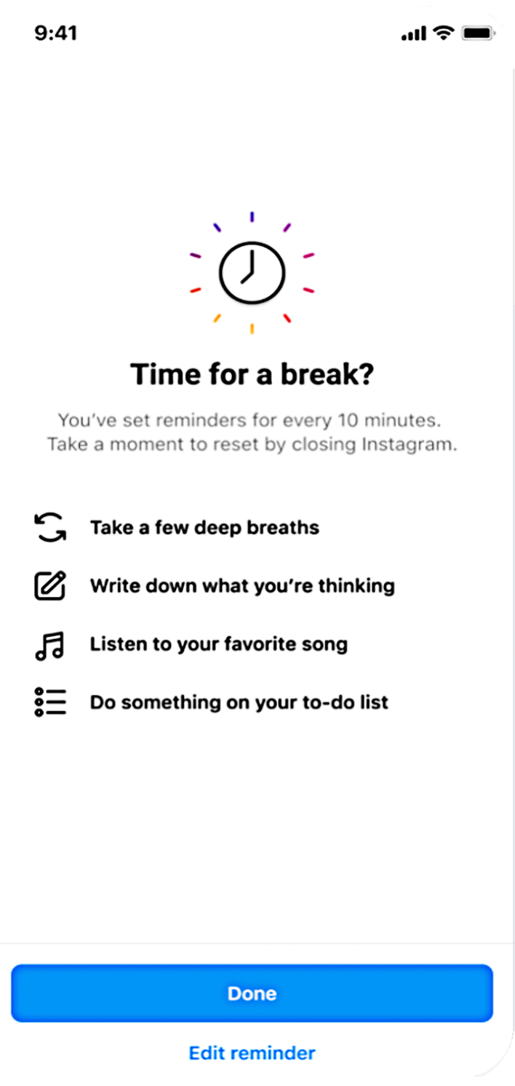
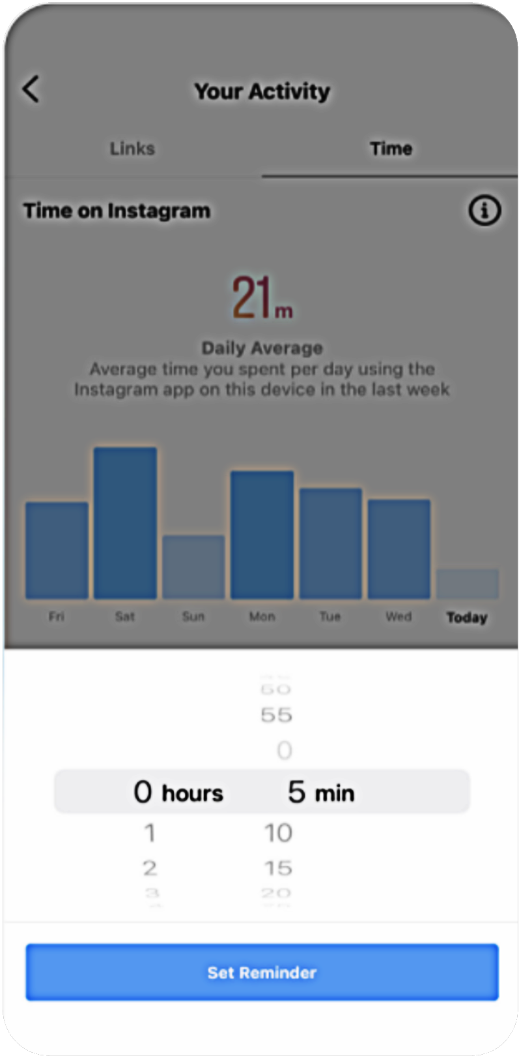
Manage time on Instagram and encouraging them to Take a Break
LESSON 1
Tools for managing time on Instagram
See your activity
Set a reminder
Mute push notifications
Take a Break

Slide 12
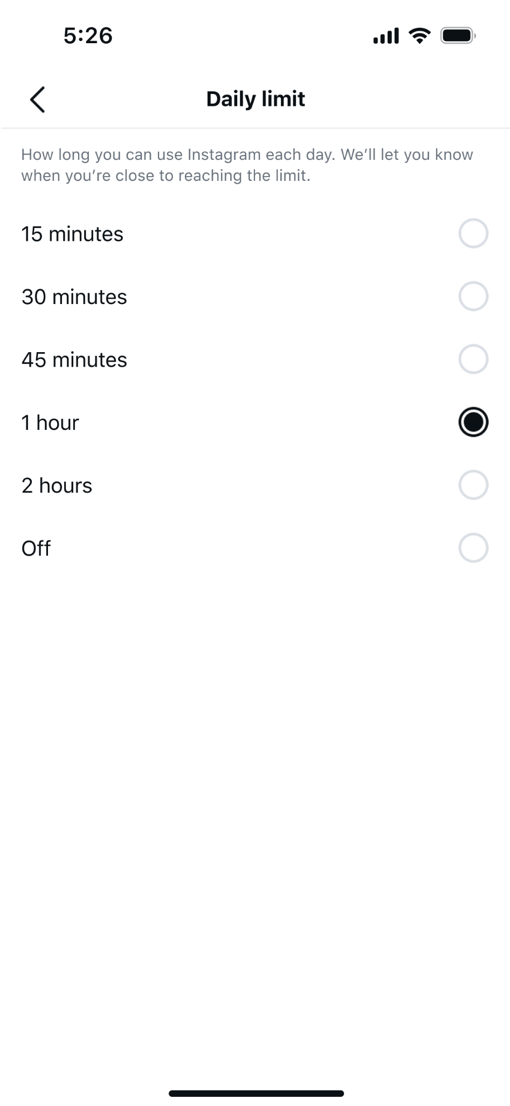
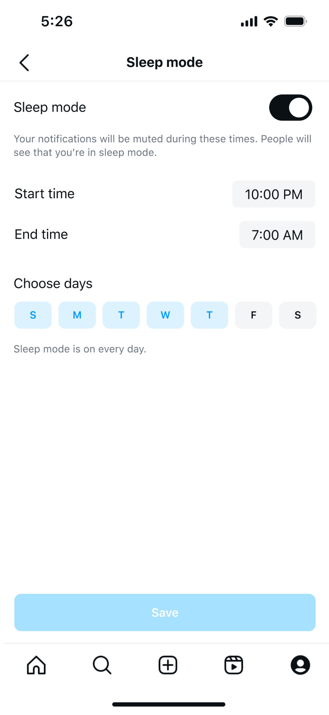
Time Limits
Teens are defaulted:
One hour daily limit, once reached they will receive a reminder to close the app
Sleep mode (10 PM - 7 AM) where their notifications will be muted
For supervised teens, parents can make these controls blocking and not allow them to use Instagram during this time.
*image mocks may not be final

Slide 13


LESSON 2
Options for teens to control their experience on Facebook, Messenger, Instagram and WhatsApp

Slide 14
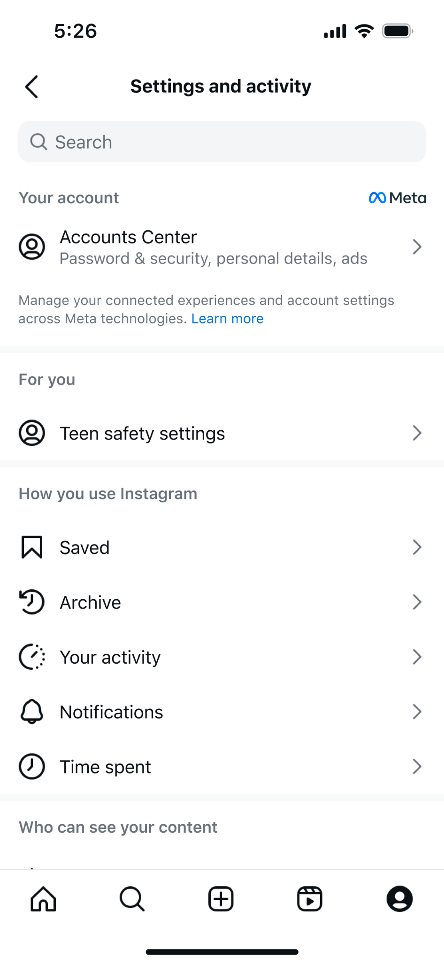

Teen Account settings
Teen Accounts are different based on the teen’s age, and if they have supervision on:
All teens (13-17) can change any setting to a more restrictive option at anytime
Early teens (13-15) require parental permission to change setting to a less restrictive option
Unsupervised late teens (16-17) can change all settings to less restrictive options without parental permission
*image mocks may not be final
Notes:
Teens can see what their settings are defaulted to in their “Teen Safety Settings”
The default settings reflect and address the top concerns of: 1. content (what you see on Instagram) 2. contact (who can interact with the teen) 3. time management (how long the teen is spending online)

Slide 15

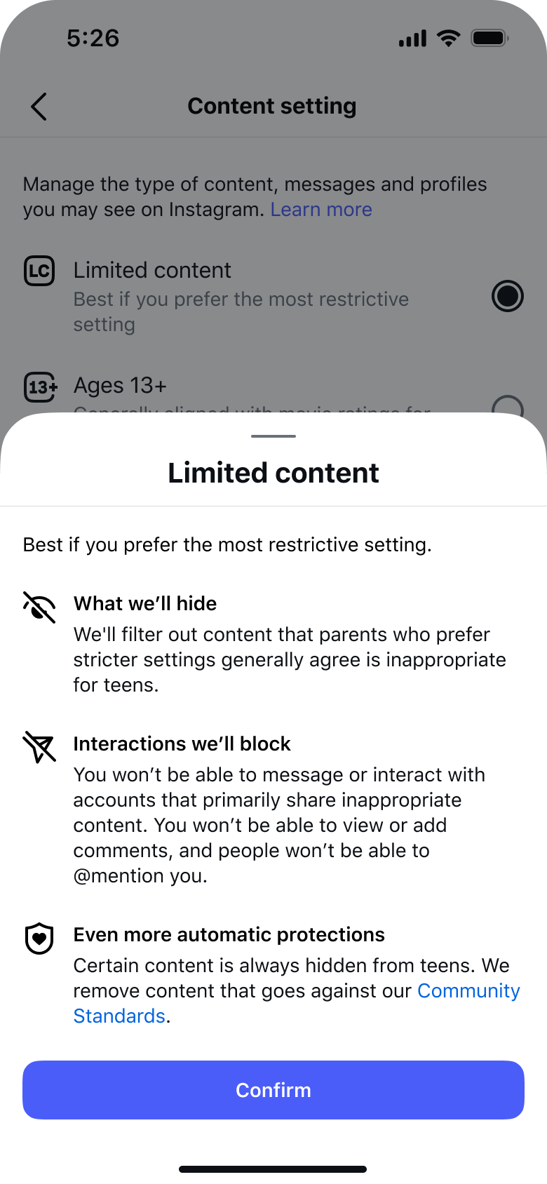
LESSON 2
Options for teens to control their experience on Facebook, Messenger, Instagram and WhatsApp
Updates to Sensitive
Content Control
2 options for teens: Ages 13+; and limited content
If your teen is under 18 years old, they will be defaulted into the 13+ option. We refined our age-appropriate guidelines to hide even more potentially inappropriate content from teens by default.
We also reviewed them against movie ratings for 13+ to help ensure that when teens are in the updated 13+ setting, it feels like the equivalent experience of watching an age-appropropriate movie.

Slide 16
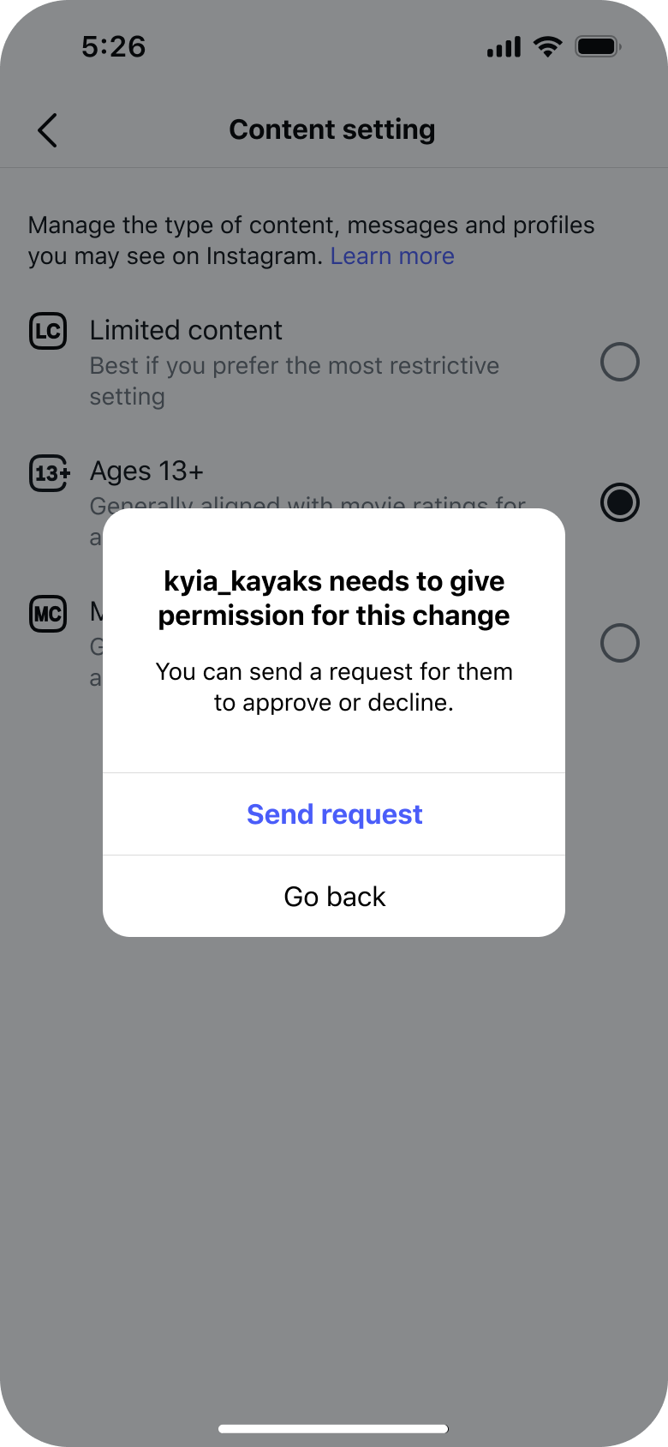
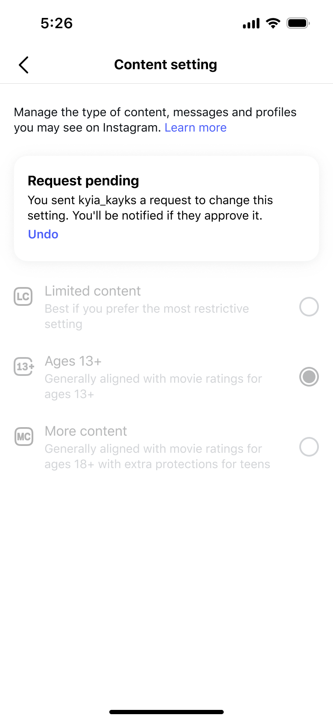
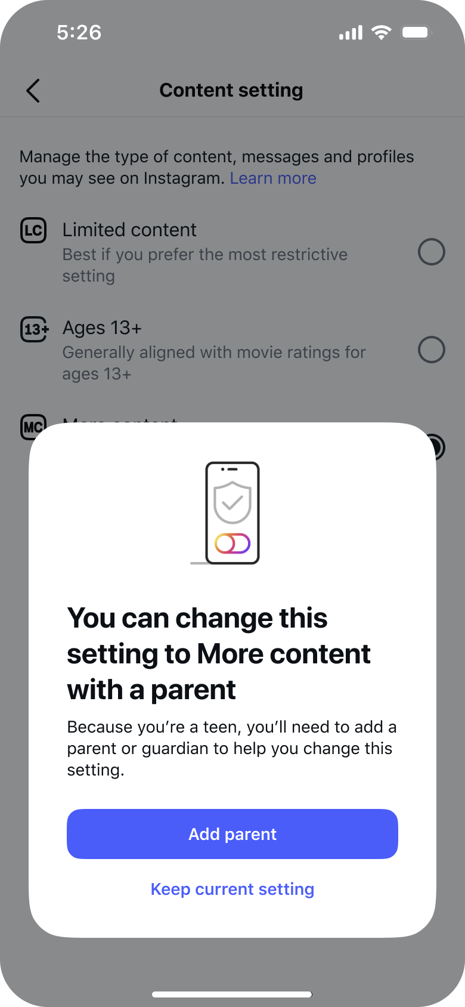
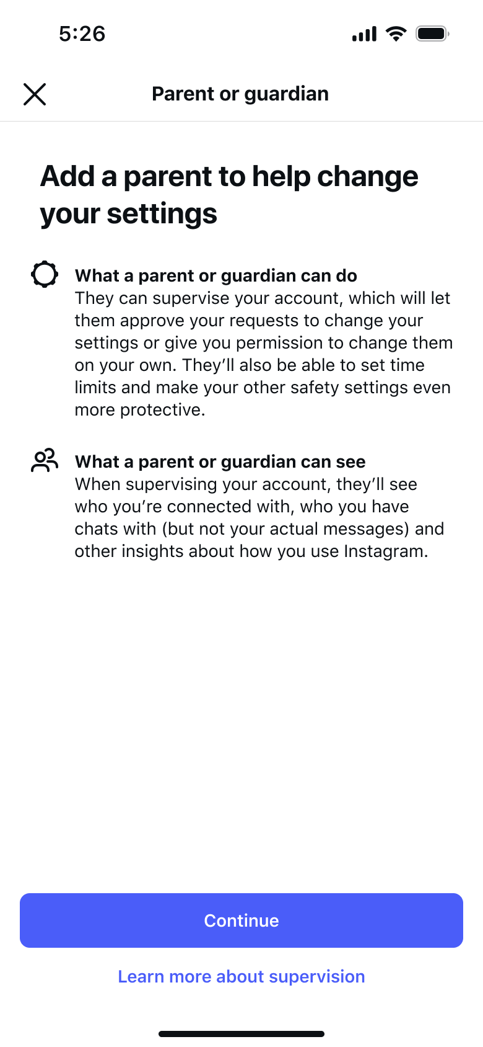
WHAT’S NEW
And an extra option for still age-appropriate but less restricted, that only parents can allow:
Supervised Teen: Send parent request
Supervised Teen: Request pending
Unsupervised Teen: Add parent prompt
Unsupervised Teen: Add parent flow
Notes:
More Content: You’ll see there’s also a More Content setting, which teens can only switch to with a parent’s permission - and that requires them to set up parental supervision on Instagram.
In the More Content setting, we’ll still hide more content from teens than we do for adults, and we will still remove content completely if it violates our Community Standards. However, teens may be see some content in their recommendations that they wouldn’t see in the 13+ and Limited Content settings, and we won’t hide entire accounts that share 18+ content. So it will be a slightly less restrictive experience - though still more restrictive than the regular adult experience.

Slide 17
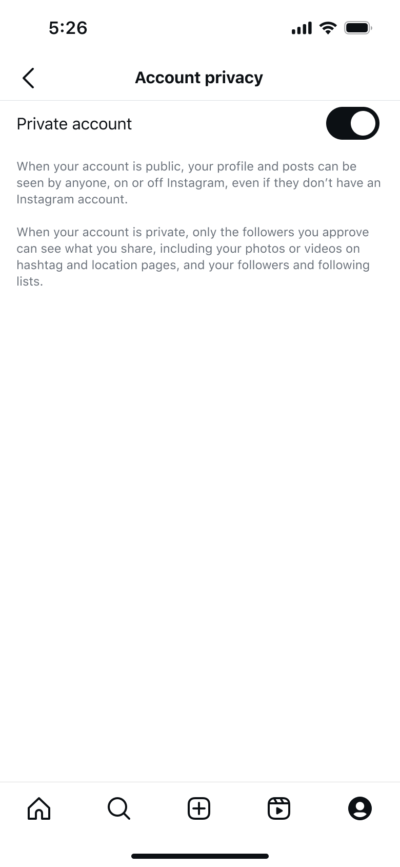
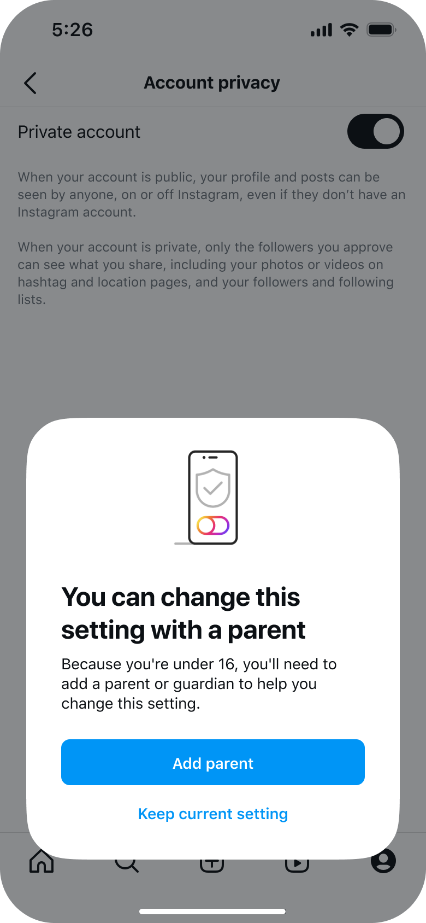
Privacy settings
With private accounts on, teens need to accept new followers, and people who don’t follow them can’t see their content or interact with them.
Early teens (13-15)
Existing and new early teens will be defaulted to private, including the ones that were previously public. Parental permission is required to change this from private to public.
Late teens (16-17)
Existing late teens (16-17) will be able to retain their account privacy settings. New late teens (16-17) will be able to choose their account privacy during IG onboarding, where “private” will be the default
*image mocks may not be final
Notes:
Let’s dive into what exactly teens are defaulted into… Private account defaults - private accounts let people control who sees or response to their content. A private account is a good way for teens to start their social media journey so they can “dip their toes in” so to speak. With private accounts on, teens need to accept new followers, and people who don’t follow them can’t see their content or interact with them.
Early teens (13-15) :Existing and new early teens will be defaulted to private, including the ones that were previously public. Parental permission is required to change this from private to public.
Late teens (16-17): Existing late teens (16-17) will be able to retain their account privacy settings and won’t be switched to private if they were previously public. New late teens (16-17) will be able to choose their account privacy during IG onboarding, where “private” will be the pre-selected option. They can update this at any time from settings

Slide 18
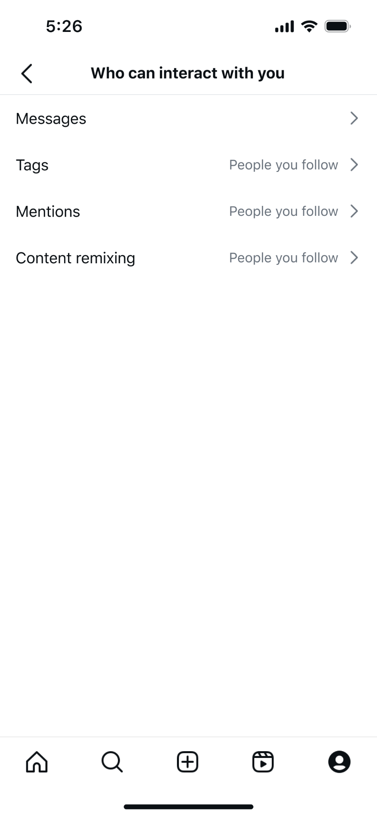
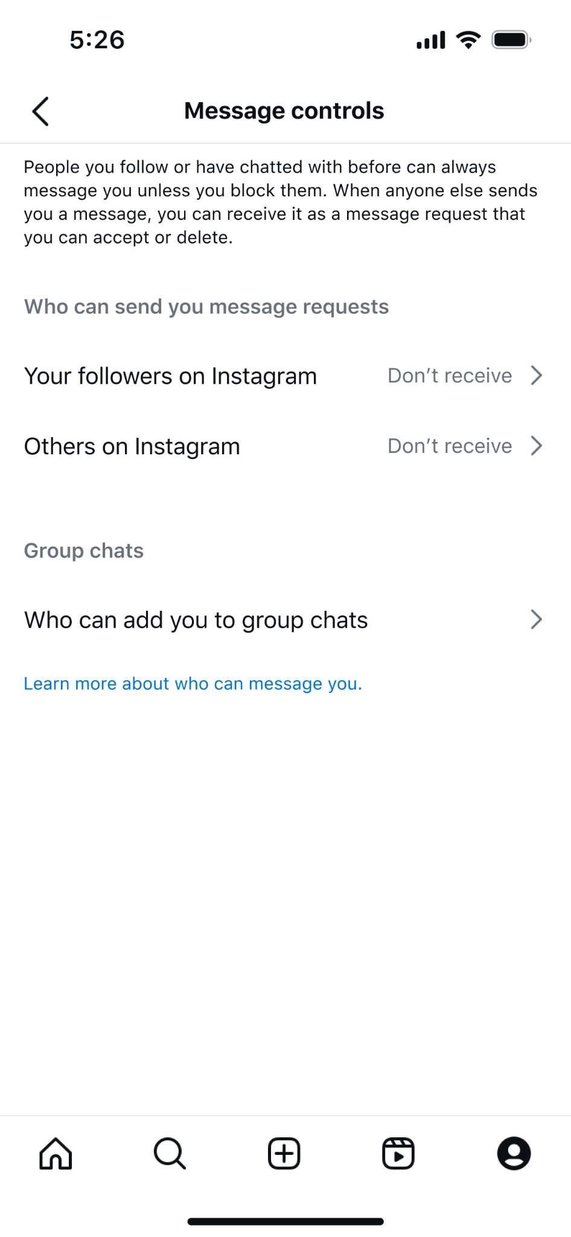
Messaging restrictions
Teens will not be able to receive new message requests from teens or adults they do not follow and are not connected with.
Teens will also only be able to be tagged, mention, content creation (e.g. Reels Remixes) by people they follow.
Teens 13-15 require parental permission to change these setting to a less restrictive option
Teens 16-17 (unsupervised) can change these settings to less restrictive options. Supervised teens require parental approval.
*image mocks may not be final
Notes:
Who can contact their teen when using social media is a top concern that we hear over and over from parents and guardians:
Users in a Teen Account will not be able to receive new message requests from teens or adults they do not follow or have not previously messaged directly. This will be on top of other protections for how others can interact with them (tags, mentions, remix).
With Teen Accounts, we are enhancing safety features related to DMs by ensuring teens can only be messaged by people they follow or have messaged with before. We think it’s important to preserve teen connections to their friends, family and online communities in a safe, age-appropriate manner.
We’ve developed technology that allows us to find accounts that have shown potentially suspicious behavior and stop those accounts from interacting with young people’s accounts. By “potentially suspicious behavior”, we mean accounts belonging to adults that may have recently been blocked or reported by a young person for example.
We prevent potentially suspicious adults from finding, following or interacting with teens, even when they may be connected with them in “real life” and we encourage teens who may already be in conversation with these adults to block and report them.
We don’t show teen’s accounts in Instagram Explore, Reels or ‘Accounts Suggested For You’ to these adults.

Slide 19



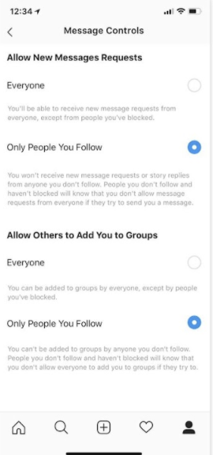
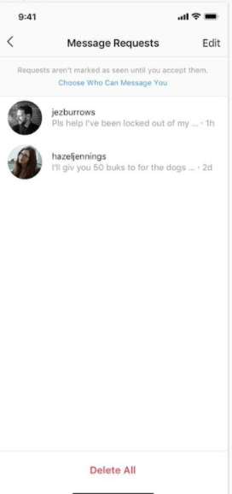
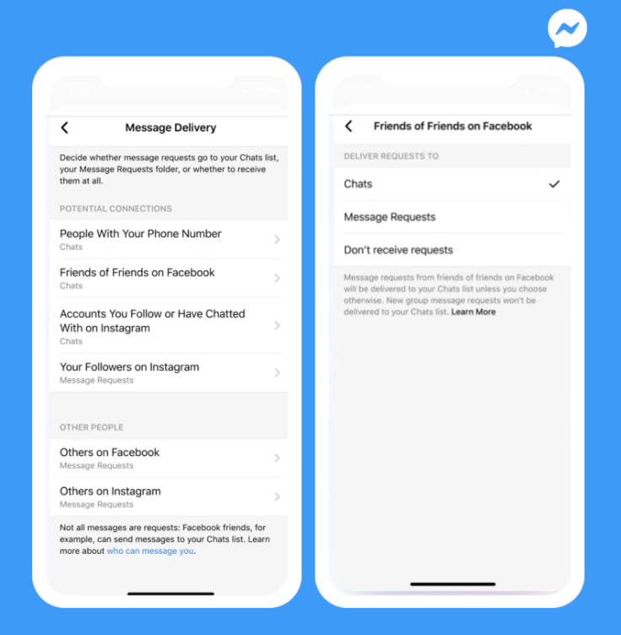
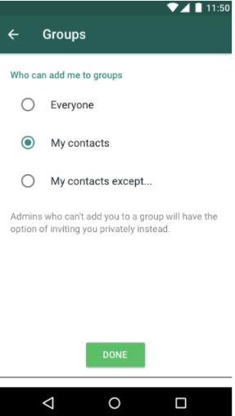
Control who can send your teen private messages across Meta technologies
LESSON 2
Options for teens to control their experience on Facebook, Messenger, Instagram and WhatsApp

Slide 20


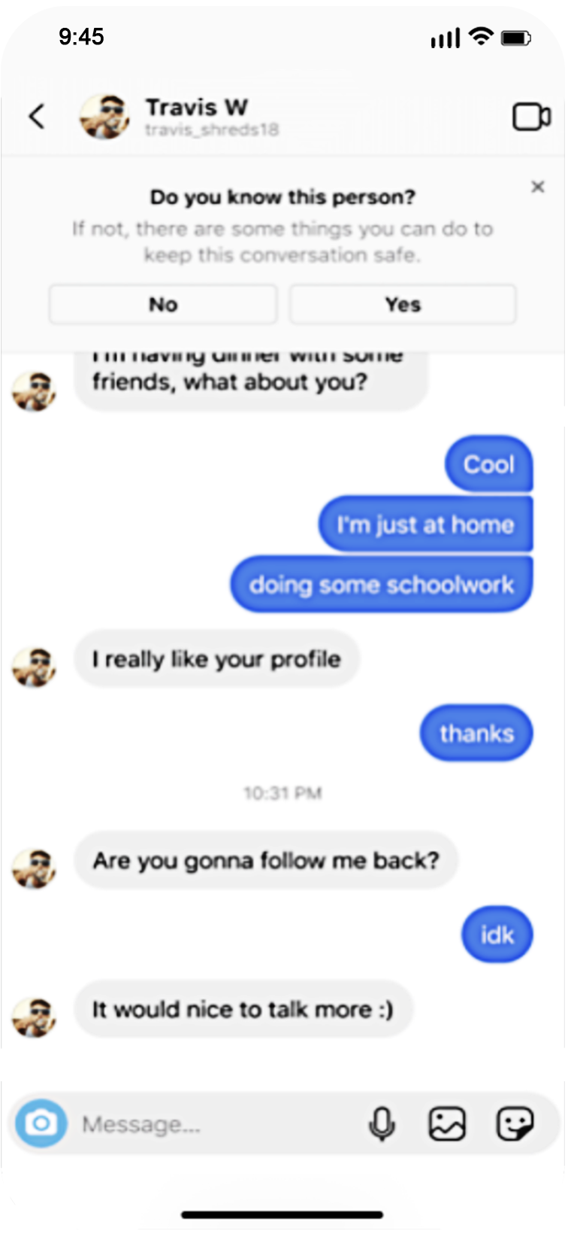
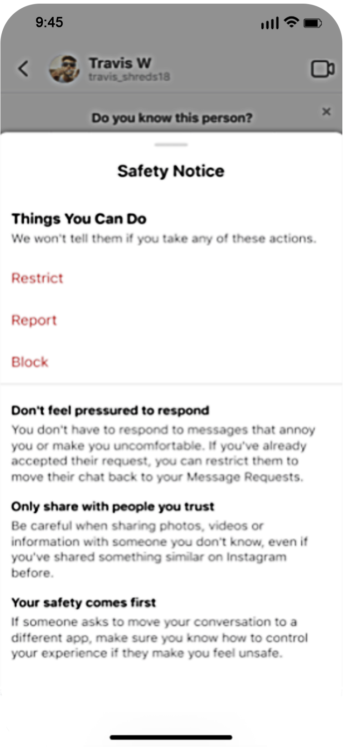
We block suspicious adults from sending direct messages (DMs) to teens if they don’t follow them
Prompting teens to be more cautious about interactions in DMs
LESSON 2
Options for teens to control their experience on Facebook, Messenger, Instagram and WhatsApp

Slide 21
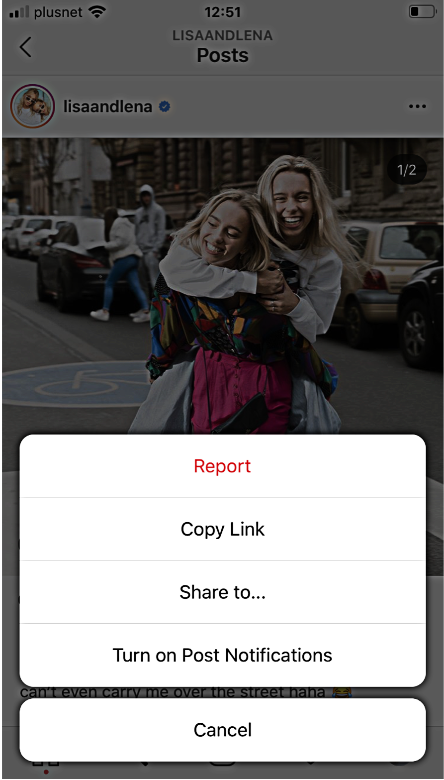
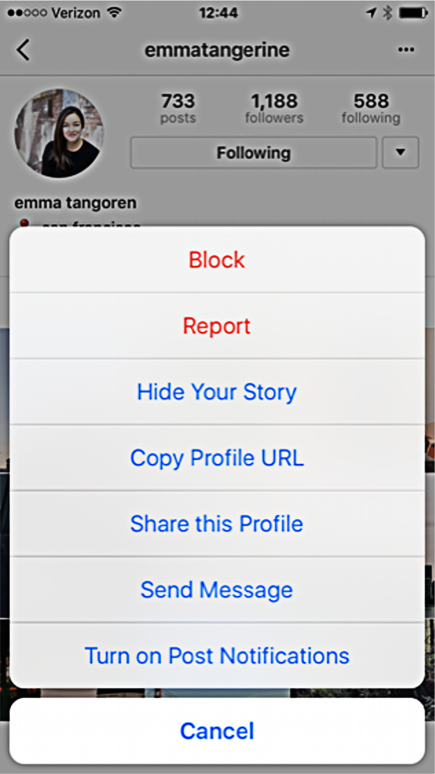
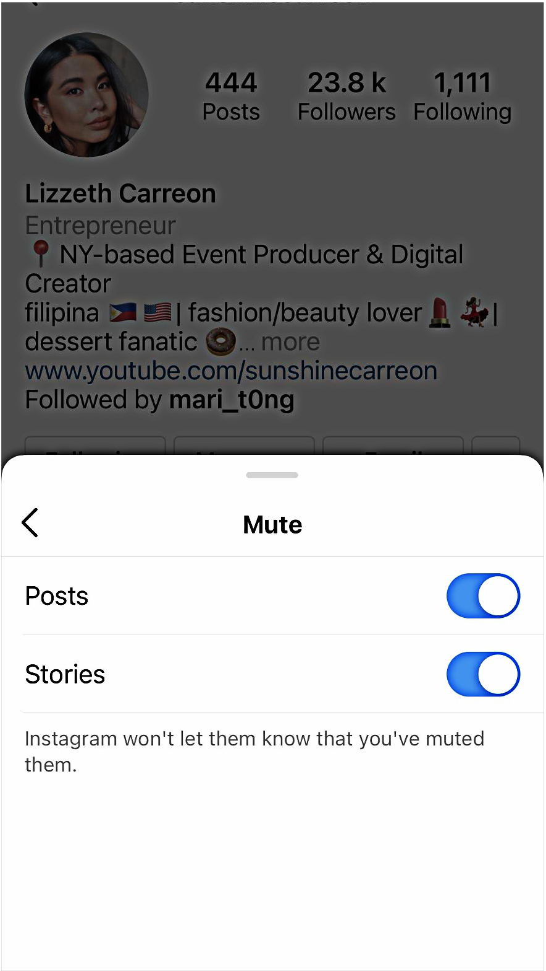
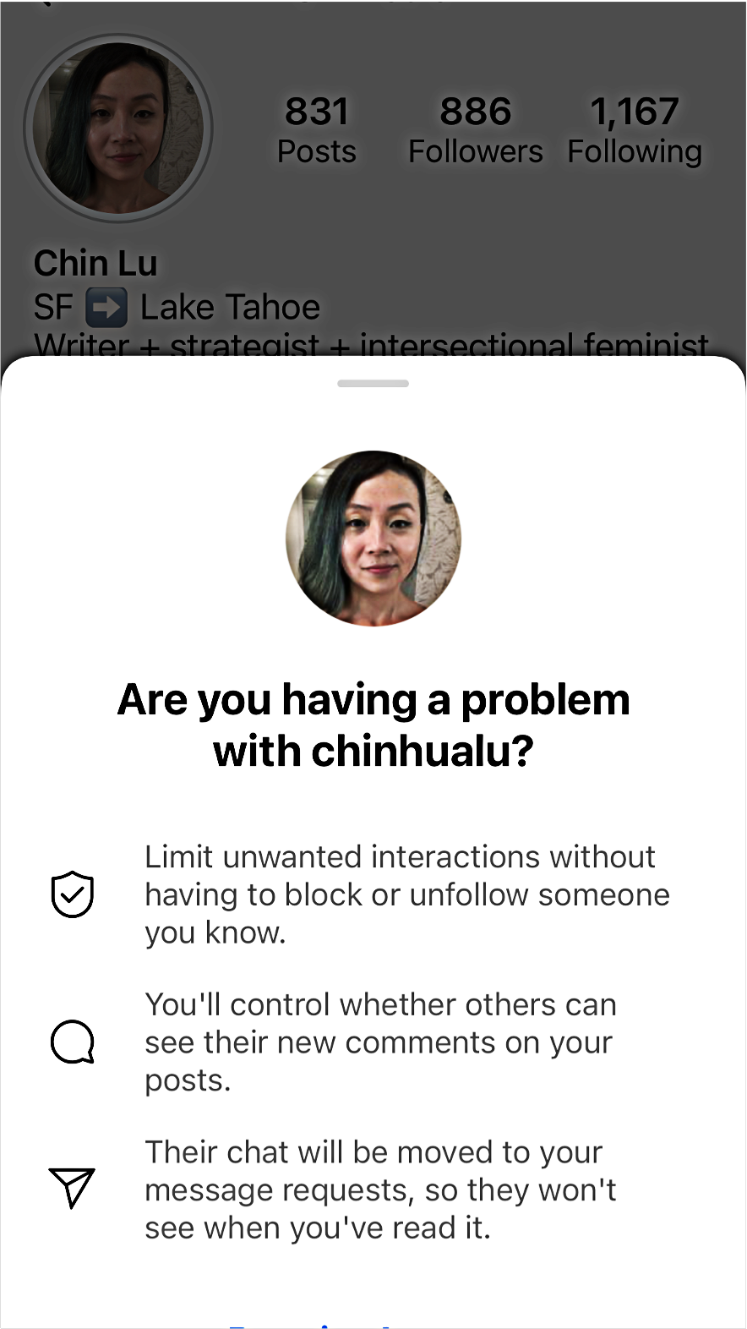
Control your teen’s experience on Instagram
LESSON 2
Options for teens to control their experience on Facebook, Messenger, Instagram and WhatsApp
Report
Block
Mute
Restrict

Slide 22
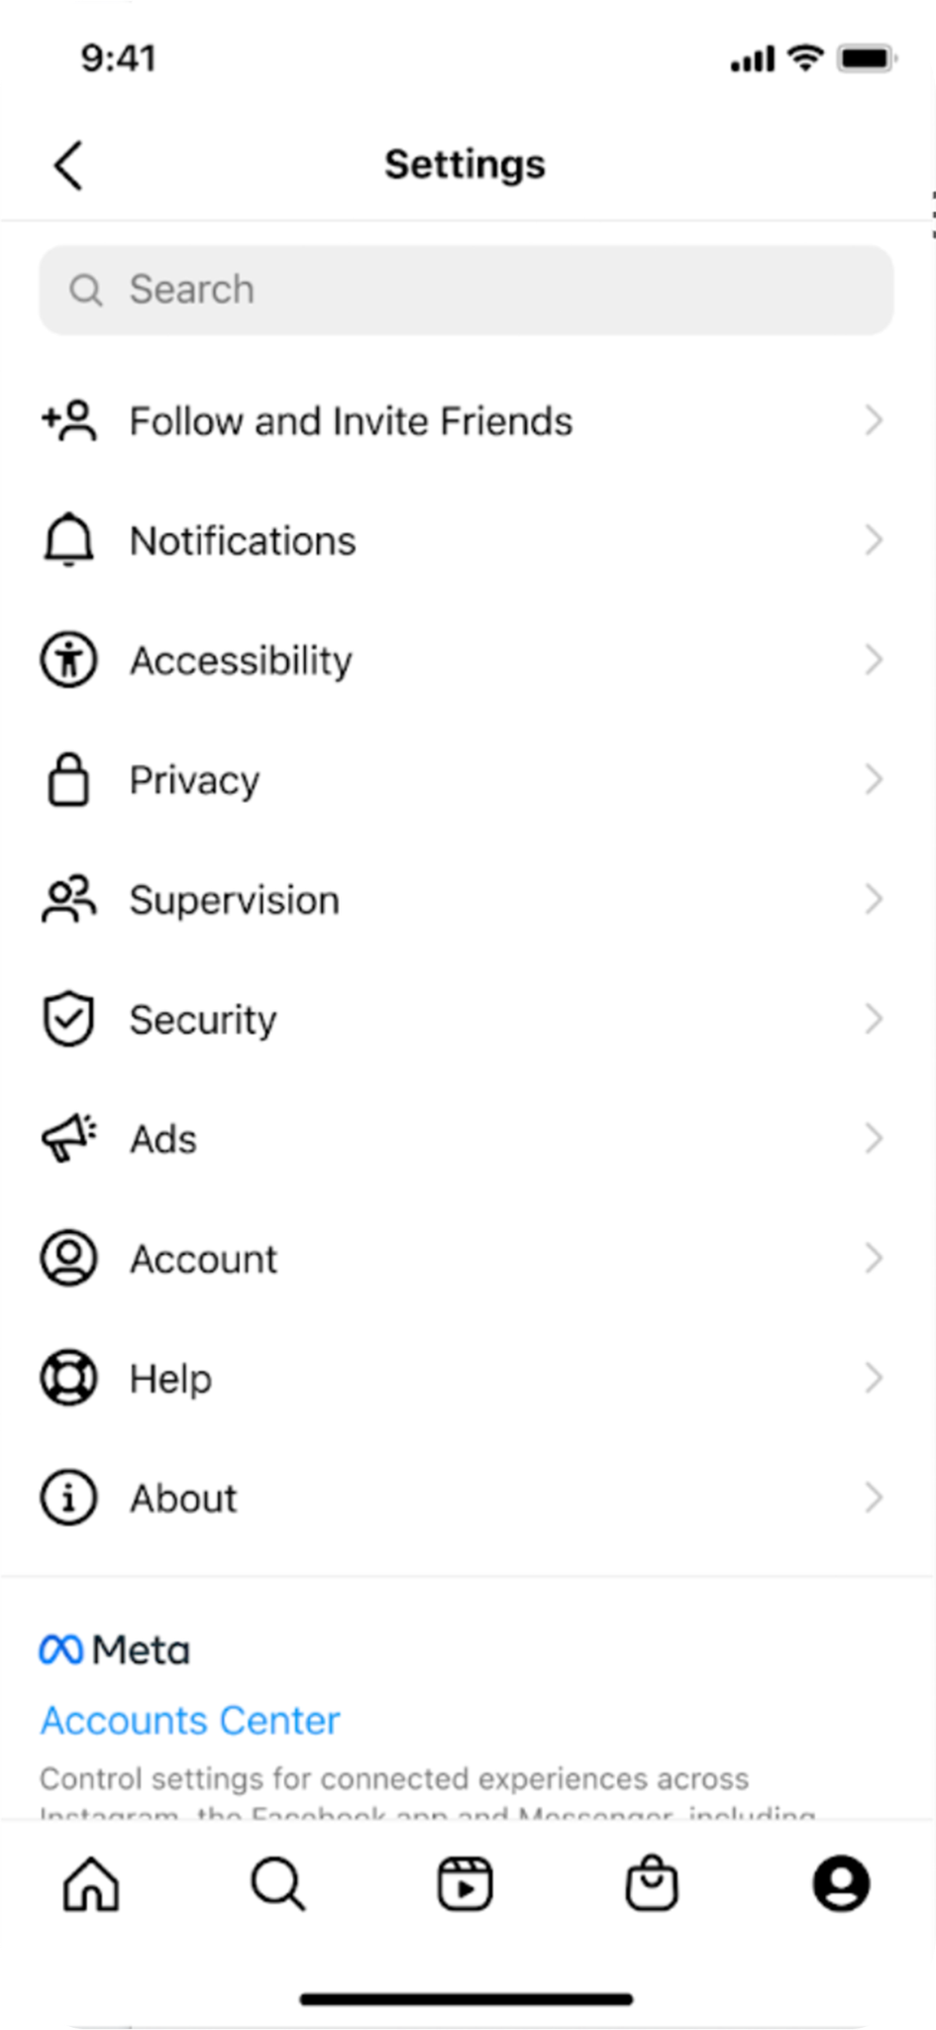
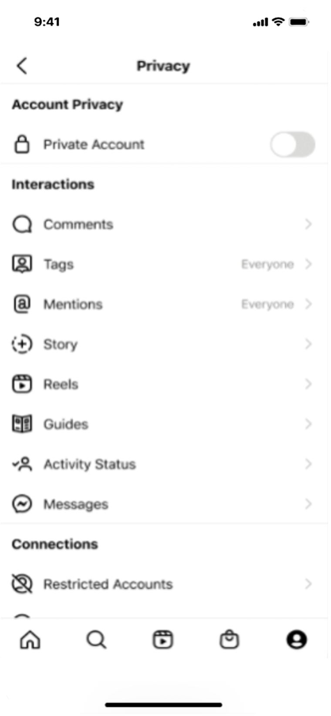
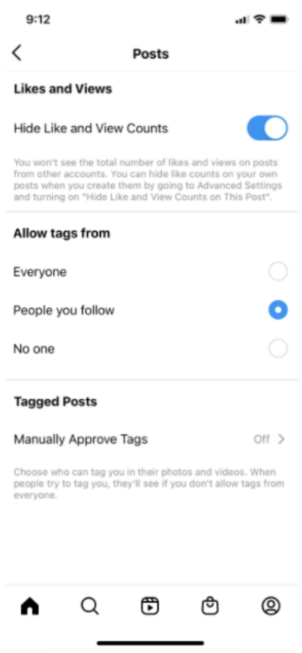
LESSON 2
Options for teens to control their experience on Facebook, Messenger, Instagram and WhatsApp
Tags and mentions
Switching off the ability for people to tag
or mention teens if they don’t follow them

Slide 23
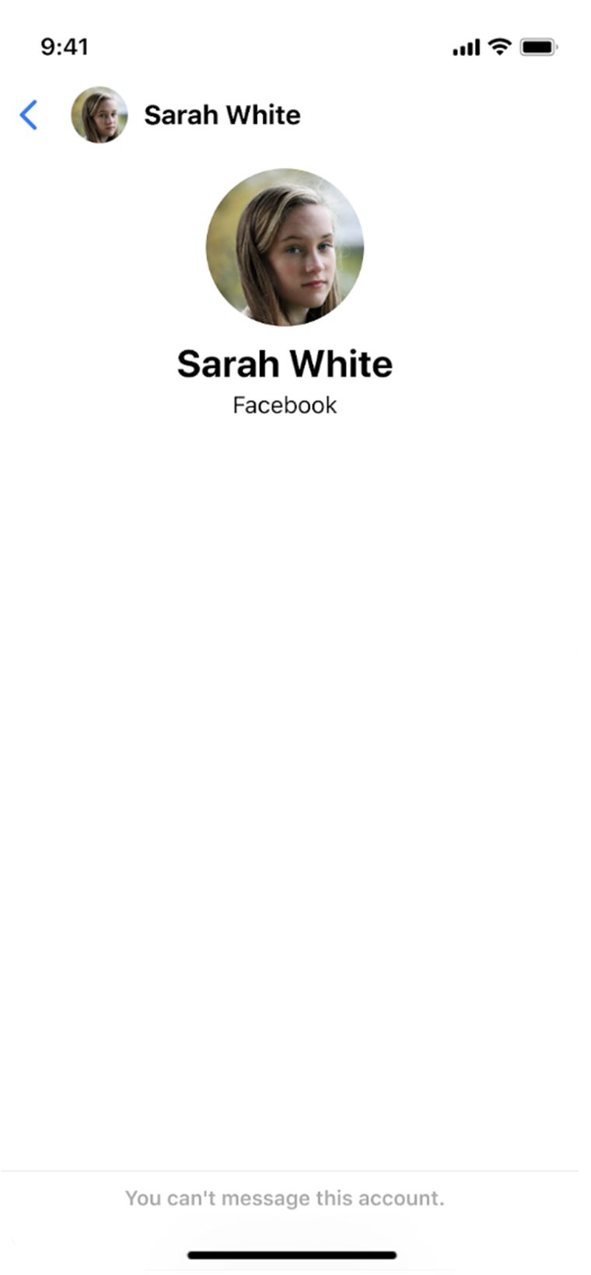
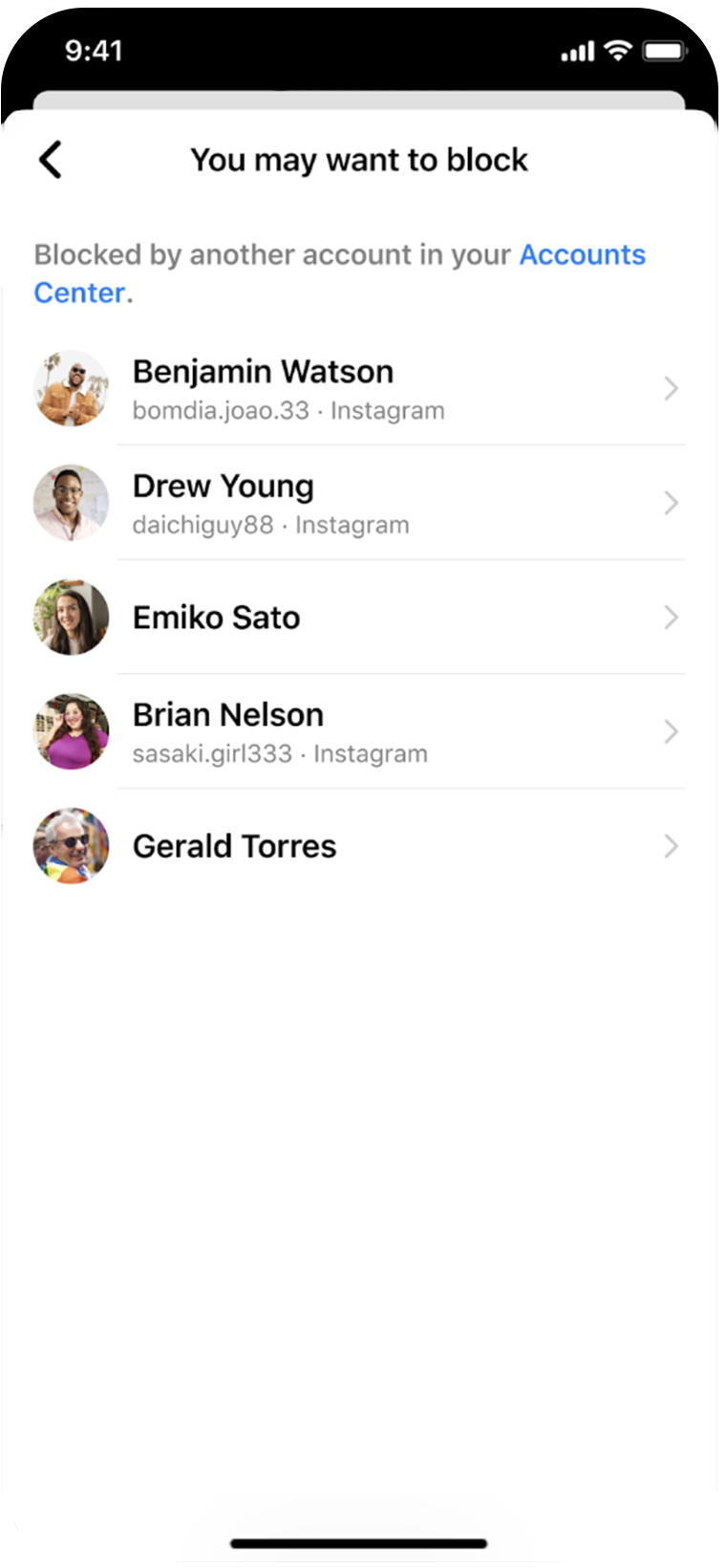
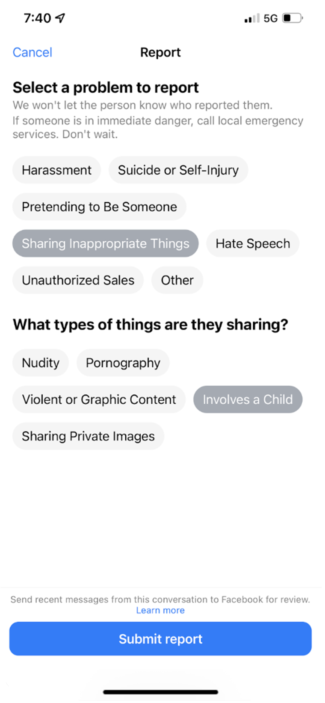
Limiting unknown adult to minor connections
Tools to block and report
Acting on user reports and messaging behaviour
LESSON 2
Options for teens to control their experience on Facebook, Messenger, Instagram and WhatsApp

Slide 24
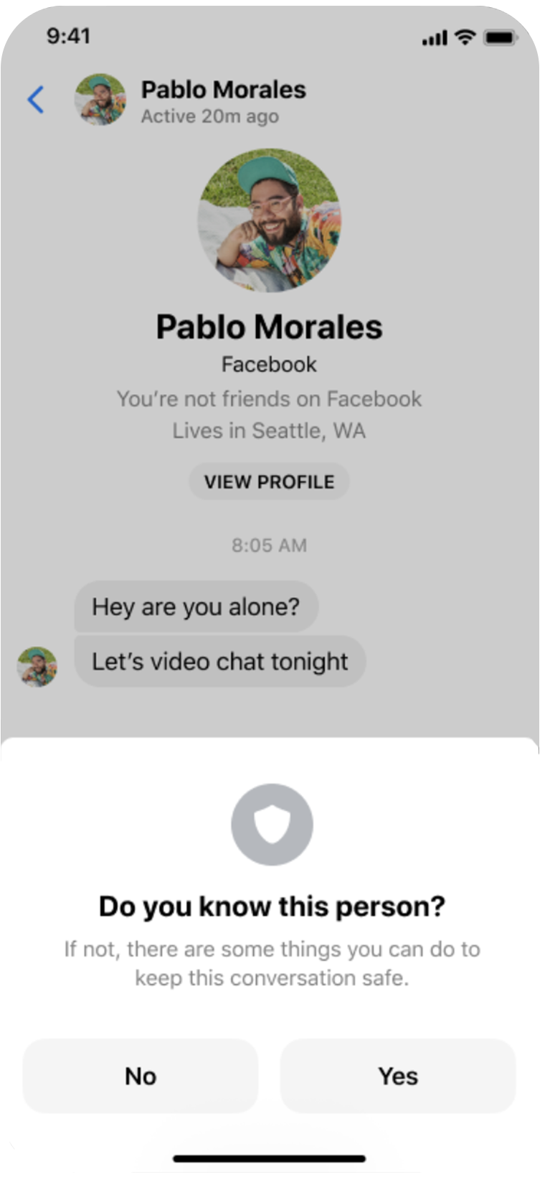
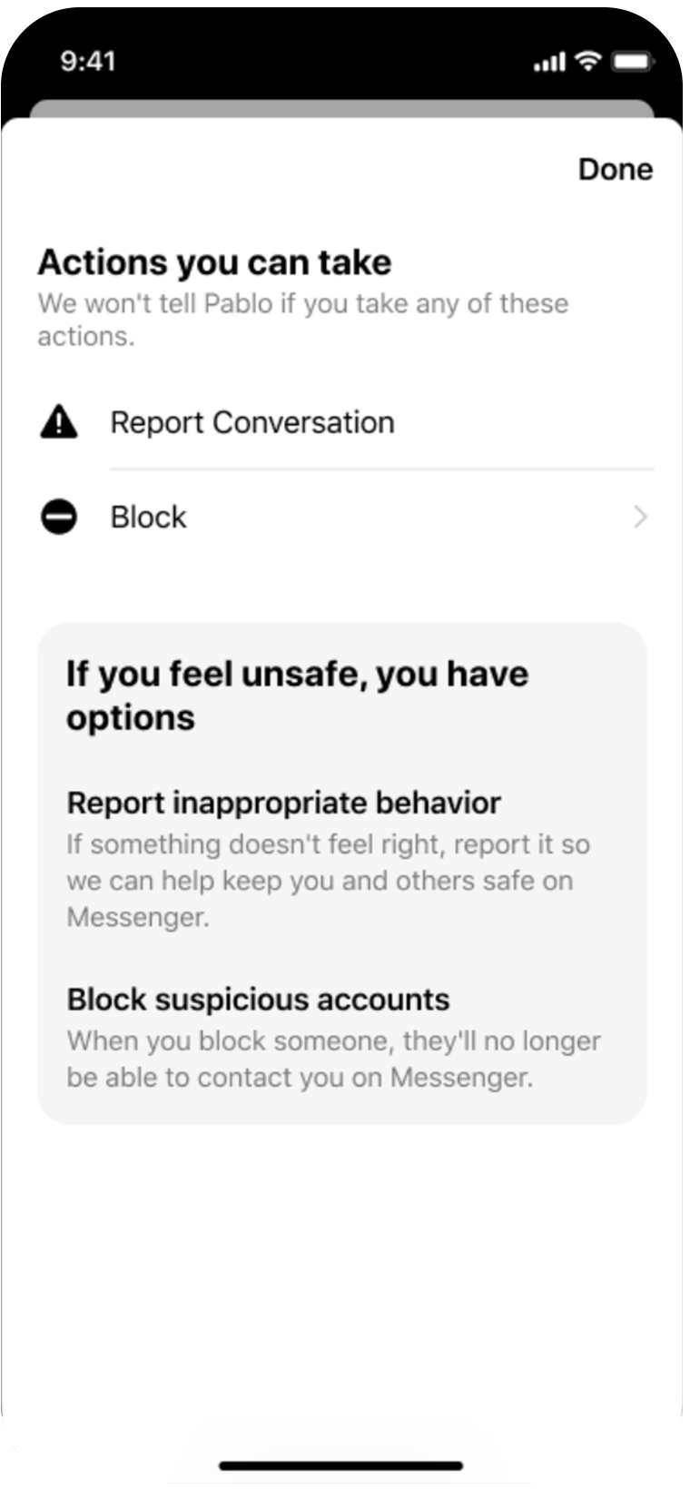
LESSON 2
Options for teens to control their experience on Facebook, Messenger, Instagram and WhatsApp
Reduce harm through in-app education
Safety Notices alert teens of suspicious activity and prompt them to block, report, ignore or restrict when something doesn’t seem right.

Slide 25
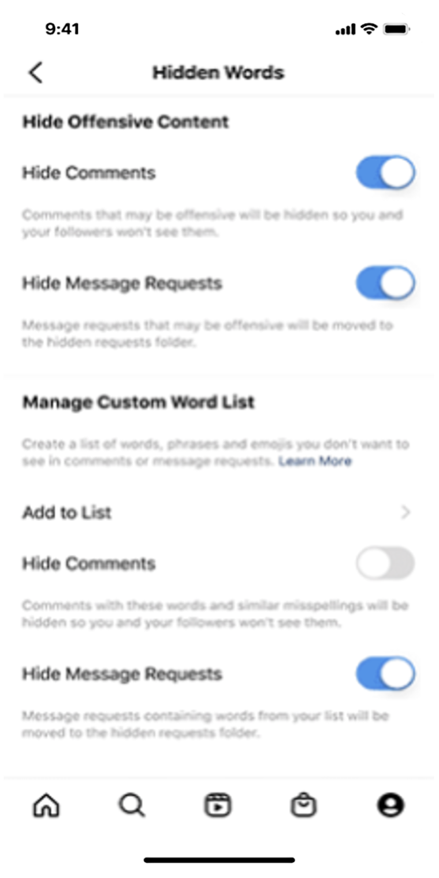
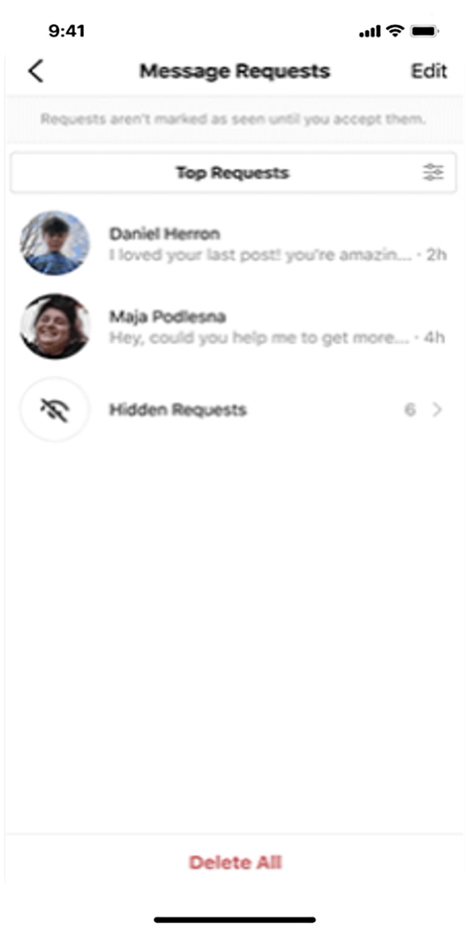
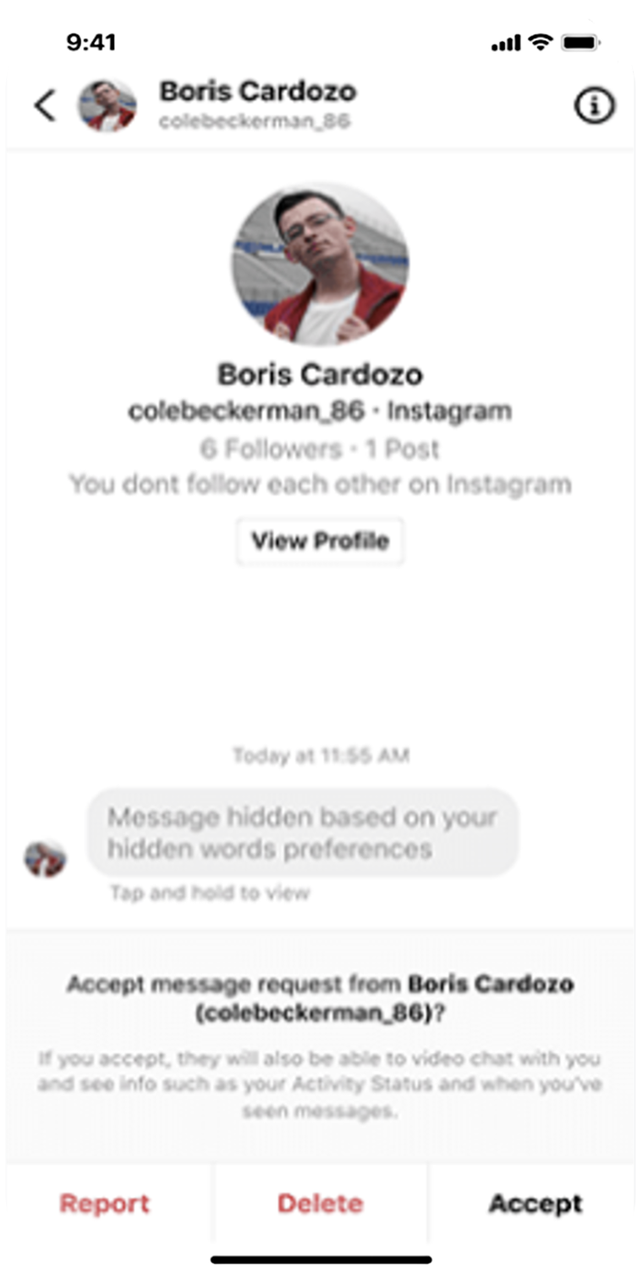
LESSON 2
Options for teens to control their experience on Facebook, Messenger, Instagram and WhatsApp
Hidden Words
Protecting teens from seeing offensive DMs and comments

Slide 26


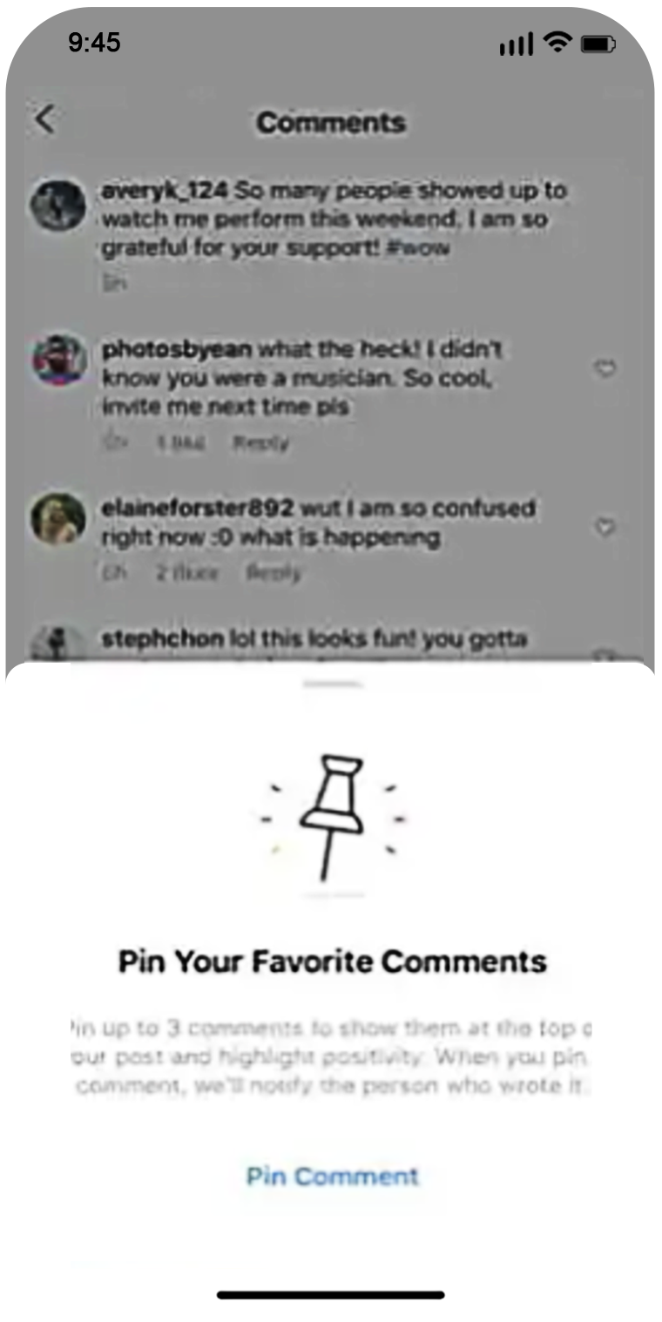

LESSON 2
Options for teens to control their experience on Facebook, Messenger, Instagram and WhatsApp
Encouraging
positive interactions
Pinned comments

Slide 27
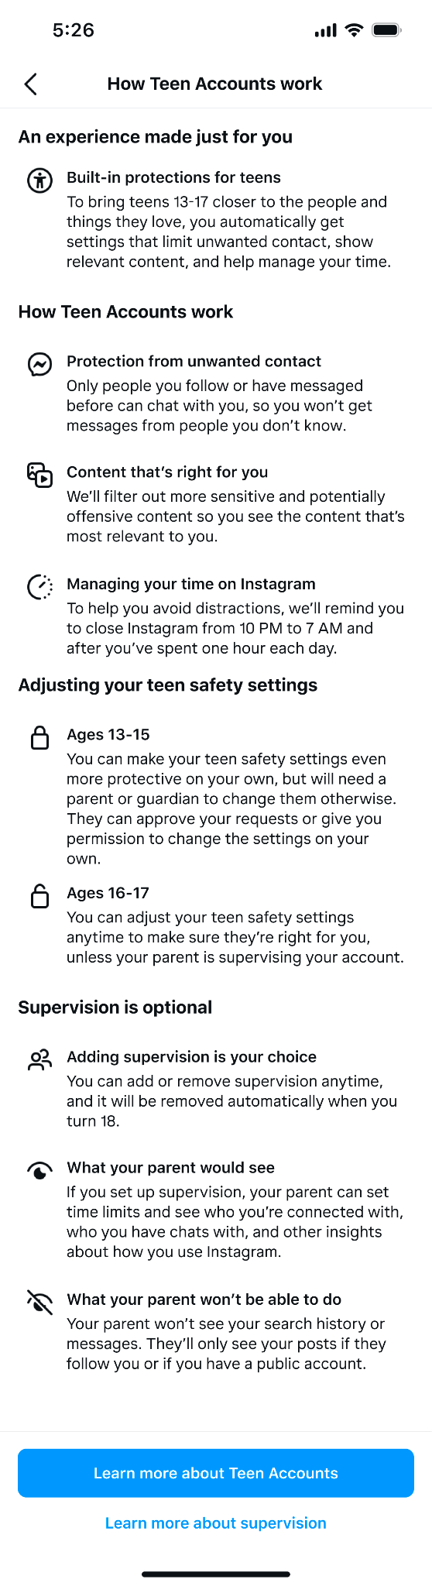
Teen Accounts education
Teens can access information from within their teen safety settings page to learn how Teen Accounts work and the role of supervision in the experience
*image mocks may not be final
Notes:
Making sure teens know exactly what Teen Accounts do it important so they know why protections are in place for them and what the mean - teens can refer to an educational guide in their teen safety settings page.

Slide 28
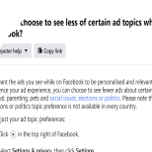
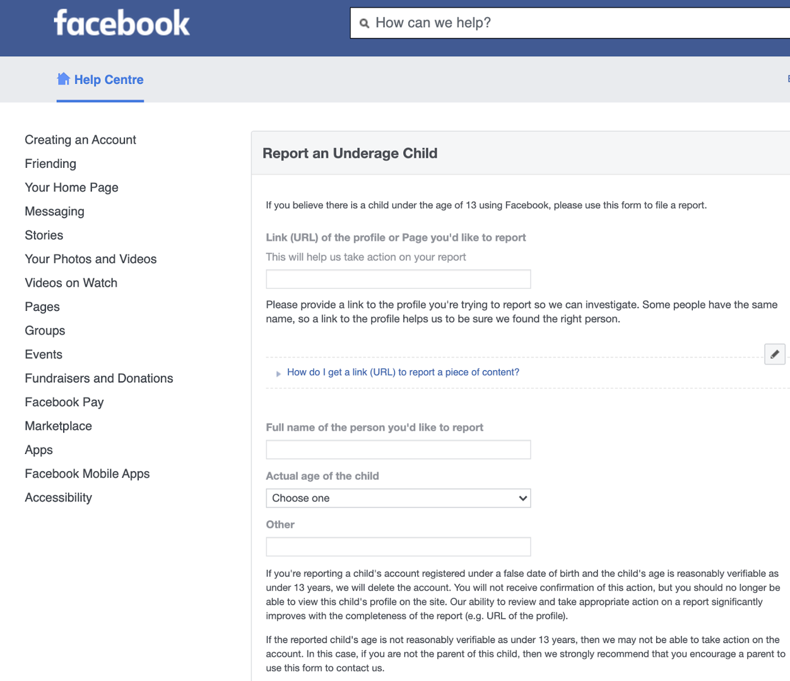
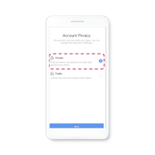
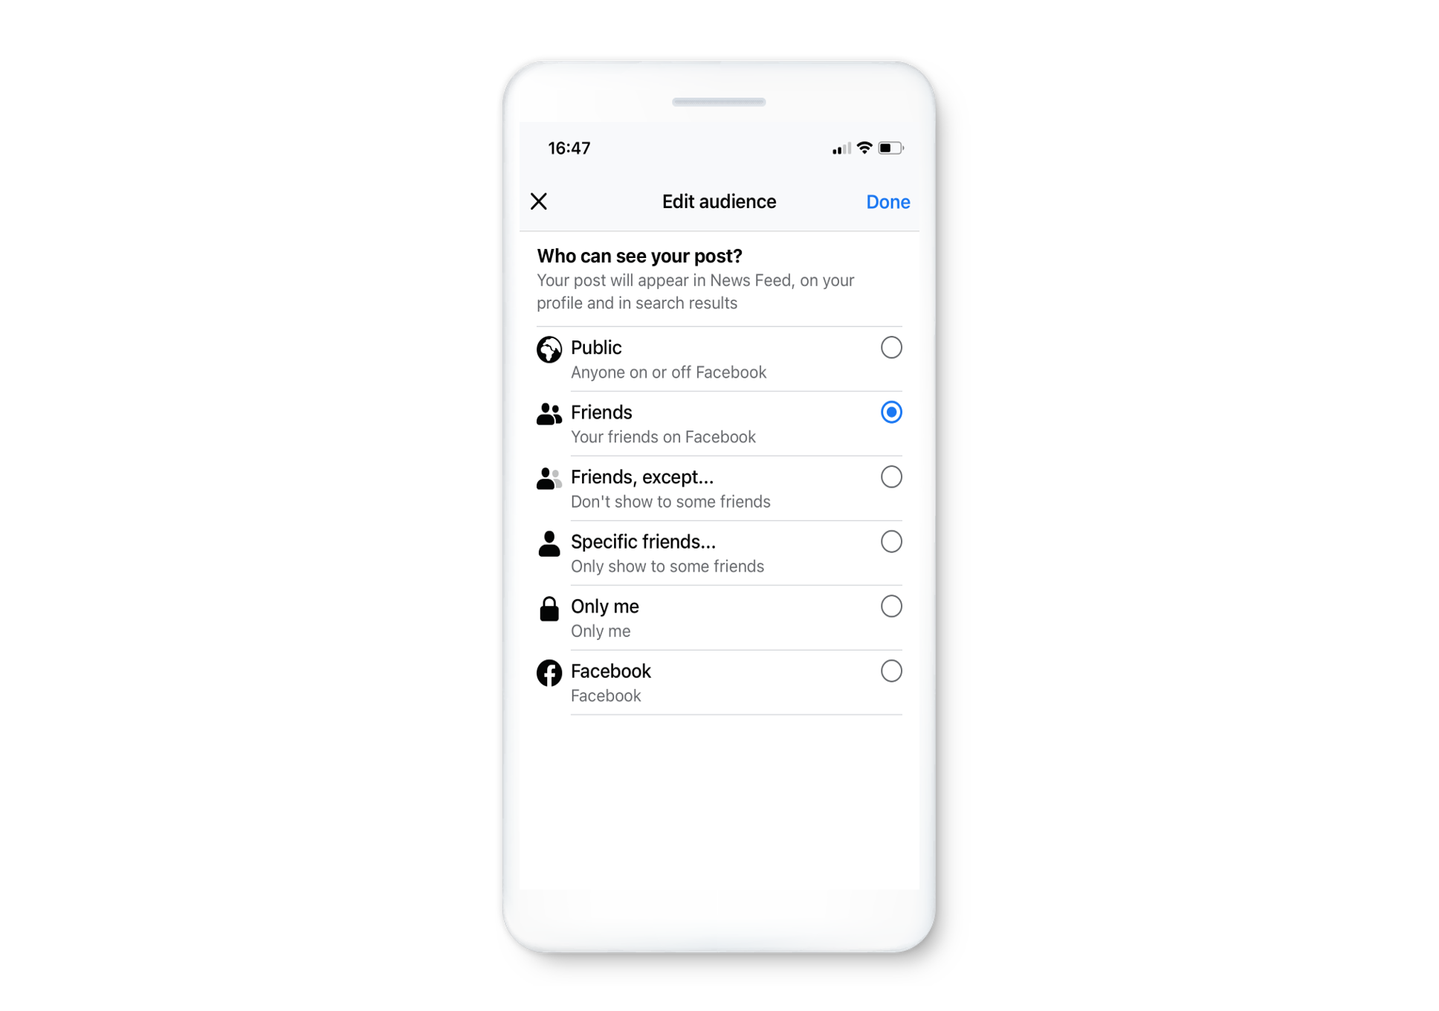



















LESSON 2
Options for teens to control their experience on Facebook, Messenger, Instagram and WhatsApp
Services, ads restrictions and controls
No access to Dating
No access to Marketplace
Prohibited ads for under 18
No interest-based targeting
Opt in for 3P data for ads
Hide, report, see less of certain ads
Age assurance
Reporting underage users (available to all)
Safeguards and default settings
Automatic default to private account for teens
Audience selector: general and ad hoc
Commenting audience
No geolocation activated by default
Opt in for SCD in profile (N/A in Instagram)
Limit interactions with unknown adults on Instagram
Instagram Hidden Words
Instagram parental supervision
Take a Break, daily limits
Transparency and education for teens and their guardians
Safety Centre
Privacy checkpoints
Parents portal
Instagram
Parents Guide
My Digital World
Youth portal and
peer voices
Data policy
Community Standards
Privacy Centre
Privacy setting
Privacy basics
Privacy checkup
TTC Labs
visual explainer
Let Me
Explain series
Family Centre and
Education Hub

Slide 29
Parental supervision
LESSON 3

Slide 30


Teen or parent initiates parental connection
When a teen tries to establish a connection with their parent’s account, they’ll have to look for their name on Instagram first. Only mutual followers will show up in search results.
Parents can also initiate the parental connection from their own accounts or Family center.
CONFIDENTIAL

Slide 31


Parent receives request to supervise
The parent/guardian will be notified that their teen sent them a request for supervision.
In this flow, we’ll explain how Instagram already protects their teen by default through Teen Account, and what they’ll be able to do once they supervise their teen.
This is also the transition point from Instagram to Family Center.
CONFIDENTIAL

Slide 32


Parental connection: Supervision set-up
Parents are transitioned to Family Center to complete the supervision set up flow.
If they ignore their teen’s request to connect, or choose to not supervise, the teen will remain in the standard Teen Account default state for their age band.
CONFIDENTIAL

Slide 33


Connection established. Supervision dashboard for parents
Once supervision is set up, parents can see their supervised teen’s settings and insights, such as time spent, followers and following, and blocked accounts in the Supervision dashboard.
The dashboard lives in Family Center and is accessible to the parent via IG settings.
The teen can also access the dashboard from their Teen safety settings page.
CONFIDENTIAL

Slide 34


Parents can grant their teen the ability to modify safety settings on their own
Parents can choose to still supervise their teen but give them permission to edit safety settings on their own. They will also be able to revoke this permission at any time.
CONFIDENTIAL

Slide 35


LESSON 3
Parental Supervision
Supervision today
Parent experience
Can manage multiple teens
Teen experience
Can only have one supervisor
Read-only view

Slide 36






LESSON 3
Parental Supervision
In detail
Visibility into followers and following, account settings and blocked accounts
Time management
(limits and scheduled breaks)
Reporting
(optional)

Slide 37




LESSON 3
Parental Supervision
4 settings parents can see

Slide 38



LESSON 3
Parental Supervision
Parental supervision tools on Instagram are now globally available

Slide 39

LESSON 4
Age Assurance

Slide 40


Age assurance
We know some teens may try to get around the new setting by lying about their age, We’re taking a number of steps, including using age verification technology, to help ensure teens on Instagram are placed in Teen Accounts. For example:
Require teens to prove their age through a video selfie or ID check if they attempt to change their birthday from U18 to over 18.
Limit teens from using a new, adult account
Exploring using technology to detect when someone may be misrepresenting their age
*image mocks may not be final
Notes:
Of course in order to create age appropriate experiences for teens, we need to know that a teen is a teen. This is a challenging and complicated problem, as teens may lie about their age.
Here’s how we think about age and our layered approach:
Go through age collection, Machine Learning, Age VErification - via Yoti, etc.
Our approach to age is one that we’re focused on how to get right - but it’s a work in progress.
We’re exploring expanding our age prediction technology to detect when someone may be misrepresenting their age, specifically whether someone is a teen under 18 or not. If we feel confident that someone is likely a teen we’ll place them in protective, age-appropriate settings. If we make a mistake, people can verify their age to reinstate the correct settings.
In addition to preventing age misrepresentation, we’re also taking steps to minimize people from setting up supervision relationships improperly.
Parental supervision on Instagram is opt-in, and requires both a teen and a parent or guardian to consent to the experience.
In addition to requiring consent, we take a number of steps to confirm that someone is eligible to supervise a teen’s account. If we determine a parent or guardian is not eligible, they are blocked from the supervision experience.
These steps include confirming a teen isn’t trying to supervise themselves, making sure an account that is being supervised cannot supervise another account, and limiting the number of accounts that a parent or guardian can supervise.
Additionally age information:
Since 2022, we’ve required teens to prove their age through a video selfie or ID check if they attempt to change their birthday from under the age of 18 to over 18. In addition, if a teen attempts to update their birthday from a younger age to an older age, we require them to prove their age with an ID check.
We’ll limit teens from attempting to create a new, adult account in a number of ways.This includes, for example, using information about a teen’s original account to prevent them from creating and using an account with an adult age (unless they prove their age with an ID check) or preventing teens from linking their accounts to accounts with adult ages.
We’re not sharing information about all of the measures we’re putting in place, because we don’t want to give teens an instruction manual on how to get around our efforts.

Slide 41


LESSON 4
Age assurance
Resources for you and your family
Education Hub

Slide 42


LESSON 4
Age assurance
Resources for parents
fb.com/safety/parents
about.instagram.com/community/parents

Slide 43


LESSON 4
Age assurance
Resources for parents
Help Centre
Safety Centre
fb.com/help
fb.com/help/instagram
fb.com/safety

Slide 44



LESSON 4
Age Assurance
Meta Privacy Centre

Slide 45

Sextortion Hub
Notes:
Educational resources for parents which includes resources, such as the Instagram Parent’s Guide and the Facebook Safety Center, alongside resources from experts and trusted organizations
We partnered with experts like ParentZone, Media Smarts, National Association for Media Literacy Education and Cyberbullying Research Center on topics related to digital wellness, safety and privacy, relationships and communication and media literacy. We’re also making these resources more accessible globally and will continue to add content as we continue expanding our parental supervision tools.
We also launched the VR Parent Education Hub that helps parents discuss safe VR use with their teens. The Hub includes a Parent's Guide to Meta Virtual Reality Parental Supervision Tools from ConnectSafely that provides context about the new VR parental supervision tools and helps parents support their teens with tips for how to conduct themselves in VR now and as they mature.

Slide 46


APPENDIX
VR resources for you and your family

Slide 47

APPENDIX
VR resources for you and your family
Resources for you and your family
VR Parent Education Hub

Slide 48
APPENDIX
VR resources for you and your family
Parental supervision in VR
Age-inappropriate content
Financial
Time spent and well-being
Safety in social VR
Existing protections
IARC ratings in
Quest Store
Content guidelines for Quest Store
PIN-protected purchases
Quest Safety Centre
Guardian and Space Sense
Reporting tools
Default privacy settings
Quest Chats and VR MSGR protections
View list of apps
View, block, approve purchases, downloads and usage of apps
Block ability for teen to connect to PC, Air Link, Developer Mode
Receive notifications of purchases
View time spent in VR
View friends list
Enable and disable social features
Meta account defaults for teens
New!
Parental supervision

Slide 49


APPENDIX
VR resources for you and your family
Protected app access

Slide 50

APPENDIX
VR resources for you and your family
Default blocking of download or purchase of International Age Rating Coalition (IARC) age-inappropriate apps in the Quest Store

Slide 51



APPENDIX
VR resources for you and your family
Parental supervision

Slide 52





APPENDIX
VR resources for you and your family
Parental dashboard

Slide 53

APPENDIX
VR resources for you and your family
Purchasing notifications and permissions

Slide 54

APPENDIX
VR resources for you and your family
Teen dashboard
(read-only view)

Slide 55






APPENDIX
VR resources for you and your family
Ads restrictions and controls for teens
Prohibited ads for under 18s
Only age, gender, location-based targeting
No interest-based targeting
Hide, report, see less of certain ads

